Slide 1






Woodville Consultants Ltd
Corporate Overview
The content of this promotion has not been approved by an authorized person within the meaning of the Financial Services and Markets Act 2000. Reliance on this promotion for the purpose of engaging in any investment activity may expose an individual to a significant risk of losing all of their property or other assets invested.

Slide 2
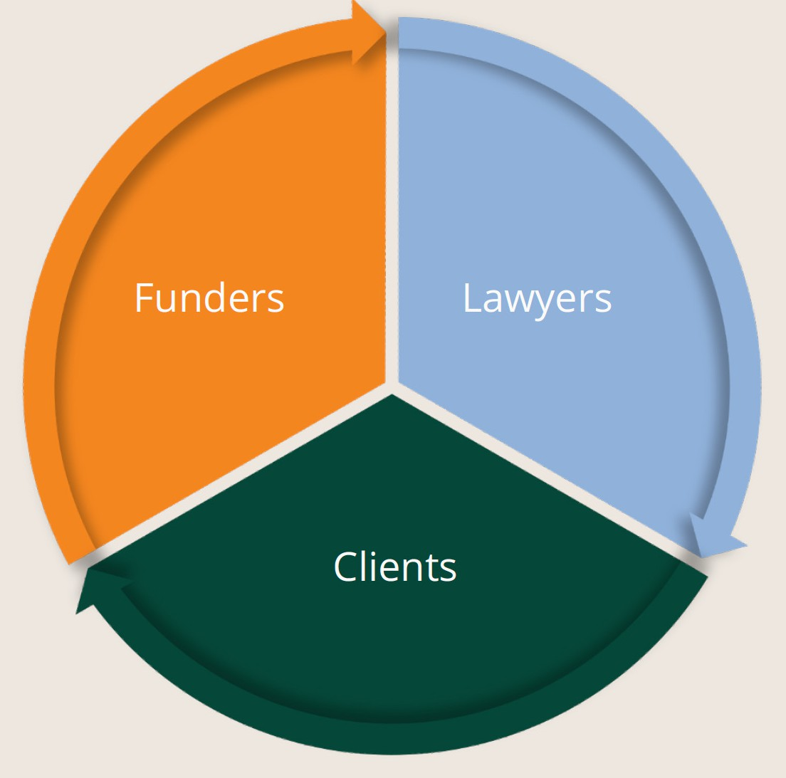

What is Litigation Funding?
Litigation funding is a mechanism whereby a qualifying investor funds all the costs of a piece of litigation, in return for a share of the proceeds.
If the claim fails, the funder loses the money, and the litigant doesn’t need to pay them back.
UK law firms require immediate capital in order to stay ahead of the competition and to quickly pursue the high volume of cases that arise each week.
The litigation funding company typically covers all of the costs of the case, in return for a share of the proceeds. When the law firm wins the case, the litigation funding company also receives back the funding they provided.
For the last decade, investors have also participated in funding cases. Investors money is used to cover the costs of litigation cases, and in return they receive a fixed rate of return or a share of the case proceeds. In most cases, third- party funding will only be available for claims that have a very high probability that the claim will be successful. The funding is also usually provided with the protection of an insurance policy. This is to mitigate the risk of the litigation funder.
Sales/distribution information: KNG International Advisors [Mex Office: +52 (998) 500-1627 | UK Office: +44 207 1832480] [info@kngadvisors.co.uk | www.kngadvisors.co.uk

Slide 3
Litigation Funding Market Size
The UK litigation funding market has quadrupled in size since 2013
Estimated size of the UK litigation market
Global total invested in litigation funding in 2023
$2.7B
$17B
Litigation finance is now a multibillion-dollar global industry, drawing in private equity funds and big institutional investors on the promise of double-digit returns.
The UK litigation funding market has quadrupled in size since 2013.
Swiss Re research found there was around $17 billion invested in litigation finance globally in 2020, with more than half of that deployed in the US.
In the UK, $2.7 billion was on the balance sheet of the country's top 15 funding firms last year, almost double the figure three years earlier, according to data from law firm RPC.
Growth of the litigation funding market since 2013
Capital available to UK litigation finance
4X
£1.9B
Sales/distribution information: KNG International Advisors [Mex Office: +52 (998) 500-1627 | UK Office: +44 207 1832480] [info@kngadvisors.co.uk | www.kngadvisors.co.uk

Slide 4
Woodville’s Model
Woodville primarily operate in cases of personal injury, housing disrepair and mis-selling claims. No win-no-repayment means only cases with a good prospect of success tend to get funding.
Video explainer: https://vimeo.com/1002645181/9eb311d39c
Diversification
Fully Insured
If a client invests with Woodville, the loan is much more diversified as it is spread across numerous loans. Rather than aiming to win 60% of cases funded like a typical litigation fund, their model is to win many more cases.
To further protect Woodville, the loan is secured on an ATE (After The Event) insurance policy. If a claim is lost or discontinued, the loan is repaid to Woodville from the insurance policy proceeds.
Track Record
Robust cash low
Over 245,427 cases have been funded since inception, with zero defaults.
Woodville charge the borrowing law firms interest on a simple,
not compound, basis at a cost of 5% per month.
Lower risk, fixed term loans
Loans made by Woodville to law firms are low value
(£1,000 - £5,000 depending on the claim type) and short term (6-12 months).
Sales/distribution information: KNG International Advisors [Mex Office: +52 (998) 500-1627 | UK Office: +44 207 1832480] [info@kngadvisors.co.uk | www.kngadvisors.co.uk

Slide 5
Track Record
The company began raising capital in 2019. Since then, over 245,427 claims have been funded, with zero defaults.
As of March 28th 2025:
£290,000,000+
£114,000,000+
4420+
Has been raised
Has been returned to investors
Investors in the company
11
8
3
0
Series of Bonds with ISIN have been repaid in full and on time (value of £23m+).
Series of Bonds with ISIN remain live, with all due coupon payments up to date
years' of accounts filed demonstrating healthy trading profits
Defaults on payments to Investors on Loan Notes or Bonds.
Sales/distribution information: KNG International Advisors [Mex Office: +52 (998) 500-1627 | UK Office: +44 207 1832480] [info@kngadvisors.co.uk | www.kngadvisors.co.uk

Slide 6
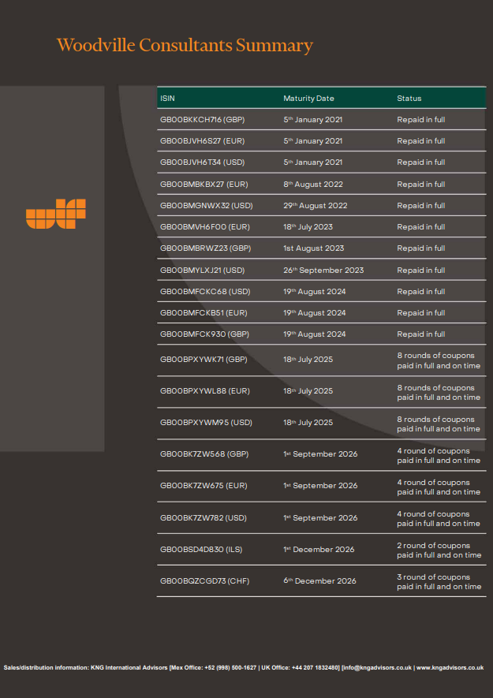

Slide 7
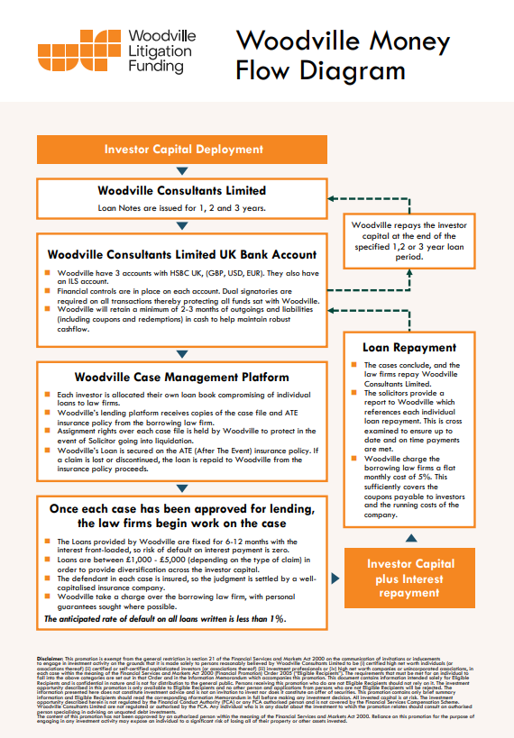

Slide 8
How do Woodville protect investor capital?
The anticipated default rate is less than 1% on all cases funded The Investor security points are summarised below:
• Woodville’s Interest is front-loaded, so risk of default on the interest is zero
• Targeting smaller value cases of £1,000 - £5,000 carries much less risk, and provides extra diversification across the Investor Capital
• Woodville’s loan is secured on an ATE (After The Event) insurance policy. If a claim is lost or discontinued, the loan is repaid to Woodville from the insurance policy proceeds.
• Assignment rights over each case is held by Woodville to
protect in the event of solicitor going into liquidation
• The defendant is insured, so the judgment is settled by a well- capitalised insurance company, giving a very high chance of successful enforcement of any judgment
• Woodville take a charge over the borrowing law firm, with
personal guarantees sought where possible
Sales/distribution information: KNG International Advisors [Mex Office: +52 (998) 500-1627 | UK Office: +44 207 1832480] [info@kngadvisors.co.uk | www.kngadvisors.co.uk

Slide 9
Loan book update 28th March 2025
Road Traffic Accident Loans
Default rate since inception Loan Capital:
Default rate since inception Loan Interest:
Total Number of Active Loans – 1,563
Total Value of Active Loans – £1,563,000
0%
0%
Housing Disrepair Loans
Total Number of Active Loans – 2,841
Total Value of Active Loans – £7,443,000
Business Energy Loans
Total Loans Written Since Inception
Average Loan duration
Total Number of Active Loans – 17,366
Total Value of Active Loans – £26,004,000
245,427
12 Months
PCP - Car Finance Loans
Total Number of Active Loans – 155,811
Total Value of Active Loans – £ 149,317,052
Number of defaults
0
Irresponsible Lender Claims
Total Number of Active Loans – 5,261
Total Value of Active Loans – £3,682,700
Sales/distribution information: KNG International Advisors [Mex Office: +52 (998) 500-1627 | UK Office: +44 207 1832480] [info@kngadvisors.co.uk | www.kngadvisors.co.uk

Slide 10
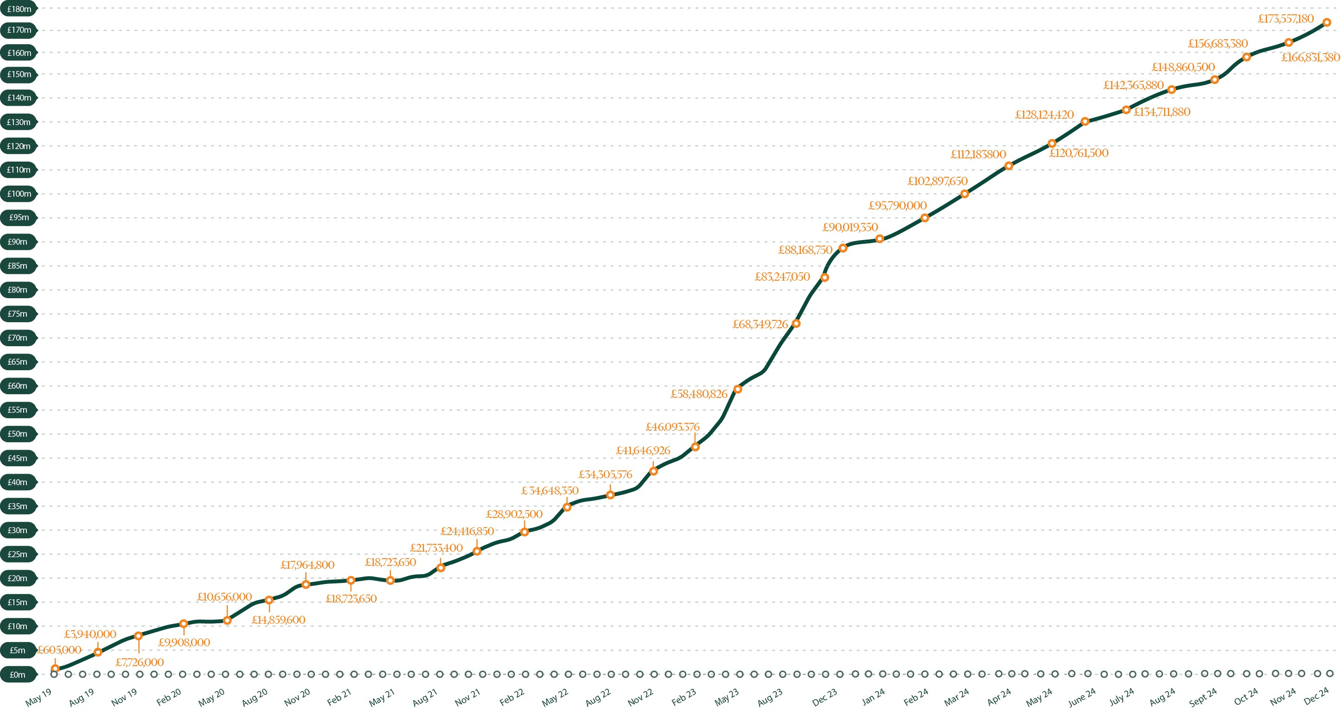
Track Record
Loan book value over time
Sales/distribution information: KNG International Advisors [Mex Office: +52 (998) 500-1627 | UK Office: +44 207 1832480] [info@kngadvisors.co.uk | www.kngadvisors.co.uk

Slide 11
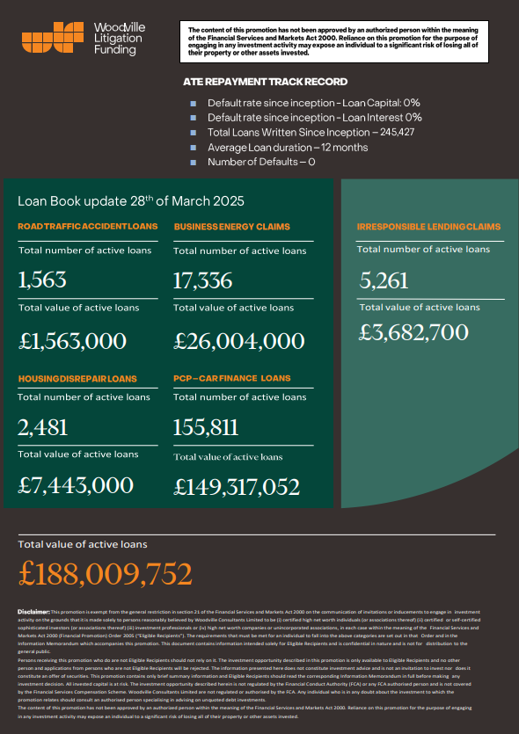

Slide 12

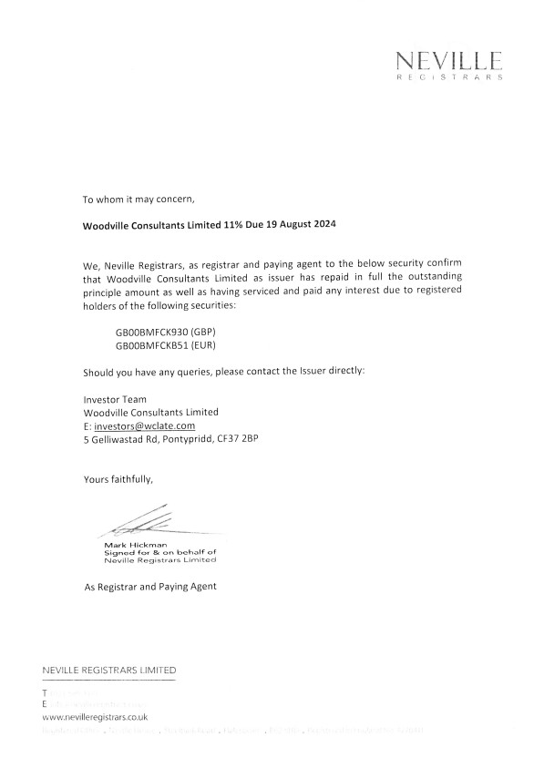
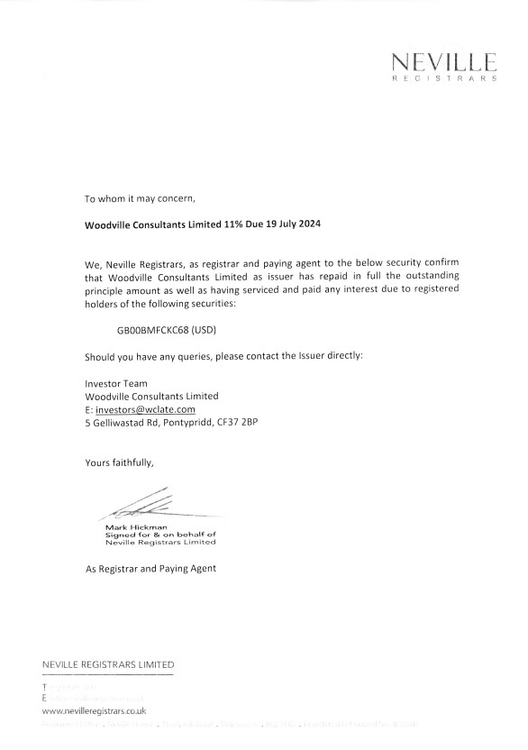

Loan Book Summary
Neville Registrars Limited
Sales/distribution information: KNG International Advisors [Mex Office: +52 (998) 500-1627 | UK Office: +44 207 1832480] [info@kngadvisors.co.uk | www.kngadvisors.co.uk

Slide 13
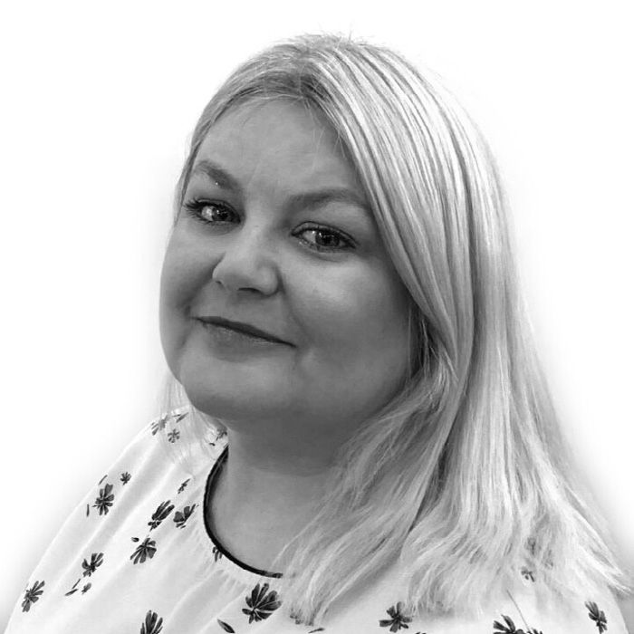
Our Team
Ann Marie Bell
Company Director
In 2012 Ann Marie began her financial career in the car finance space before moving into payroll lending in 2018 and in 2019 oversaw the expansion into ATE lending
Career highlights
Summary
Set up and successfully ran her own law firm for over 5 years.
Taking a car finance model into Pension fund lending support.
Securing a stopping up order granted on the basis of public safety which overrode the rights of ramblers under the CROW Act. This is almost never granted as the right to roam the countryside under the CROW is considered sacrosanct.
Being one of less than 5 lawyers in the country to successfully challenge the banks and lending institutions resulting in credit card or loans being declared unenforceable during the unenforceability claims period. and capable of resisting any form of legal challenge.
Ann Marie has previous credit lending and
legal experience in the Consumer credit
sector. She has a broad insight into executive
activity and has driven and overseen the
expansion of sales, administration and
specialist function teams.
Positive, creative, versatile, decision maker
and leader-mentor in financial services activity.
Sales/distribution information: KNG International Advisors [Mex Office: +52 (998) 500-1627 | UK Office: +44 207 1832480] [info@kngadvisors.co.uk | www.kngadvisors.co.uk

Slide 14
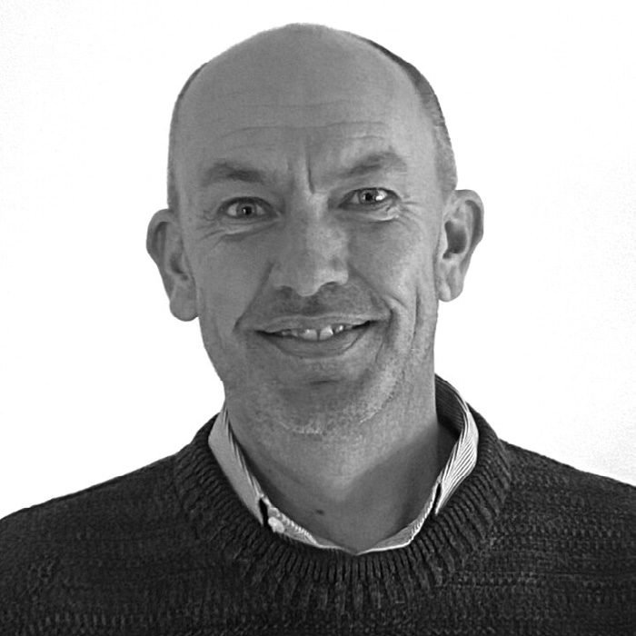
Our Team
Peter Legge
Company Director
Peter has 15 years’ experience in the Financial Services sector, 12 of which have been as an IFA arranging private client portfolios through regulated investment.
Career highlights
Summary
Instigated the platform structure for a large IFA practice as a solution to their 1000+ client bank, over a 2 year period. £10m placed on the platform in the first 12 months.
Key member of a large team of real estate agents in Western Australia, no previous experience but through rapid key relationship building, quickly became one of the top 3 Real Estate Agents in the Company.
Dealing with SME’s across the UK in arranging bespoke Trust solutions and providing niche asset protection and management services to all.
Peter has worked for 20+ years across the sectors or financial services, and more recently as a partner on a Litigation Finance fund raise.
Historically working on a consultancy basis to meet the funding obligations of the client, often including bespoke product designing.
Positive, creative and versatile to executives and high net worth individuals whose circumstances often require none standard solutions.
A strong ethical belief of the services provided.
Sales/distribution information: KNG International Advisors [Mex Office: +52 (998) 500-1627 | UK Office: +44 207 1832480] [info@kngadvisors.co.uk | www.kngadvisors.co.uk

Slide 15
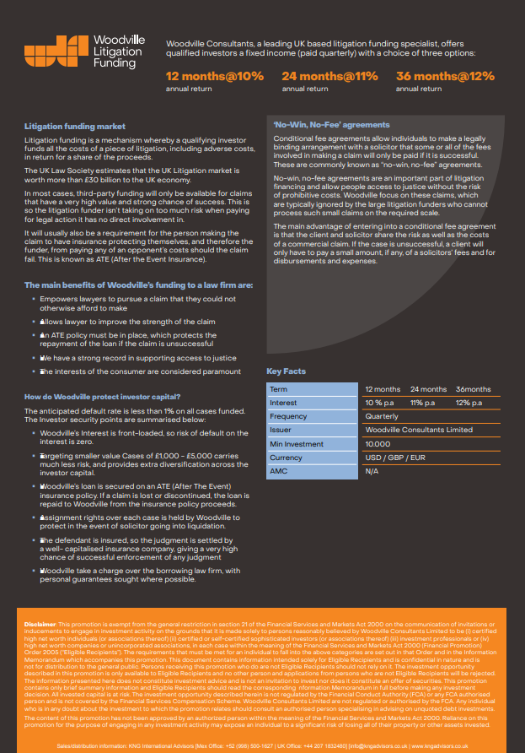

Slide 16
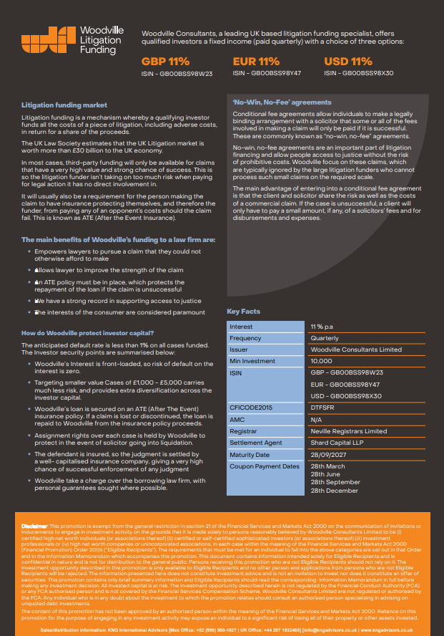

Slide 17
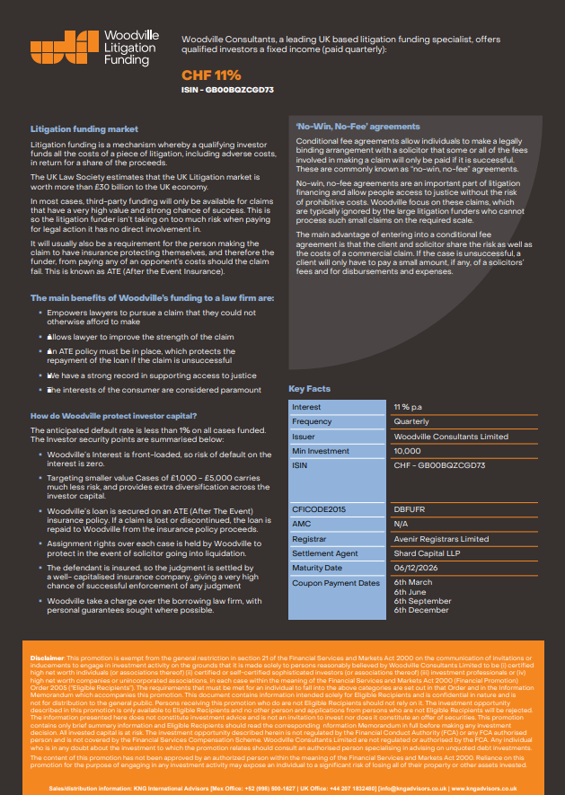

Slide 18
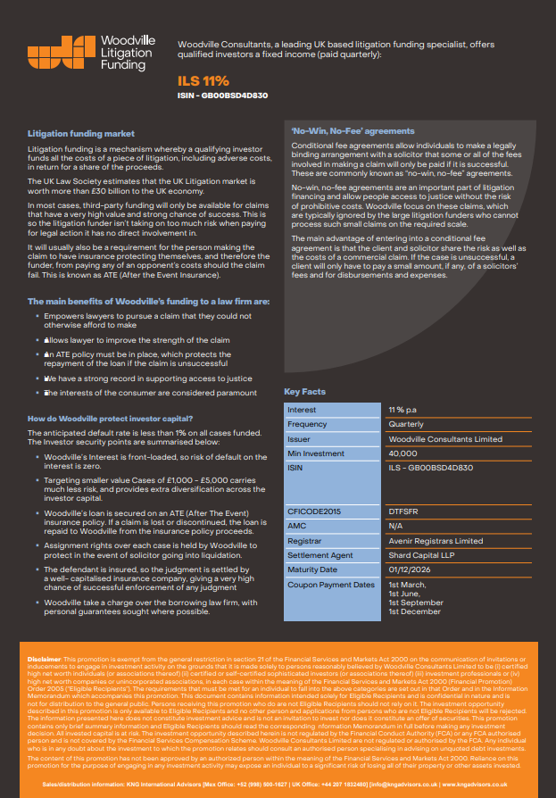

Slide 19

Woodville Consultants Summary
Company formed in 2019, issuing loans to a carefully vetted panel of SRA regulated law firms.
Over 245,427 legal claims have been funded.
There have been zero defaults.
19 series of bonds issued to date, each ranging from 1-3 years.
4420+ private investors receiving income between 10-12% annually.
A total of 11 series have been repaid in full and on time.
Current Loan Book is valued in excess of £188,009,752. Over £114 Million has been returned to investors.
The company has announced record profits in its’ fourth year of trading, operating profit is £3,631,319.
Sales/distribution information: KNG International Advisors [Mex Office: +52 (998) 500-1627 | UK Office: +44 207 1832480] [info@kngadvisors.co.uk | www.kngadvisors.co.uk

Slide 20

Disclaimer
This promotion is exempt from the general restriction in section 21 of the Financial Services and Markets Act 2000 on the communication of invitations or inducements to engage in investment activity on the grounds that it is made solely to persons reasonably believed by Woodville Consultants Limited to be (i) certified high net worth individuals (or associations thereof) (ii) certified or self-certified sophisticated investors (or associations thereof) (iii) investment professionals or (iv) high net worth companies or unincorporated associations, in each case within the meaning of the Financial Services and Markets Act 2000 (Financial Promotion) Order 2005 (“Eligible Recipients"). The requirements that must be met for an individual to fall into the above categories are set out in that Order and in the Information Memorandum which accompanies this promotion. This document contains information intended solely for Eligible Recipients and is confidential in nature and is not for distribution to the general public. Persons receiving this promotion who do are not Eligible Recipients should not rely on it. The investment opportunity described in this promotion is only available to Eligible Recipients and no other person and applications from persons who are not Eligible Recipients will be rejected. The information presented here does not constitute investment advice and is not an invitation to invest nor does it constitute an offer of securities. This promotion contains only brief summary information and Eligible Recipients should read the corresponding Information Memorandum in full before making any investment decision. All invested capital is at risk. The investment opportunity described herein is not regulated by the Financial Conduct Authority (FCA) or any FCA authorised person and is not covered by the Financial Services Compensation Scheme. Woodville Consultants Limited are not regulated or authorised by the FCA. Any individual who is in any doubt about the investment to which the promotion relates should consult an authorised person specialising in advising on unquoted debt investments.

Slide 21
Thank you
The content of this promotion has not been approved by an authorized person within the meaning of the Financial Services and Markets Act 2000. Reliance on this promotion for the purpose of engaging in any investment activity may expose an individual to a significant risk of losing all of their property or other assets invested.

