Slide 1



03 Marzo2025

Slide 2

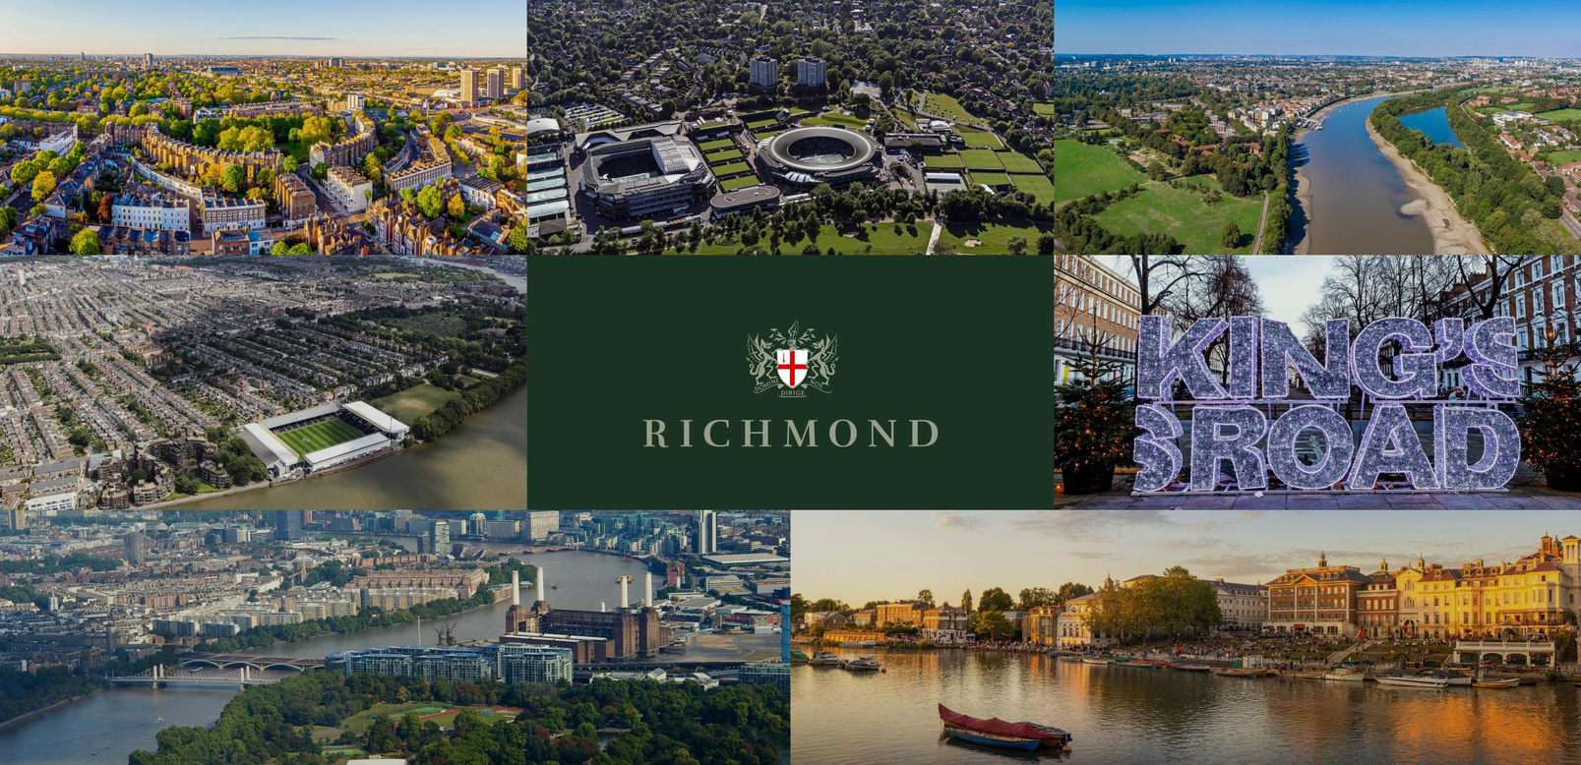





PRINCIPALES ÁREAS DE
INVERSIÓN
NOTTING HILL
WIMBLEDON
CHISWICK
FULHAM
KENSINGTON &
CHELSEA
BATTERSEA
RICHMOND

Slide 3
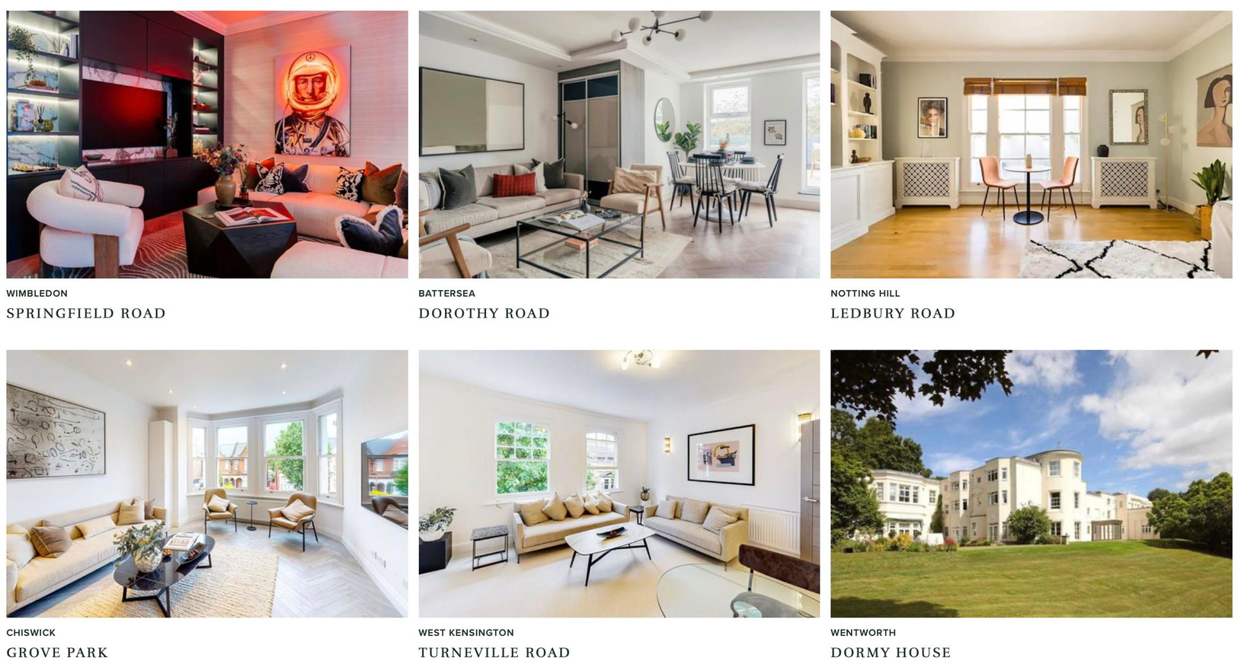
PORTAFOLIO

Slide 4







PROYECTO WIMBLEDON

Slide 5
PROYECTO WIMBLEDON

Slide 6
PROYECTO WIMBLEDON
1. PRECIO DE COMPRA £1.3M
2. GASTOS DE DESARROLLO £600,000
3. VALORACIÓN ACTUAL £3.0M
4. BENEFICIOS OBTENIDOS £1.1M

Slide 7
CÓMO GANAMOS DINERO
1. COMPRAMOS INMUEBLES 25% POR DEBAJO DEL VALOR DE
MERCADO
2. DESARROLLAMOS LAS PROPIEDADES Y HACEMOS 25% DE
GANANCIA
3. EL CRECIMIENTO DEL CAPITAL HA SIDO 410% EN LONDRES DESDE 2000
4. EL RENDIMIENTO DEL ALQUILER ES 7% EN NUESTRO
PORTAFOLIO DE LONDRES

Slide 8

PRODUCTOS
NOTAS DE
BONOS
ACCIONES
PRÉSTAMO
PERIODO: 2 AÑOS TIPO: CONVERTIBLE RENDIMIENTO: 12% P.A MÍNIMO: 5,000 DIVISDA:USD,EUR,GBP CONVERSION: 20% POR DEBAJO DEL
PRECIO DE LA ACCIÓN AL
VENCIMIENTO
PERIODO: 2 O 3 AÑOS TIPO: INGRESO &
CRECIMIENTO RENDIMIENTO: 10-12% P.A MÍNIMO: 30,000 DIVISA:USD,EUR,GBP BONUS: BONIFICACIONES
DISPONIBLES PARA
INVERSIONES DE 250.000
Y 500.000
PRIECIO DE LA ACCIÓN: £6.33
DESCUENTO : 21%
PURCHASE PRICE: £5.00
MÍNIMO: £5,000
DIVISA: GBP
PERIODO DE RETENCIÓN:
2 AÑOS

Slide 9

DISCLAIMER
This promotion is exempt from the general restriction in section 21 of the Financial Services and Markets Act 2000 on the communication of invitations or inducements to engage in investment activity on the grounds that it is made solely to persons reasonably believed by London Richmond Limited to be (i) certified high net worth individuals (or associations thereof) (ii) certified or self-certified sophisticated investors (or associations thereof) (iii) investment professionals or (iv) high net worth companies or unincorporated associations, in each case within the meaning of the Financial Services and Markets Act 2000 (Financial Promotion) Order 2005 (“Eligible Recipients”). The requirements that must be met for an individual to fall into the above categories are set out in that Order and in the Information Memorandum which accompanies this promotion. This document contains information intended solely for Eligible Recipients and is confidential in nature and is not for distribution to the general public. Persons receiving this promotion who do are not Eligible Recipients should not rely on it. The investment opportunity described in this promotion is only available to Eligible Recipients and no other person and applications from persons who are not Eligible Recipients will be rejected. The information presented here does not constitute investment advice and is not an invitation to invest nor does it constitute an offer of securities. This promotion contains only brief summary information and Eligible Recipients should read the corresponding Information Memorandum in full before making any investment decision. All invested capital is at risk. The investment opportunity described herein is not regulated by the Financial Conduct Authority (FCA) or any FCA authorised person and is not covered by the Financial Services Compensation Scheme. London Richmond Limited are not regulated or authorised by the FCA. Any individual who is in any doubt about the investment to which the promotion relates should consult an authorised person specialising in advising on unquoted debt investments.

