Slide 1



COMPANY PRESENTATION 3 MARCH 2025

Slide 2

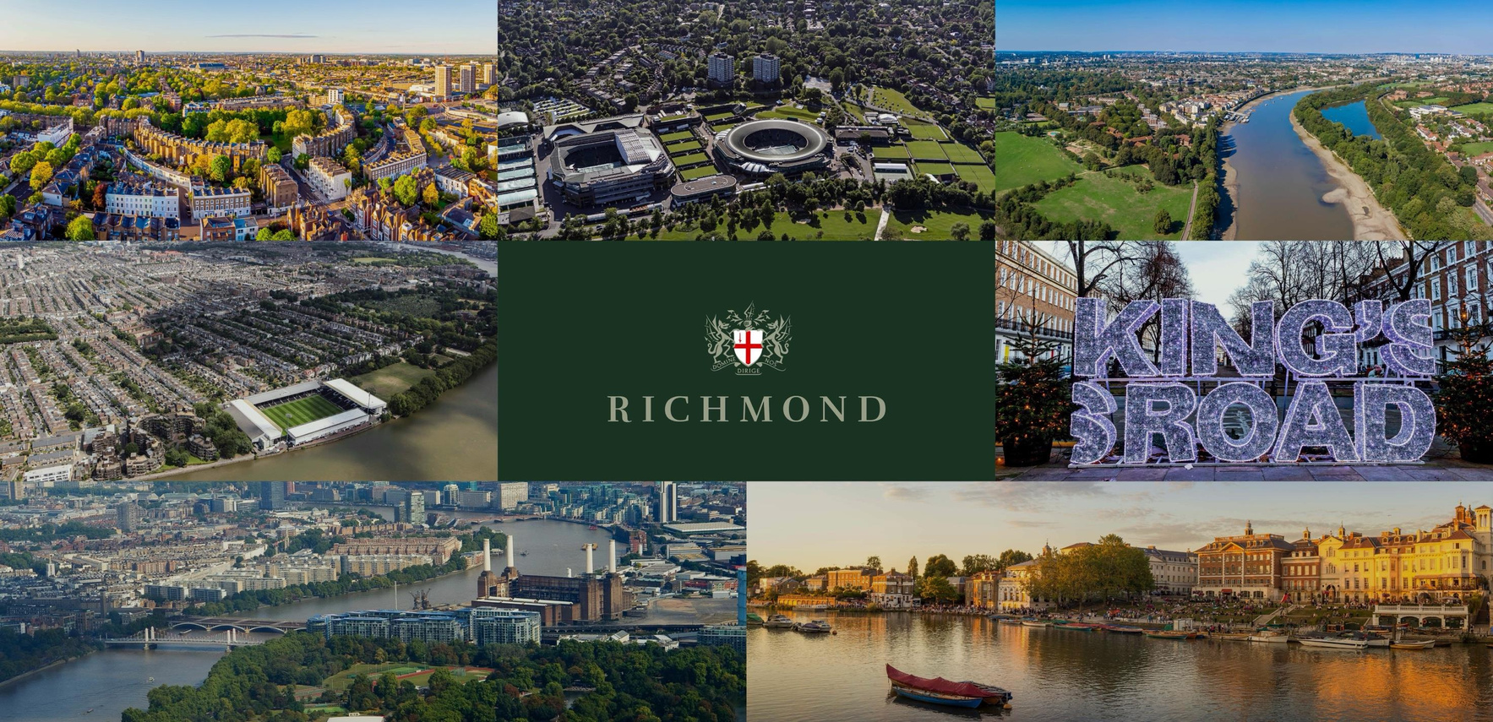






KEY INVESTMENT AREAS
NOTTING HILL
WIMBLEDON
CHISWICK
FULHAM
KENSINGTON &
CHELSEA
BATTERSEA
RICHMOND

Slide 3
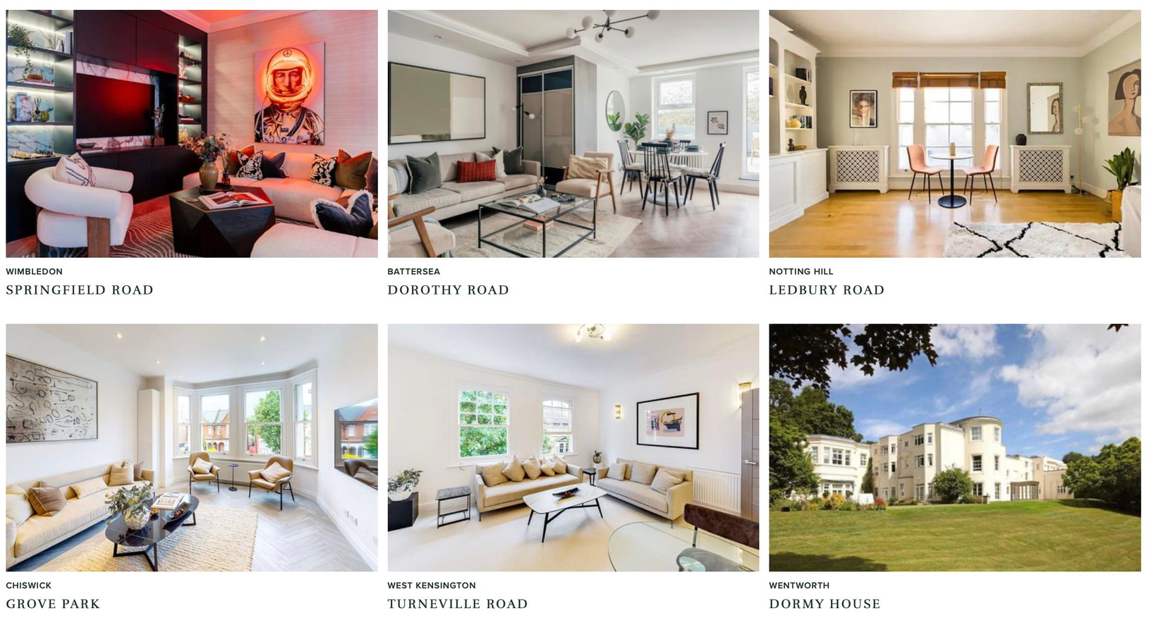
OUR PORTFOLIO

Slide 4






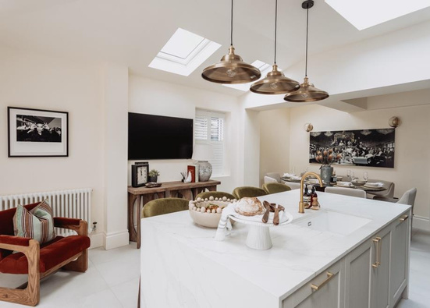

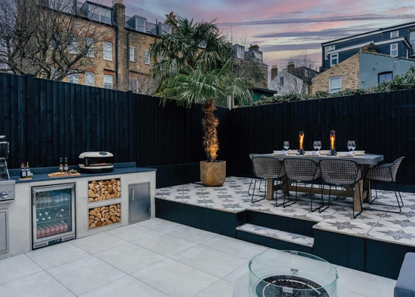
WIMBLEDON PROJECT

Slide 5
WIMBLEDON PROJECT

Slide 6
WIMBLEDON PROJECT
1. PURCHASE PRICE £1.3M
2. DEVELOPMENT COSTS £600,000
3. CURRENT VALUATION £3.0M
4. PROFIT ACHIEVED £1.1M

Slide 7
HOW WE MAKE MONEY
1. WE BUY PROPERTIES 25% BELOW MARKET VALUE
2. WE DEVELOP THE PROPERTIES AND MAKE 25% PROFITS
3. CAPITAL GROWTH HAS BEEN 410% IN LONDON SINCE 2000
4. RENTAL YIELD IS 7% ON OUR LONDON PORTFOLIO

Slide 8

INVESTMENT PRODUCTS
LOAN NOTES
BONDS
SHARES
TERM: 2 OR 3 YEARS TYPE: INCOME & GROWTH RETURN: 10-12% P.A
MINIMUM: 30,000
TERM: 2 YEARS TYPE: CONVERTIBLE RETURN: 12% P.A MINIMUM: 5,000 CURRENCY:USD,EUR,GBP
CONVERSION:
20% BELOW SHARE PRICE
AT MATURITY
SHARE PRICE: £6.33 DISCOUNT: 21% PURCHASE PRICE: £5.00 MINIMUM: £5,000 CURRENCY: GBP
CURRENCY:USD,EUR,GBP BONUS: BONUS RETURNS
AVAILABLE FOR 250K &
500K INVESTMENTS
HOLDING PERIOD: 2 YEARS

Slide 9

DIS CLAIMER
This promotion is exempt from the general restriction in section 21 of the Financial Services and Markets Act 2000 on the communication of
invitations or inducements to engage in investment activity on the grounds that it is made solely to persons reasonably believed by London Richmond Limited to be (i) certified high net worth individuals (or associations thereof) (ii) certified or self-certified sophisticated investors (or associations thereof) (iii) investment professionals or (iv) high net worth companies or unincorporated associations, in each case within the meaning of the Financial Services and Markets Act 2000 (Financial Promotion) Order 2005 (“Eligible Recipients”). The requirements that must be met for an individual to fall into the above categories are set out in that Order and in the Information Memorandum which accompanies this promotion. This document contains information intended solely for Eligible Recipients and is confidential in nature and is not for distribution to the general public. Persons receiving this promotion who do are not Eligible Recipients should not rely on it. The investment opportunity described in this promotion is only available to Eligible Recipients and no other person and applications from persons who are not Eligible Recipients will be rejected. The
information presented here does not constitute investment advice and is not an invitation to invest nor does it constitute an offer of securities. This
promotion contains only brief summary information and Eligible Recipients should read the corresponding Information Memorandum in full before
making any investment decision. All invested capital is at risk. The investment opportunity described herein is not regulated by the Financial Conduct
Authority (FCA) or any FCA authorised person and is not covered by the Financial Services Compensation Scheme. London Richmond Limited are not regulated or authorised by the FCA. Any individual who is in any doubt about the investment to which the promotion relates should consult an authorised person specialising in advising on unquoted debt investments.

