Slide 1
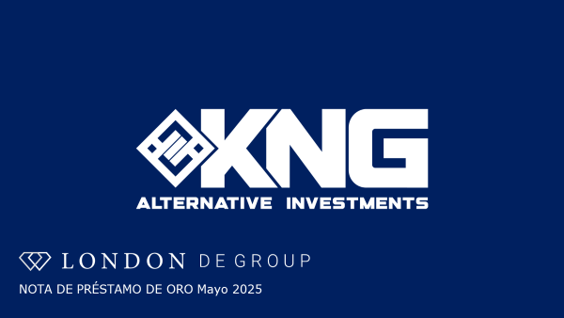
GOLD LOAN NOTE May 2025

Slide 2

Donde vemos Private Debt/Deuda Privada en un Portafolio Diversificado?
Calpers recalibates Asset Allocation For July 1st 2025
CalPERS is the largest public pension fund in the US.$442 billion under management, voted to increase its allocations to private equity, private debt and other alternatives
CalPERS es el mayor fondo público de pensiones de Estados Unidos.
Con 442.000 millones de dólares bajo gestión, votó a favor de aumentar sus asignaciones a capital riesgo, deuda privada entre otras inversiones alternativas
CalPERS (California Public Employees' Retirement System) has a new asset allocation target that includes the following percentages:
42% in global equity
30% in fixed income
15% in real assets
13% in private equity
5% in private debt
The allocation adds up to 105% due to the 5% allocation to leverage. CalPERS also increased its equity allocation to 50% and boosted fixed income to 28%.

Slide 3


D E G R O U P
GOLD LOAN NOTE PRESENTATION
May 2025

Slide 4
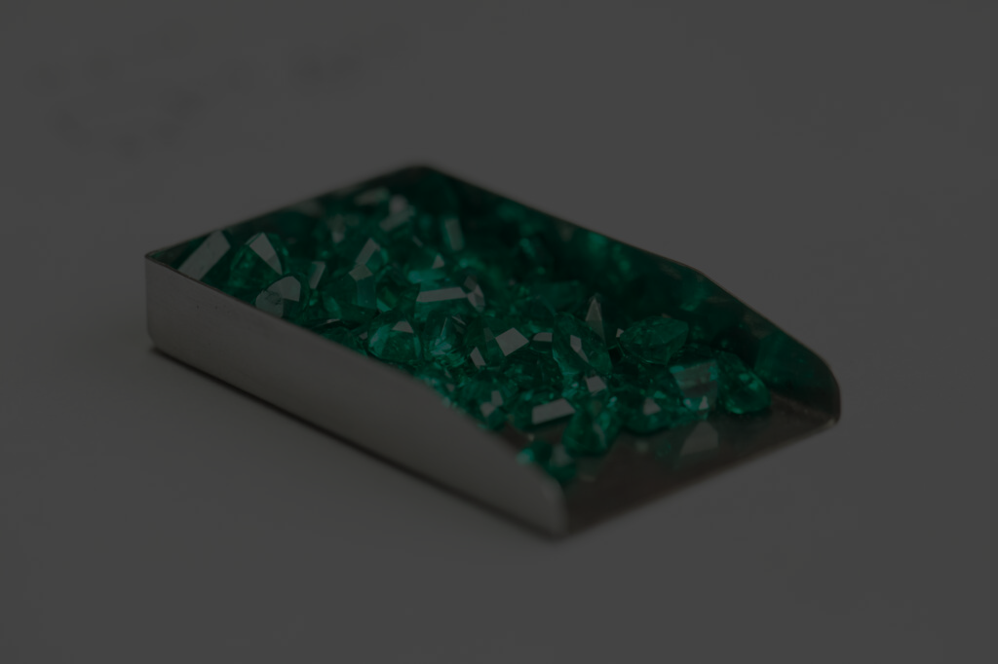

D E G R O U P
Introduction to the London DE Group
London DE (LDE)
London DE, Parent Company of the group, has been trading since 2013. London Gold Xchange and Sylvera are owned and operated by LDE Group.
Founded by Philip Spencer, Commissioned Officer in UK Armed Forces, Stockbroker and Wealth Manager in City of London and Dubai, UAE.
The LDE Group has established connections with commodity sources, offering unique financial opportunities and competitive prices.

Slide 5

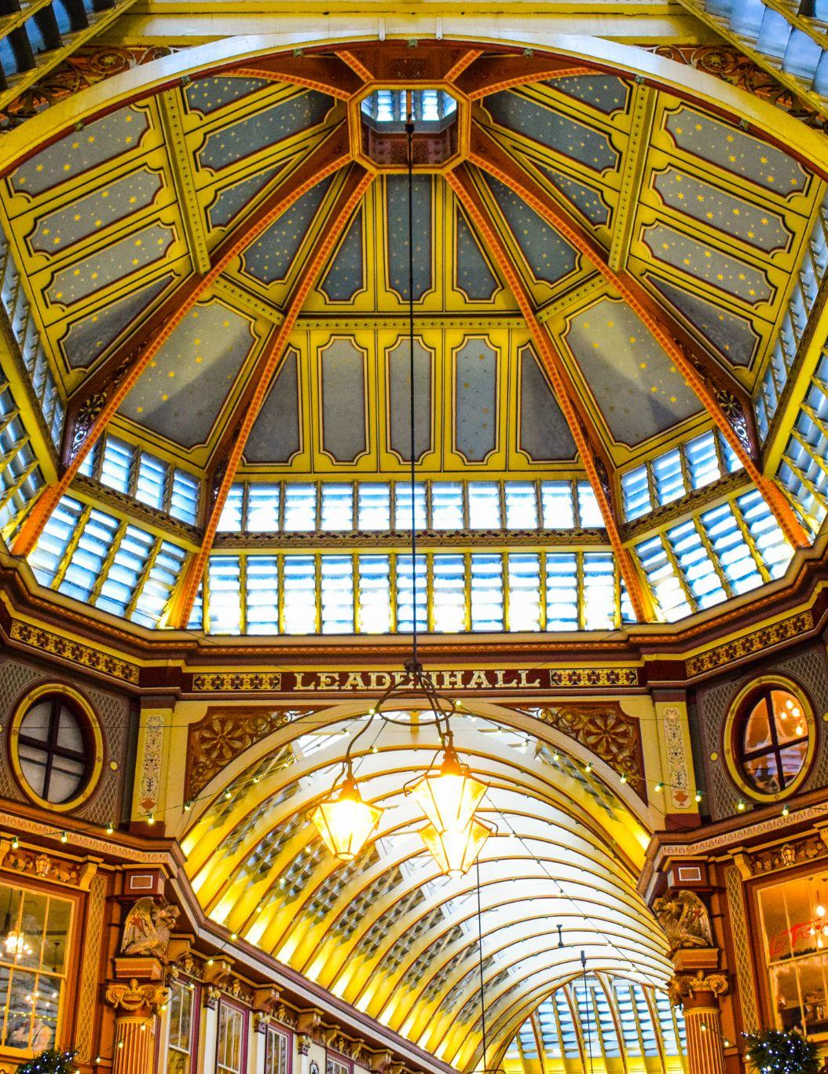
D E G R O U P
THE FOUNDER & CEO
PHIL SPENCER
Commissioned Officer in UK Armed Forces
Stockbroker and Wealth Manager in City of London and Dubai, UAE
Founded London DE in December 2013
Passionate entrepreneur, with a high degree of integrity
Ethical approach to disrupt the coloured gemstone and artisanal gold markets.

Slide 6
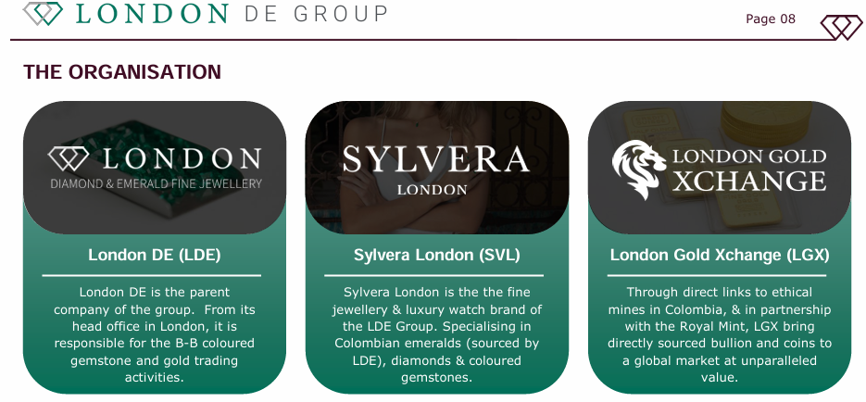




D E G R O U P
Introduction to the London DE Group
London Gold Xchange (LGX)
Sylvera London (SVL)
Through direct links to ethical mines globally, LGX offers a fixed-rate loan note, bullion and coins.
Sylvera London is the the fine jewellery & luxury gemstone of the LDE Group.

Slide 7
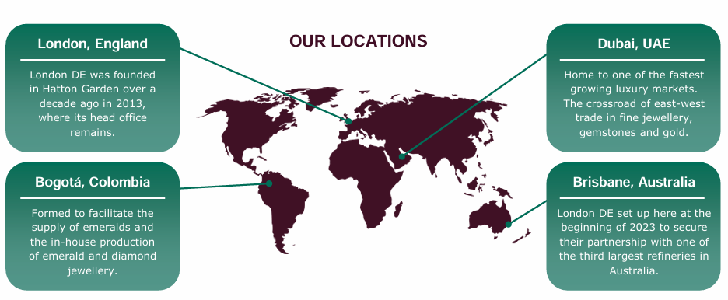
D E G R O U P
THE FOUNDER & CEO
PHIL SPENCER
Commissioned Officer in UK Armed Forces
Stockbroker and Wealth Manager in City of London and Dubai, UAE
Founded London DE in December 2013
Passionate entrepreneur, with a high degree of integrity
Ethical approach to disrupt the coloured gemstone and artisanal gold markets.

Slide 8
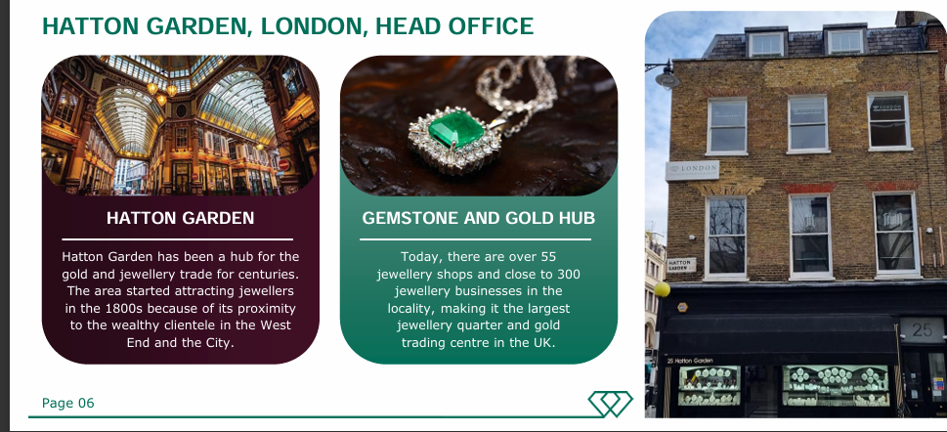
D E G R O U P
Introduction to the London DE Group
London Gold Xchange (LGX)
Sylvera London (SVL)
Through direct links to ethical mines globally, LGX offers a fixed-rate loan note, bullion and coins.
Sylvera London is the the fine jewellery & luxury gemstone of the LDE Group.

Slide 9
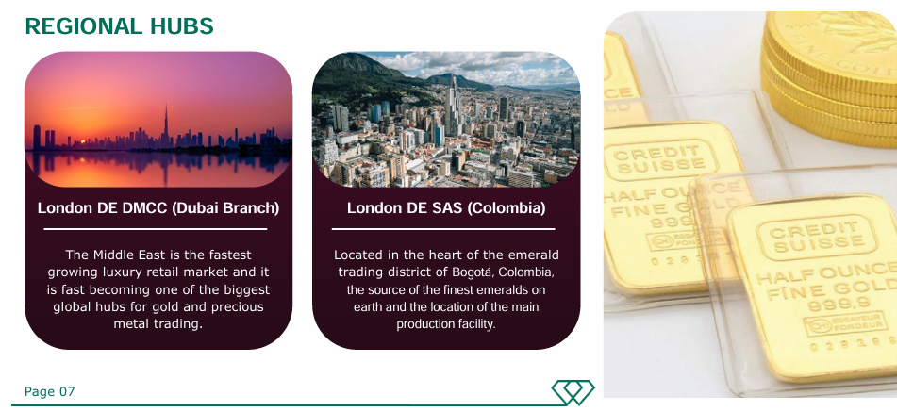
D E G R O U P
THE FOUNDER & CEO
PHIL SPENCER
Commissioned Officer in UK Armed Forces
Stockbroker and Wealth Manager in City of London and Dubai, UAE
Founded London DE in December 2013
Passionate entrepreneur, with a high degree of integrity
Ethical approach to disrupt the coloured gemstone and artisanal gold markets.

Slide 10


D E G R O U P
D E G R O U P
THE CURRENT GOLD MARKET
As of April 2025, gold reached an all-time high of $ 3,400 per ounce, driven by escalating geopolitical tensions and economic uncertainties.
In 2024, total global gold demand hit a record 4,974.5 metric tons, a 1% increase from the 2023.
Annual investment in gold rose by 25% in 2024, reaching a four-year high of 1,179.5 metric tons.
Page 010

Slide 11






D E G R O U P
Problems in the Open Market
Market Volatility
Liquidity Issues
Storage & Security
Commodity markets fluctuate due to economic and geopolitical factors.
Selling gemstones can take time, and gold sales may involve premiums.
Both require secure storage and insurance, adding to costs.
High Transaction Costs
Ethics & Sourcing
Niche Expertise
Dealers, auction houses, and taxes reduce investment returns.
Conflict sourcing and environmental damage affect desirability.
Assessing gemstone value requires specialist knowledge.

Slide 12
D E G R O U P
D E G R O U P
The London DE Solution
London DE’s Fixed Rate Loan Note offers asset-backed, high-yield returns while mitigating common investment risks in gold & gemstones.
FIXED INCOME RETURNS
Loan Notes provide monthly interest payments, reducing exposure to market fluctuations.
REGULAR MONTHLY PAYMENTS
Investors receive fixed interest payments every month, ensuring consistent cash flow.
INVESTOR FUNDS ARE HELD IN ESCROW
Funds are only released upon successful purchase, certification, and assay of gold.
NO HIDDEN FEES
Investors pay no additional transaction costs, maximizing net returns.
ESG-ALIGNED
London DE sources gold and gemstones through ethical, conflict-free supply chains.
PROVEN TRACK RECORD
London DE has been paying investors monthly returns since 2018, ensuring reliability and trust.
Page 012

Slide 13






D E G R O U P
D E G R O U P
The London DE Solution
18%
Return
$100,000
Minimum Investment
1.5%
Per Month
18%
Return
$500,000
Minimum Investment
1.5%
Per Month
Monthly interest is paid in all major currencies or
physical gold bullion interest can be paid annually
A Golden Visa to the UAE is included free of charge in this threshold offering tax and residency benefits
Minimum
Investment
£100,000
Investment Term
60 months
Interest Paid
Monthly
Security Trustee Cotswolds Capital Trustee
Asset Backed
Fixed income Loan Note
Security
Legal charge over the Company and Assets
Page 013

Slide 14

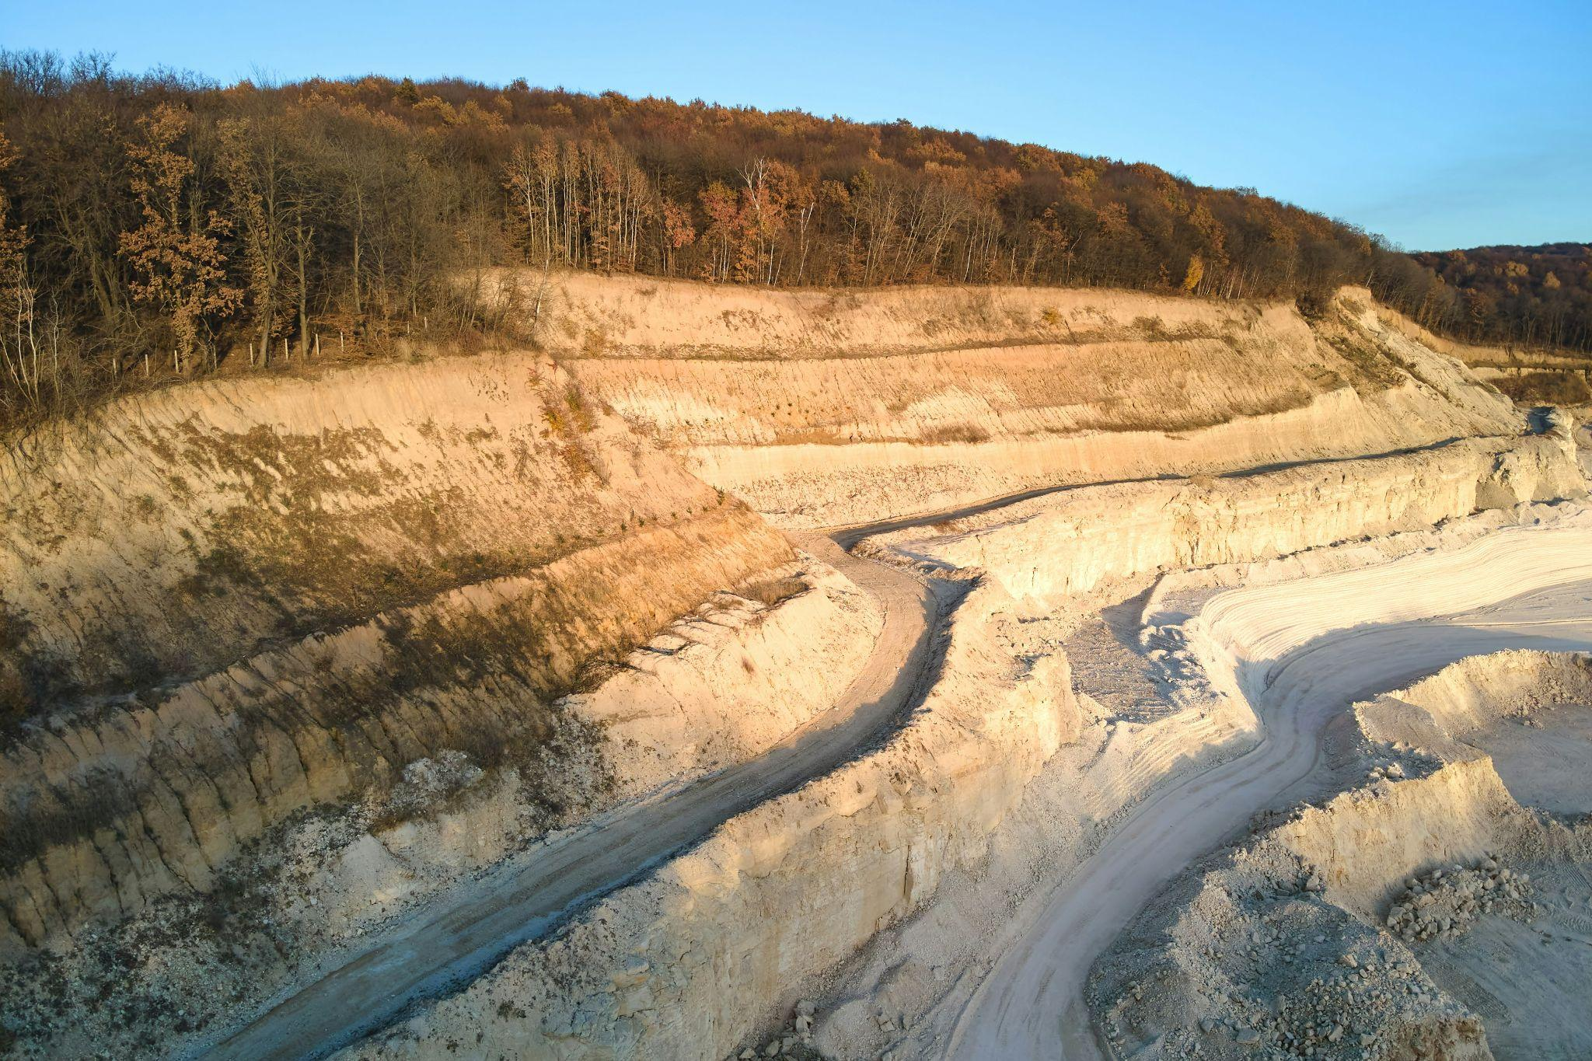
D E G R O U P
Why Now?
London DE is exploring, extracting and investing in local economies across the globe. These relationships have enabled London DE group to expand activities in various countries and gain trust with suppliers and investors alike.
Increased raise - further investment
Joint venture - exploring, extracting and investing in the local economy
Larger discounts
GROWING OPPORTUNITIES
INCREASED TOTAL
London DE is securing competitive gold and gemstone deals in Zimbabwe through direct sourcing while expanding into its growing property market.
Due to the commodity relationships that have been built created, the Security Trustee, Cotswolds Capital, have increased the total raise to £18 million.
Page 014

Slide 15




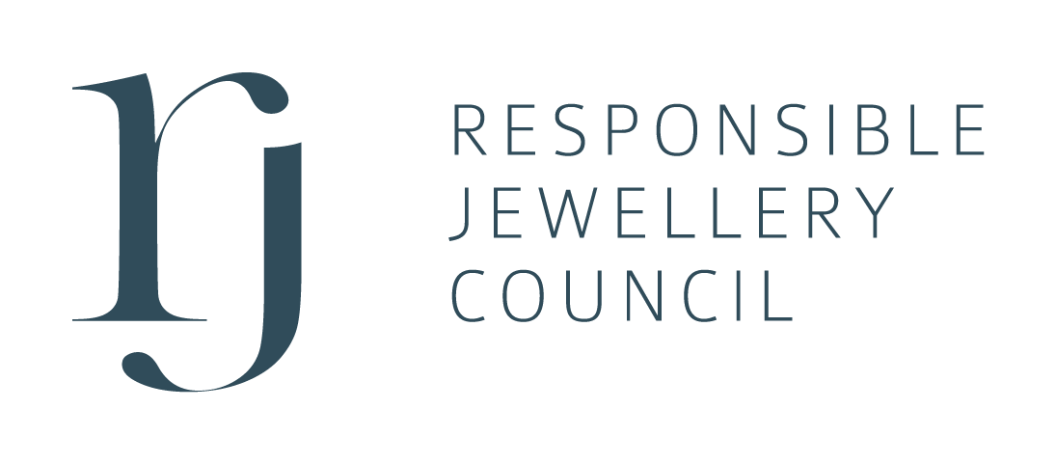






D E G R O U P
Strategic Alliances & Licenses
We have been establishing and maintaining a standard of excellence in the trade of precious metals, gemstones, coloured gemstones, and fine jewellery since our establishment in 2013.

Slide 16
D E G R O U P
1.
Investor Subscribes. LDE Receives the net proceeds of the investment into the Currency Cloud FX portal
EXAMPLE = £100,000 £15,000 administration, marketing, and operational costs.
2.
Funds are deployed to a secure holding account (usually Mashreq) to execute the trade (in USD) to purchase under spot price.
EXAMPLE = £85,000 Proof of funds sent to Seller, who sources and ships the gold to the refinery
3.
Gold is received by the refinery and Assayed. Funds are released from the account to the Seller only when the Final Assay Report is presented.
EXAMPLE = £85,000 Released from the secure account to the Seller upon delivery of the Assay Report.
4.
The refinery pays London DE Group (LBMA second fix spot price -1%).
EXAMPLE = £90,100 Approximately £90,100 is paid by the refinery to LDE for the trade, leaving a profit of £5,100. (an average 6% gross margin per trade).
5.
This process is repeated on average 24 times per year.
EXAMPLE = £207,400 Generating £207,400 on the original £100,000 loan (£85,000 of which was deployed into the trade twice per month for 12 months).
6.
Interest payments are paid monthly with a minimum term of 12 months.
EXAMPLE = £118,000 The total repayment after 12 months equates to 18% on a £100,000 loan note. This leaves a profit of £89,400 to pay overheads, interest and LDE profit.

Slide 17






D E G R O U P
London DE Flow of Funds
1.
LDE Receives the net proceeds of the investment into the Currency Cloud FX portal
2.
Funds are deployed to a holding account to purchase gold under spot price.
3.
Gold is received by the refinery, final assay report is presented and funds released.
4.
The refinery pays London DE Group for the pure gold (LBMA second fix spot price -1%).
5.
This process is repeated twice per month making on average 6% margin per trade.
6.
Loan note interest payments of 18%pa are paid monthly for a term of 5 years.

Slide 18
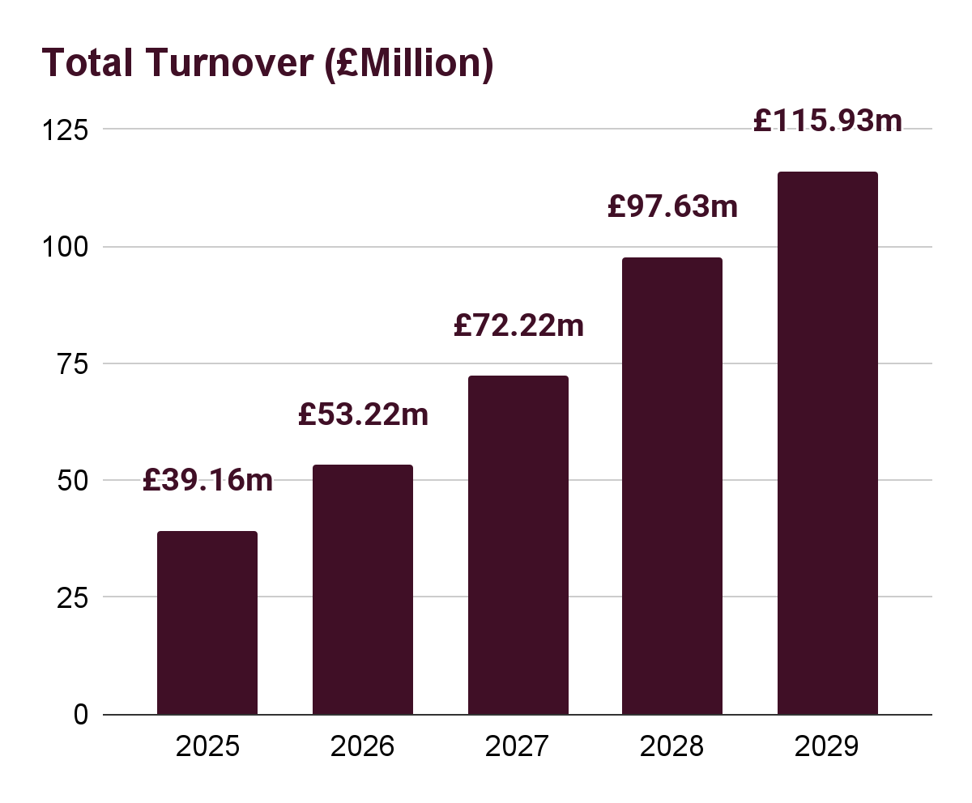
D E G R O U P
FINANCIAL FORECASTS
REVENUE SOURCE | DESCRIPTION | 2025 | 2026 | 2027 | 2028 | 2029
Gold sales | Turnover | £36.43mn | £48.63mn | £65.32mn | £89.63mn | £105.70mn
 | Gross Profit | £2.19mn | £2.92mn | £3.92mn | £5.38mn | £6.34mn
(B-B = 90% / B-C = 10%) | Net Profit | £728K | £972K | £1.31mn | £1.79mn | £2.11mn
Jewellery, watch & gemstone sales | Turnover | £2.73mn | £4.59mn | £6.90mn | £8.01mn | £10.23mn
 | Gross Profit | £1.64mn | £3.21mn | £4.83mn | £5.60mn | £7.17mn
(B-B = 20% / B-C = 80%) | Net Profit | £327K | £803K | £1.69mn | £1.96mn | £2.51mn
Totals: | Total Turnover | £39.16mn | £53.22mn | £72.22mn | £97.63mn | £115.93mn
 | Total Gross Profit | £3.82mn | £6.13mn | £8.75mn | £10.98mn | £13.51mn
(B-B = 55% / B-C = 45%) | Total Net Profit | £1.06mn | £1.78mn | £2.01mn | £3.75mn | £4.62mn
Conservative five year forecast for the LDE group, compiled by Hilton Accountants in London, UK on 1st Nov 2024 and reviewed quarterly.
Page 18

Slide 19
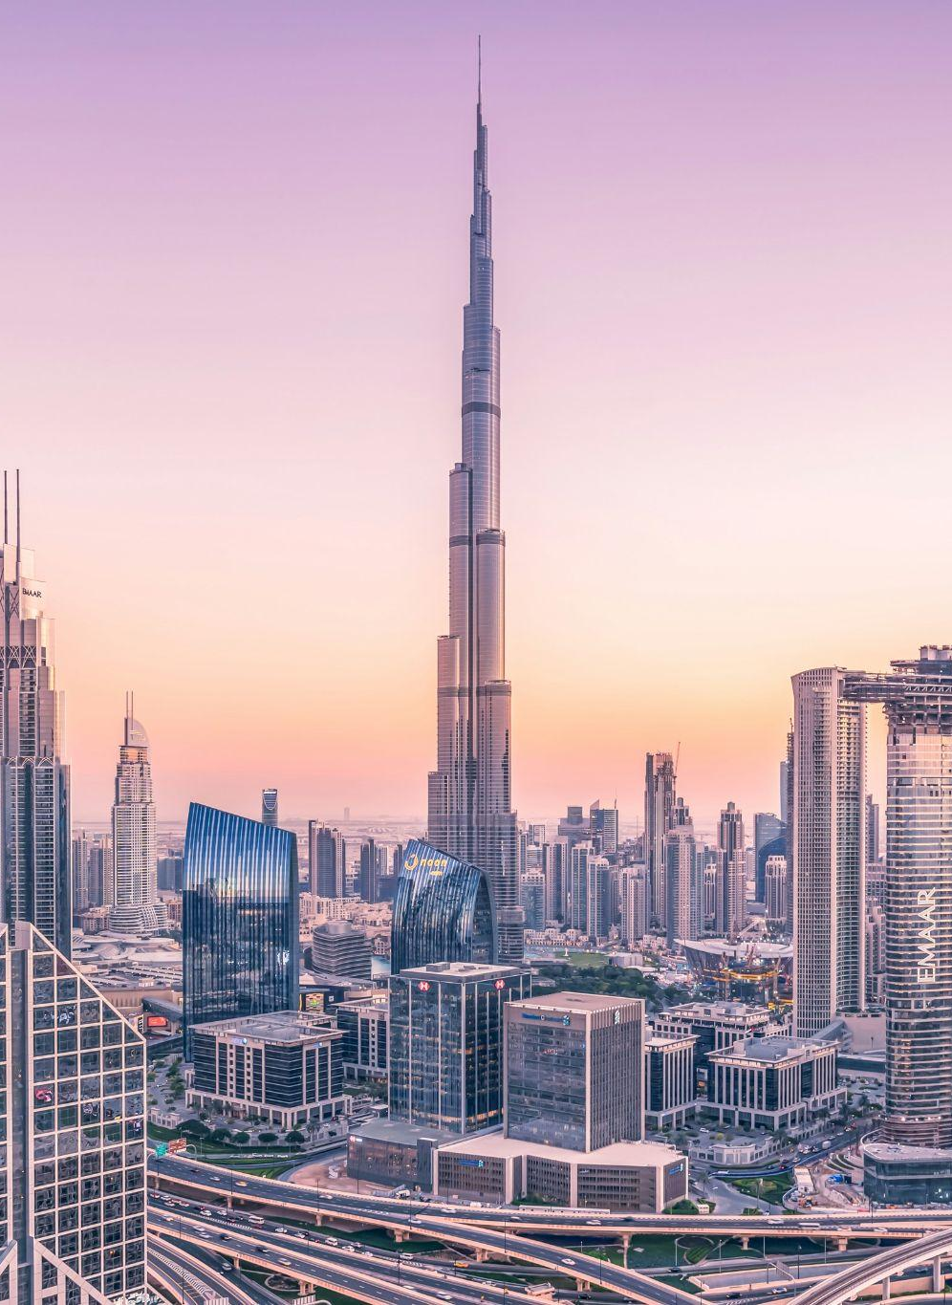
D E G R O U P
Page 19
UAE Golden Visa: Your Path to Long-Term Residency
Tax Benefits
Golden Visa holders in the UAE benefit personally from a tax-free environment. There is no personal income tax or wealth tax. Corporate tax is only 9%..
Residency & Mobility
The UAE Golden Visa offers a 10-year renewable residency. There is no mandatory stay requirement, allowing full freedom to live, work, and study in the UAE.
Business & Investment Perks
Visa holders can own 100% of their business without a local sponsor. There are no trade license restrictions, and all profits can be repatriated abroad.
Eligibility Paths
Eligibility includes investors with AED 2M+ in real estate or AED 1M in business. Professionals earning AED 30,000+ and top-tier students can also qualify.

Slide 20
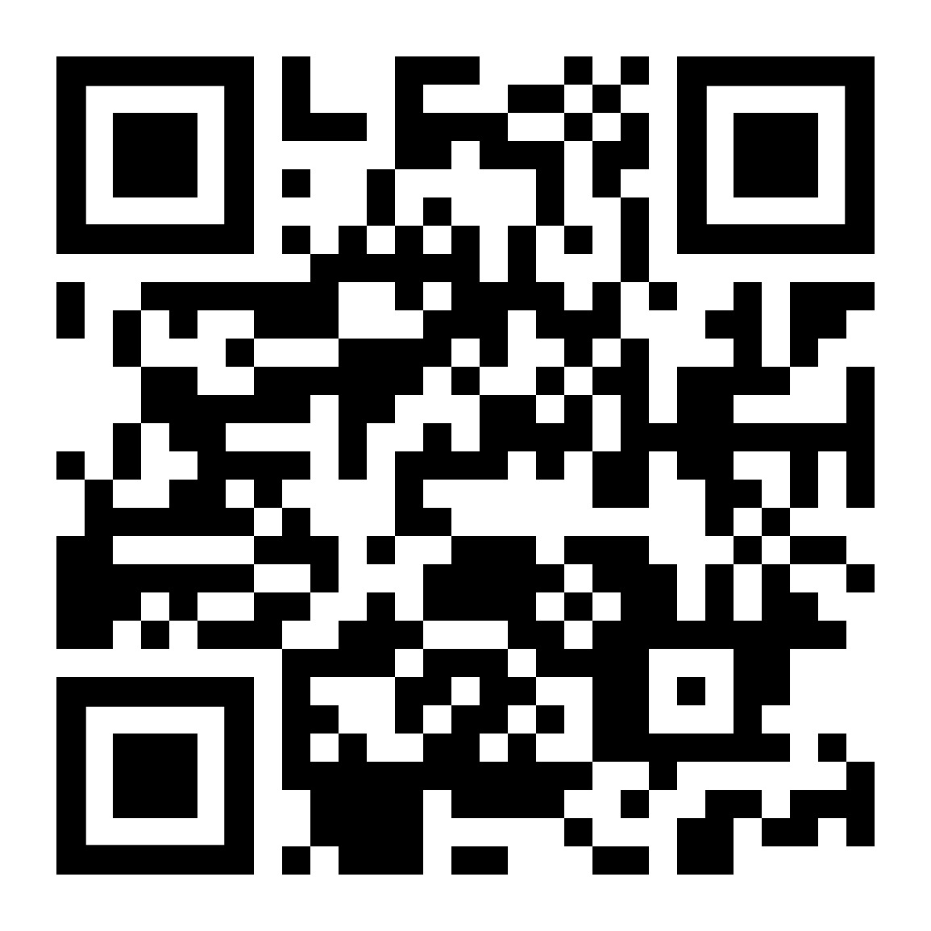
D E G R O U P
neil@londonde.com
(Incorporated in England and Wales under the Companies Act 2006
Registered no: 08806847)
Total Raise: £18mn
Date of Information Deck April 2025

