Slide 1
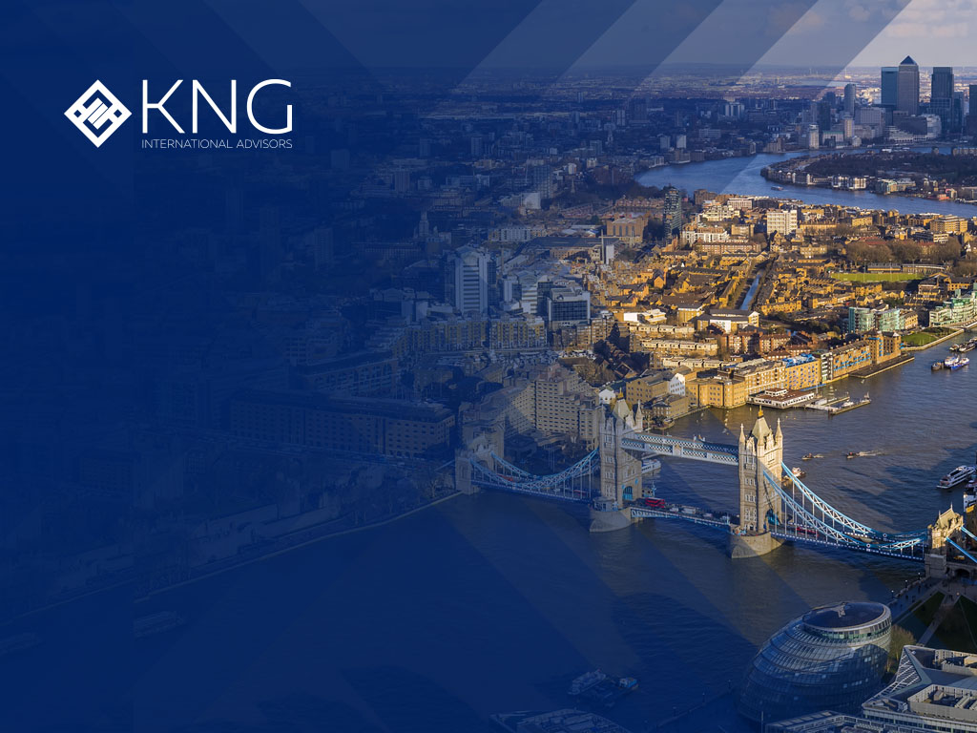
CREATING AND MANAGING WEALTH ACROSS BORDERS

Slide 2
INTRODUCTION: - Private Debt in a Balanced Portfolio - High Yield Fixed Income

Slide 3

CONTENTS
About us
Why is it necessary to invest savings?
What is corporate debt?
The investment portfolio that produces income
How to invest in a portfolio from only $10,000 USD
Contact us

Slide 4

01
About us
KNG International Advisors

Slide 5


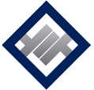
KNG
International Advisors
About us
We are an international wealth advisory and distribution company of funds and international investment instruments. We provide our services to individuals, companies, family offices, fund managers, AFORES, AFPs and independent financial advisors.
We have 20+ years of experience in the industry and have our own network of 120 advisors around LATAM, Caribbean and Africa.
We are brokers for 50+ global Banks and financial institutions, providing savings and investment solutions for our clients and a network of financial advisors.

Slide 6

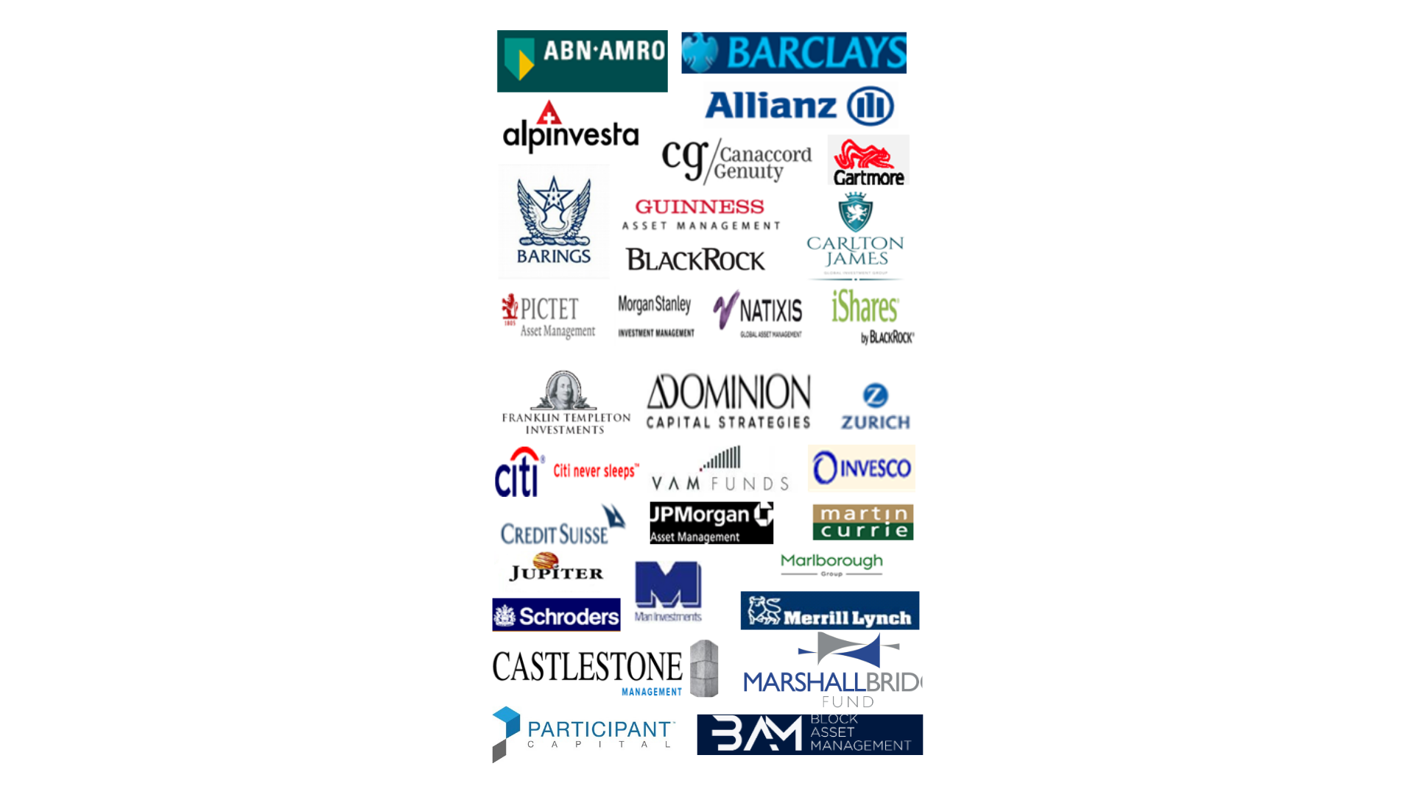





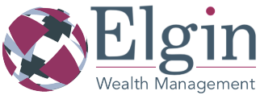


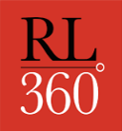

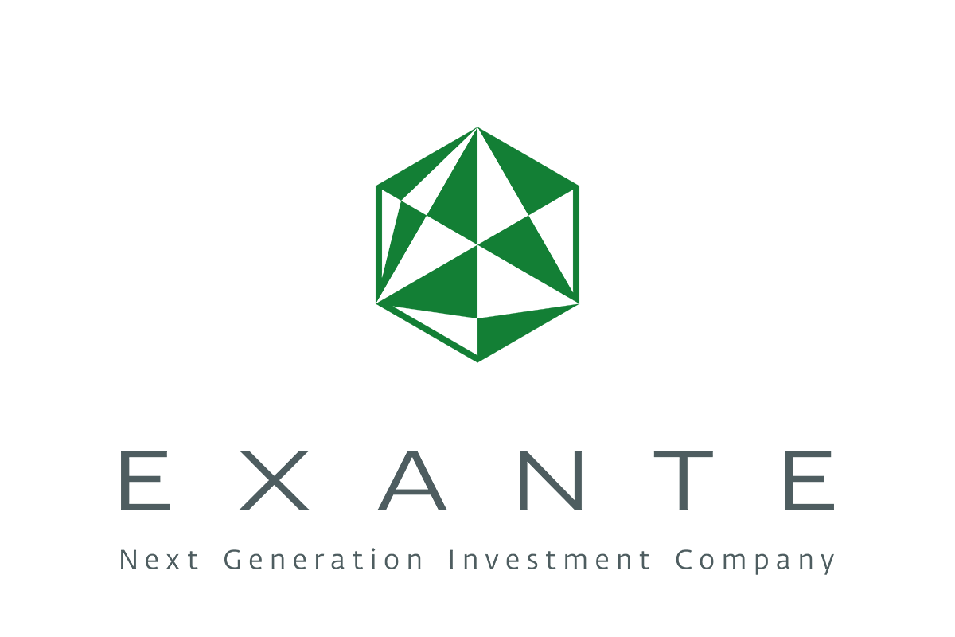




Some Financial Institutions We Work With
Investment Plataforms $10,000 USD | Savings-Investment Plans $250 USD | Investment Fund Managers $10,000 USD | Asset Managers $100,000 USD | International Bank Accounts $100,000 USD

Slide 7



Service
We provide a ongoing cross border service as your wealth manager.
All our senior advisors are qualified by the Chartered Insurance Institute and hold an Award or Diploma in International Financial Planning from the UK.
Personalised attention in advising on future financial objectives and priorities, with regular reviews of the composition of your portfolio in relation to your financial objectives. All contracts with banks and insurers are signed directly with the financial institution.
We perform in-depth due-diligence and complete analysis of investment instruments in order to offer global best-of-breed investments in their respective categories, whether fixed income or equities. Funds with 5 years out-performance and ranked in the top quartile of their respective category.

Slide 8


Our Products y Service
Financial Protection
International Trusts
International Major Medical Insurance
International Life Insurance
Create and Manage Wealth
International Retirement Plans
Educational savings funds
Management of international fixed income investment portfolios 8% to 10% per annum
Management of international equity investment portfolios
Wealth Banking from London and NY
International Debit Accounts (USD, EUR, GBP)

Slide 9
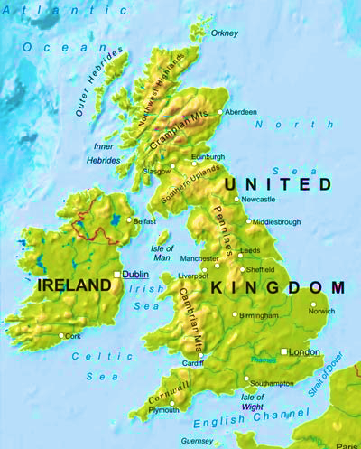


Protection to all Investors
Choose the investment platform in a highly regulated jurisdiction which ring fencing your assets.
SECURITY
Multi-Currency investment accounts: (€,$,£ + many other hard currencies).
Accounts for individuals, trusts or corporations.
We use the Isle of Man and Guernsey, British Crowns as the main jurisdiction for our international client base
By law client investment capital is always managed in segregated accounts with well known custodians (such as Pershing BNY Mellon - $42 billion under custody) to ensure absolute investor protection.
Maximum tax efficiency with gross roll up of interest/profit/dividends reinvested within the investment platform.
Tax deferral for investment withdrawals, dependent on country of residence.

Slide 10
02
Why Invest?
KNG International Advisors

Slide 11
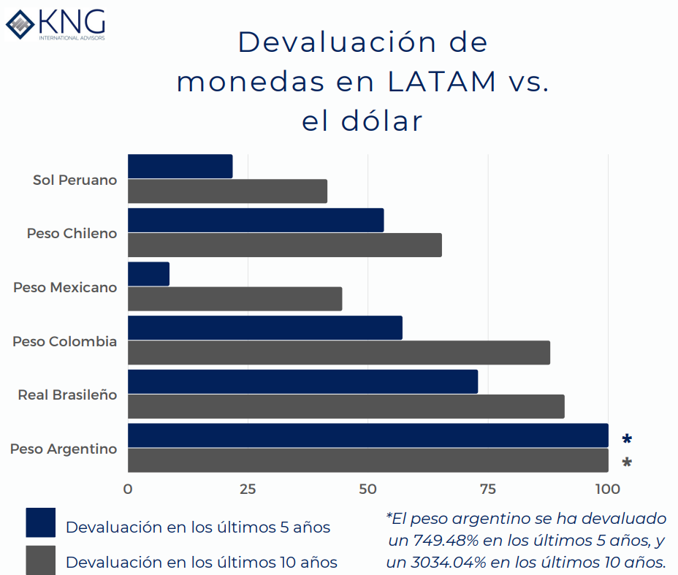
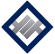
Why Invest?
Finding a safe spot to domicile your investment account
LATAM & AFRICA
Protect your savings from Inflation
Sept 2022 Data:
Mexico: 44.56%;
Chile 65.32%;
Brazil: 90.86%;
Colombia: 87.87%;
Perú: 41.47%;
Argentina 3034.04%
Protection/Refuge for life savings in a AAA rated country due to:
LATAM and Africa currency devaluations.
Economic and political uncertainty in LATAM countries.
Personal security - have more confidentiality
Fuente: XE.com

Slide 12
Why Invest?
Latin America's Inflation
Country | Tasa Inflación Anual a Septiembre 2022
Mexico | 8.7%
Argentina | 83.00%
Chile | 13.7%
Perú | 8.53%
Brazil | 7.71%
Colombia | 11.44%
Fuentes:
Instituto Nacional de Estadística y Geografía (INEGI), Instituto Nacional de Estadística e Informática (INEI), Instituto Brasileiro de Geografía e Estadística, Departamento Administrativo Nacional de Estadística (DANE), Instituto Nacional de Estadística y Censos, Instituto Nacional de Estadística de Chile

Slide 13
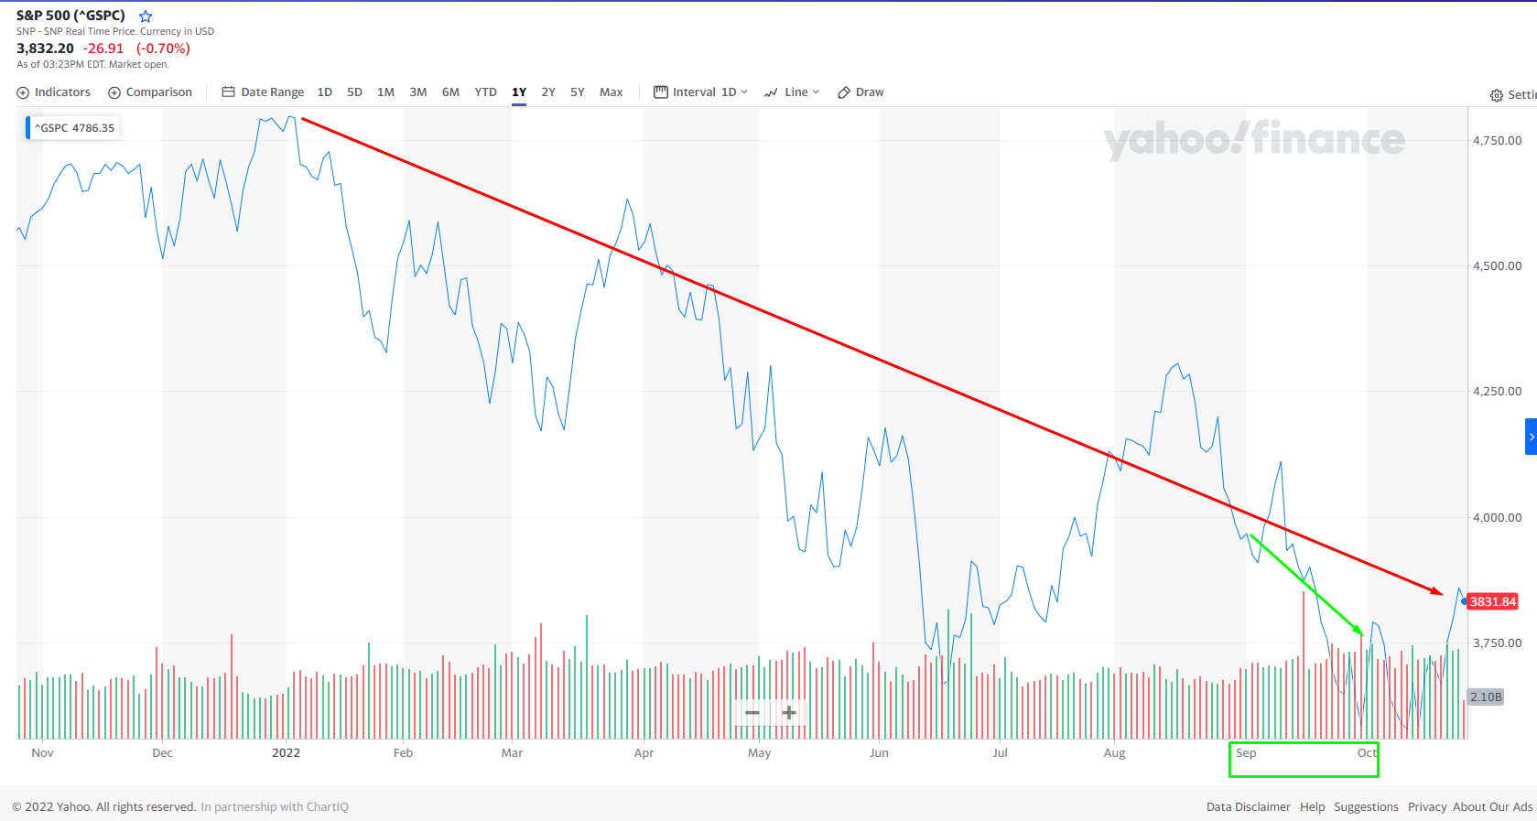
Why Invest?
S&P 500 Max

Slide 14
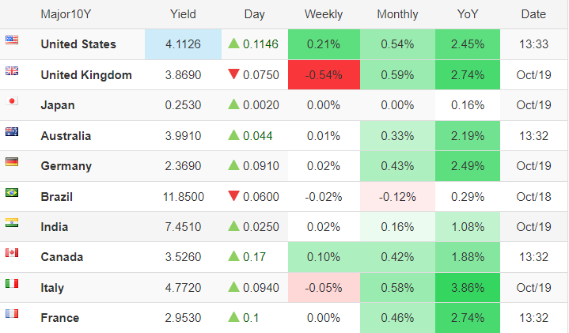

Why Invest?
Alternative jurisdictions to locate your Assets
Clients looking for better income options on their existing retirement savings or a complementary income (from their AFORE/AFP or an inheritance or full insurance or cash on top of their emergency fund or an alternative investment to their current portfolio).
Very low and negative fixed rates in general.
Take advantage of tax benefits when planning your financial future.

Slide 15






Why Invest?
Example of Private Debt's success in DIVERSIFYING your portfolio
Example of how an investor received the following income payments during 2022 with a USD $250,000 investment of when global stock markets were down around 20%
Bond | Annual Return | Weighting | Investment Amount | Annual Income
URBAN VILLAGE | 8.00% | 16.67% | USD 41,666.67 | USD 3,333.33
LINKLEASE FINANCE PLC | 9.00% | 16.67% | USD 41,666.67 | USD 3,750.00
POPIFI BONDS PLC | 8.10% | 16.67% | USD 41,666.67 | USD 3,375.00
LONDON RICHMOND | 10% | 16.67% | USD 41,666.67 | USD 4,166.67
ZENITH ENERGY | 10.375% | 16.67% | USD 41,666.67 | USD 4,322.92
WOODVILLE | 11% | 16.67% | USD 41,666.67 | USD 4,583.33
Total Gross Return | USD 23,531.25

Slide 16
03
What is Corporate Debt?
KNG International Advisors

Slide 17
Corporate Bonds
What is a Bond?
Bonds are debt securities issued usually by corporations and governments - a loan with a promise to pay a specified interest for a specified term. A bond has various regulatory requirements that numerous counterparties, such as the respective stock exchange where the bond is to be quoted on an open secondary market or the clearing systems such as Euroclear, Crest, etc.
Credit Ratings
The highest rating is generally considered AAA, and the lowest is C or D. A rating provided by a third party auditor provides an unbiased option of the financial outlook of the company and hence the likelihood of paying coupons on time and capital back at maturity. There are numerous credit rating agencies, some more known than others. E.g S&P, Moodys, AM Best, Fitch, Euroratings, Next Wave, BCR etc
Senior Secured Bonds
A senior secured bond structure is widely used by SMEs to raise capital as investor capital is backed by physical assets or company bank accounts from the operating company. Such assets are placed into Trust o SPV managed by a regulated security trustee who has first lien or first legal charge over the assets in case of default. In the case of a default, the trustee sells the assets and priority of payment is given to the senior bondholders who are the first to be compensated.
Secured Bonds
A Secured bond means that the debt is secured by a specific asset owned by the issuer. It serves as collateral for the
loan. If the issuer defaults on the loan, title to the asset is transferred to the bondholders.

Slide 18
Corporate Bonds
Loan Notes
Loan Notes are private debt structures not listed on a stock market exchange and therefore have less o zero liquidity prior to maturing. They are can transferred to a new owner if required under a private contract. They are quicker and less costly to set up than bonds and hence tend to offer higher annual coupons over a reduced term than bonds. Loan notes can be Secured or Unsecured and the debt can also be insured by a specialized insurance company to add further protection for Investors. Un-secured Bonds
A Un-secured Bond relies on the future revenues of the operating company and in case of a default falls under secured debt. A credit rating is a very important source from a third party as a measure of the financial strength and security of the company.
Subordinate Bonds - A Subordinat Bond is a debt paid when others creditors are fully re-imburse.
Convertible Bond
A convertible bond is a fixed-income corporate debt security that yields interest payments, this can be converted into a
pre-determined number of common stock or equity shares at maturity rather than recieving cash. This gives the Investor the potential upside of capital growth as well as the fixed income.
Stocks/Shares
Stocks and shares represent equity ownership in a corporation or financial asset, owned by investors who exchange capital in return for these units. Each investor in a company owns a fraction of that company. Ordinary shareholders are often the last creditors to be compensated in the event of bankruptcy. Preferential shares

Slide 19


Investment-Grade
Corporate Bonds

Slide 20
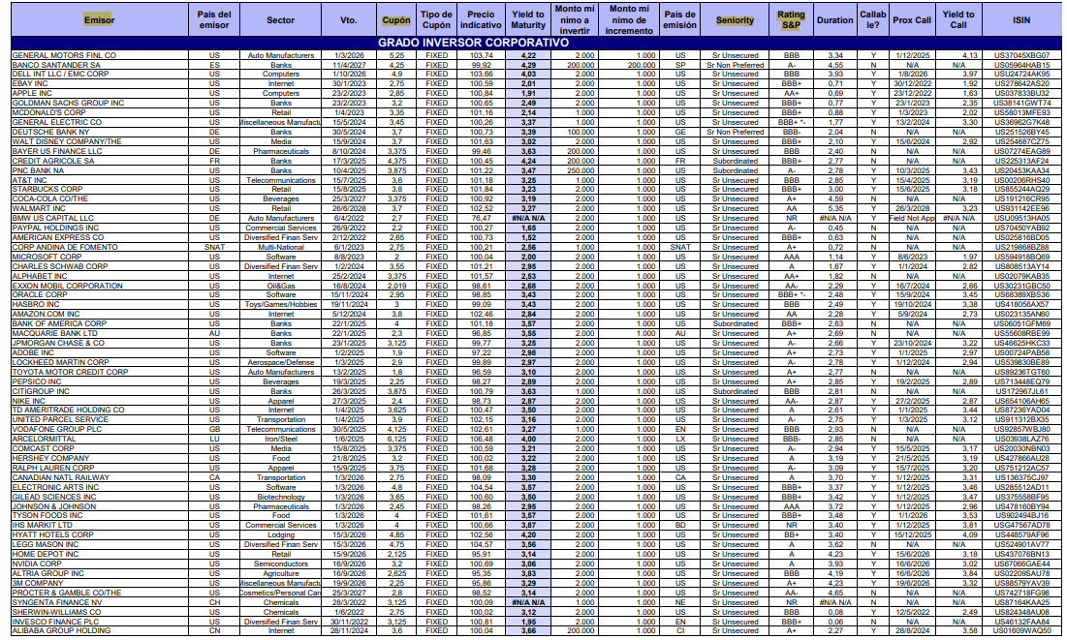
Investment Grade Corporate Bond

Slide 21
High Yield Bonds &
Loan Notes

Slide 22
High Yield Bonds and Loan Notes
The bridge between fast growing companies and global investors
Fast Growing Small Medium Enterprises
Massive demand from SMEs but banks don´t issue debt nor do they lend
For many companies it is the only and the quickest option of finance
Debt is still cheaper than equity
Investors Growing Appetite for Non Correlated Investments
Many mature investors are looking for high fixed income that beats inflation
Demand for secure, asset backed (under English law) rated solutions
High level of investor protection and security
Predictable returns with no volatility

Slide 23
High Yield Bonds and Loan Notes
Essential characteristics we use to choose quality private debt
Senior Secured Debt
Asset-backed under English law (strict, fast and efficient law)
Remote bankruptcy structure - a PLC or SPV with no assets, no liabilities, but has the first lien or charge over the assets of the underlying operating company that receives the finance
Well known and FCA regulated Security Trustee has first lien or charge of all the operating company´s accounts and assets in case there is a default.
If a Security Trustee is not in place we require a A-Rated Insurance company to insure the debt to protect investors
Annual external audits to provide a Credit Rating by a proven and internationally accepted agency.
Term maturities of 12 months up to 5 years - liquidity of full capital at maturity.
Interest coupons paid either quarterly, half yearly or yearly (the more frequent the more attractive).
Highly recognised UK lawyer firm responsible for the Investment Memorandum and debt structure.
Well known and FCA regulated Registrars - register bondholders, calculate register and pay interest coupon payments.
Bonds are listed on a recognised European stock exchange such as Frankfurt or Ireland
Low investment minimums, typically from $1,000 USD via investment platform, so investors can diversify across several bonds, mitigate risk and reinvestment of the income produced. (Direct investment typically between $100,000 USD to $250,000 USD).
Buy in and sell at Par (platforms show secondary market prices after bond purchase)
Transferable but NOT liquid until maturity

Slide 24
High Yield Bonds and Loan Notes
Essential characteristics we use to choose quality private debt
Operating Company Due Diligence
Companies must be in a high growth sector.
Revision of Director/CEO/Owners CVs and verification of their successful track record in the specific sector.
Companies with a quantifiable and proven successful business model and manageable debt strategy.
Company assets valued over the value of the debt in a secondary market
Access and revision of financial statements and balance sheets through Companies House
Proven track record of prompt coupon payment (LSE –CLICK) and ability to pay back debt
Regular meetings and updates with corporate management of the company.
We don’t work with Start Ups

Slide 25
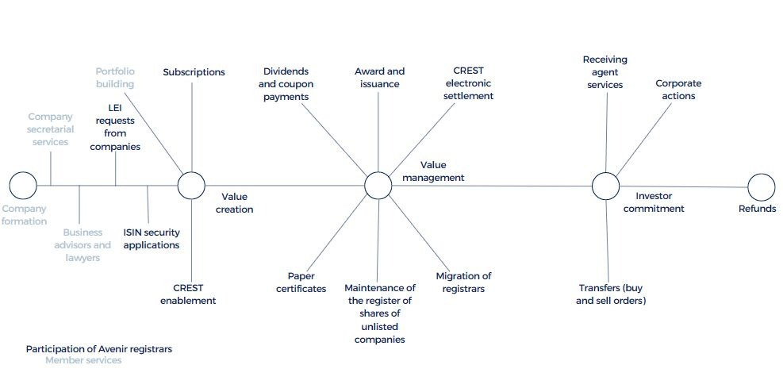








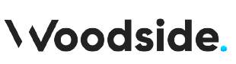
Corporate Bonds Direct From the Issuer
RESPONSIBILITIES OF THE REGULATED COUNTERPARTIES – that surround the management of the debt.
- The Registrar

Slide 26
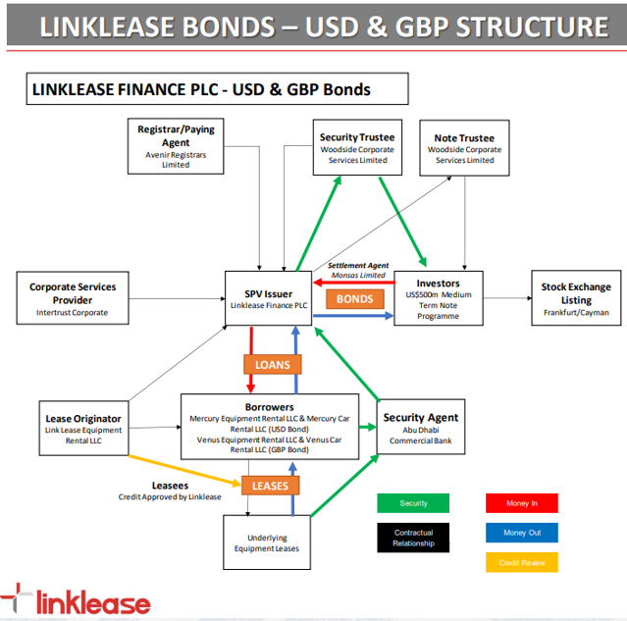
Corporate Bonds Direct From the Issuer
Example: How is a Senior Secured Bond Structured? (con Linklease Finance Plc)
Linklease Finance PLC is a vehicle created specifically for debt issuance and is bankruptcy remote. This is to separate the risk of the sponsor (Linklease) from the risk of the bond issuer.
In order to offer greater protection to the bondholders, the borrowers were incorporated as separate SPVs. This allowed for the ring-fencing of the assets of each of the Bonds. This has been structured in a way that protects the bondholders, who have security over the assets and leases of the bonds in which they have invested. It also ensures that the assets are segregated from Linklease's existing portfolio. All of the borrower's assets, shares and bank accounts are pledged in favor of the issuer.
The security and note trustee is there solely to act on behalf of the bondholders in the event of default (including nonpayment of a coupon or principal to the bondholders). The trustee for these bonds is Woodside Corporate Services. It is based in the United Kingdom and is regulated by the FCA. In the unlikely event of default, the trustee would have the option to proceed with the sale of the asset portfolio and the leases.
The bail trustee will be supported by a security agent. The security agent can seize assets, stocks and bank accounts on behalf of the bond trustee. The trustee would then arrange for the bondholders and creditors to be paid. In the case of Linklease Finance PLC, the security agent is Abu Dhabi Commercial Bank (ADCB), one of the leading banks and brokers in the region.
Structture
Network borrower
Trustee
Security Agent

Slide 27

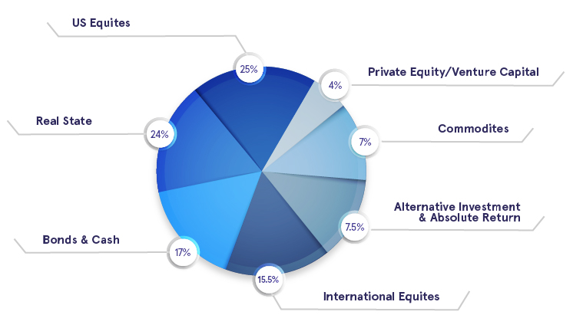
Harvard University and its investment allocation
Prestigious institutions such as Harvard and Yale University, along with pension funds, are highly recognised for their portfolio diversification.

Slide 28
04
A Portfolio that Produces a Regular Income in Hard Currencies
USD EUR GPB
KNG International Advisors

Slide 29
Reduce Concentration Risk & Diversify
Mitigate Risk by investing in up to 10 different Bonds and Loan Notes
Diversify across different industry sectors
Diversify the coupon payment frequency
Diversify the issuer
Diversify the geographic region
Diversify the maturity terms to scale and increase liquidity
Diversify the security trustees
Bodysmart 12% pa 2025
Urban Village 8% - 10% pa Flexi Note 5 years
Linklease 9% pa 2023
78th Group LL5 15% pa 12 months
Zenith 10.375% pa 2026
Woodville 11% pa 2024
London Richmond 10% pa 2025
78th Group CM3 17% pa 12 months
Propifi 8.1% pa 2025
Zenzic 7.25% pa 2026

Slide 30
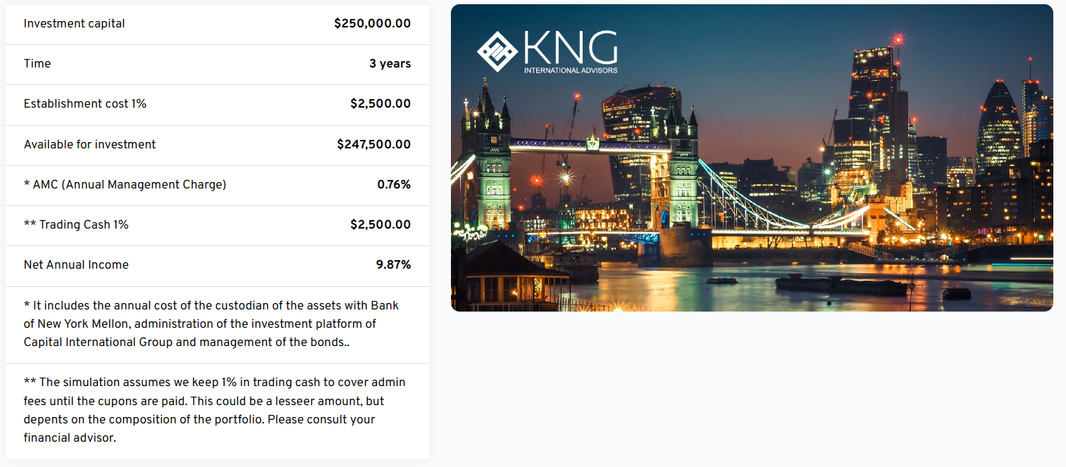
Corporate Bonds Direct From the Issuer
Example of a diversified investment portfolio in Fixed Income assets using the Fixed Income Simulator on the KNG broker portal

Slide 31
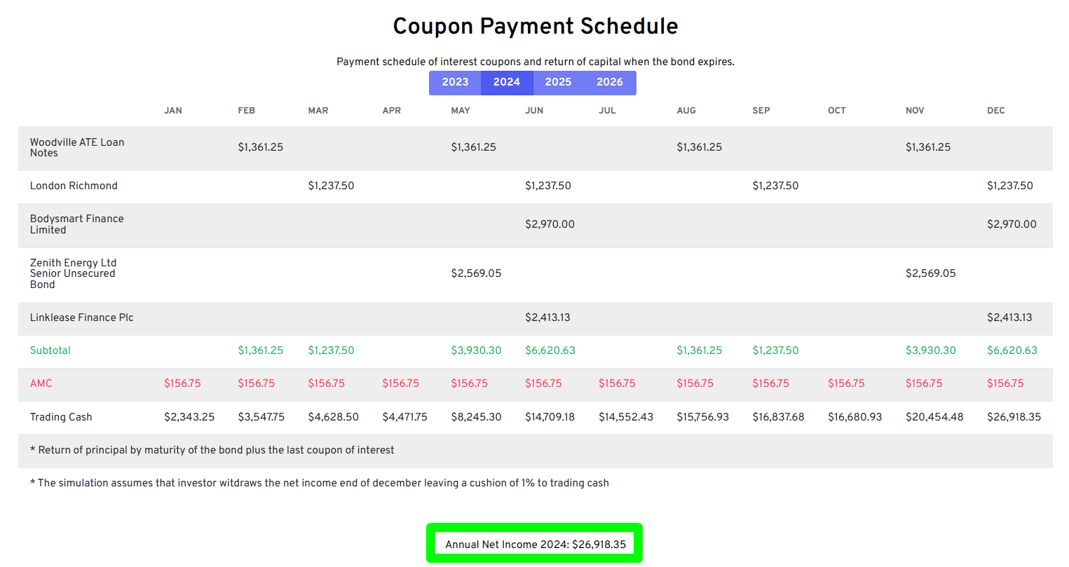
Corporate Bonds Direct From the Issuer
Example of how an investor can receive a regular income from a diversified investment

Slide 32
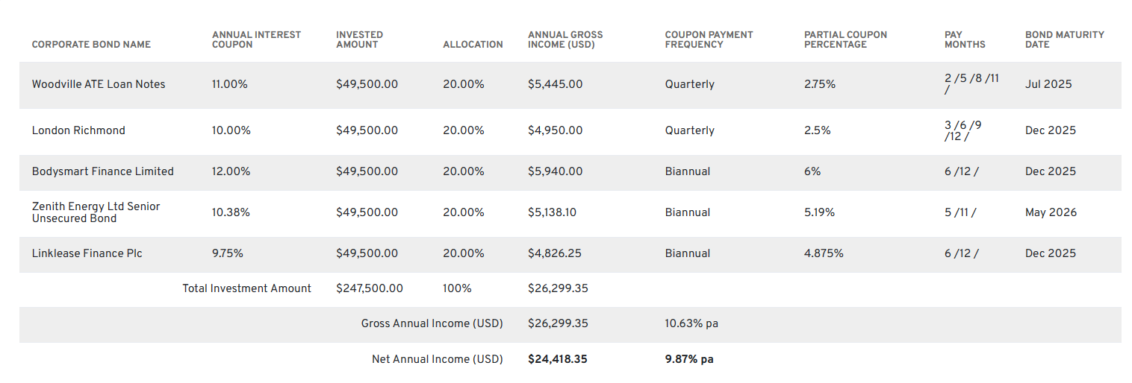
Corporate Bonds Direct From the Issuer
Diversified portfolio details, terms, payment dates, maturities, gross & net income.
You can also take the option to reinvest the income AND GAIN A COMPOUND RETURN

Slide 33
05
How to Invest?
KNG International Advisors

Slide 34

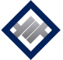
How to Invest?
Open a personal or corporate investment account with the international open architecture investment platform:
Established in 1996.
Member of the London Stock Exchange.
Licensed and Regulated - Isle of Man Financial Services Authority.
Headquartered in Isle of Man, UK.
Regulated offices in Cape Town & Johannesburg, South Africa.
200+ employees.
$5 billion under management.
Bank license (1.2 banking license).
AA+ S&P credit rating.
100% of capital managed in segregated accounts under custody (BNY Pershing - $42 trillion under custody).
Personal Application Requirements
Notarized ID / selfie with ID.
Notarized proof of address in applicant's name / selfie with POA (legible).
Bank statement - showing funds to invest before they are transferred.
Financial institution applications and forms
Corporate Application Requirements
Certificate of incorporation.
Memorandum and Articles of Association.
Register of shareholders.
Register of directors.
List of authorized signatures of the company.
Verification of the ID and POA of any shareholder holding 25% or more of the issued shares.

Slide 35
Why and How to Invest?
Capital International Group
Minimum $50,000 USD
Open Architecture Plataform:
You can buy and sell assets from any country:
Stocks
Investment grade bonds
High yield bonds
Mutual funds
ETFs and ETCs
Structured Notes
Alternative investment funds.
The ideal minimum investment is $100,000 USD
Segregated accounts by law in IOM, UK to protect investors.
All assets are held under custody with Pershing ($42 trillion under custody)
Online valuations.
Online Trading / Email /Tel
Multi-Currency
Tax benefits within the platform
Multiple co-owners for succession of assets.
Platform Fees | CIG 0
Establishment Fee Charged to the CASH CREDIT REDEMPTION account | 1% set-up fee on the amount invested. 1% is set aside into the Credit Redemption Account and charged at 0.25% annually for approx. 4 years until it’s used up.
Advisor Fee Charged to the CASH TRADING account | Up to 1.5% pa . The proportional amount is charged monthly.
Custodian Cost Charged to the CASH TRADING account | 0.26% pa with a minimum amount of £220 per year The proportional amount is charged monthly.
Dealing Fee Charged to the CASH TRADING account | Equities/Bonds/Notes/Alternatives 0.25% | Collectives/UCITS Funds etc £35

Slide 36
Why and How to Invest?
Capital International Group
Minimum $50,000 USD
Open Architecture Platform:
You can buy and sell assets from any country:
Stocks
Investment grade bonds
High yield bonds
Mutual funds
ETFs and ETCs
Structured Notes
Alternative investment funds.
The ideal minimum investment is $100,000 USD
Segregated accounts by law in IOM, UK to protect investors.
All assets are held under custody with Pershing ($42 trillion under custody)
Online valuations.
Online Trading / Email /Tel
Multi-Currency
Tax benefits within the platform
Multiple co-owners for succession of assets.
3 Establishment Collection Structures | CIG 7 | CIG 4.5 | CIG 0
Initial Commission | Agent charges 100% upfront commission | Agent charges 50% upfront commission | Agent charges 0% upfront commission.
Credit Redemption Account | 8.5% set-up fee on the amount invested. 8.5% is set aside into the CRA and charged at 1.45% annually for approx. 5 years until it’s used up. | 6% set-up fee on the amount invested. 6% is set aside into the CRA and charged at 1% annually for approx. 5 years until it’s used up. | 1% set-up fee on the amount invested. 1% is set aside into the CRA and charged at 0.25% annually for approx. 4 years until it’s used up.
Advisor Fee Charged to the CASH TRADING account | Not available | Up to 1.5% pa The proportional amount is charged monthly. | Up to 1.5% pa The proportional amount is charged monthly.
Custodian Cost Charged to the CASH TRADING account | 0.26% pa with a minimum amount of £220 per year The proportional amount is charged monthly. | 0.26% pa with a minimum amount of £220 per year The proportional amount is charged monthly. | 0.26% pa with a minimum amount of £220 per year The proportional amount is charged monthly.
Dealing Fee Charged to the CASH TRADING account | Equities/Bonds/Notes/Alternatives 0.25% Collectives/UCITS Funds etc £35 | Equities/Bonds/Notes/Alternatives 0.25% Collectives/UCITS Funds etc £35 | Equities/Bonds/Notes/Alternatives 0.25% Collectives/UCITS Funds etc £35

Slide 37
06
Contact information and
Social Networks
KNG International Advisors

Slide 38
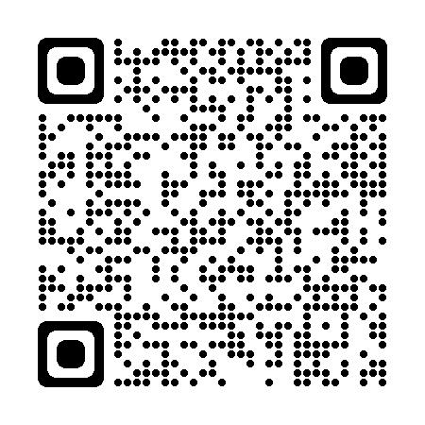
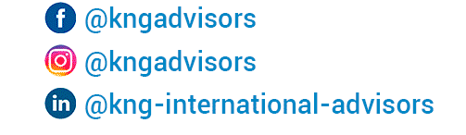
Follow us
By following us you will get
Weekly reports with the most relevant information on the international financial market.
Notifications of global investment opportunities
Notifications of interest coupon payments on high-yield corporate bonds
Personal financial intelligence tips
Webinars with fund managers and bond issuers from London, Switzerland and NY

Slide 39
Contacto
TAKE THE NEXT STEP
Make a free Appointment
For more information, details of the funds and their performance, customized projections and free advice please contact us:
Cancún, Mexico Neil Emberson Head Office UK: (+44) 207 183 3787
Oficina principal México:(+52) 998-500-1627
Directo: (+52) 998-580-5896
Email: n.emberson@kngadvisors.co.uk
www.kngadvisors.co.uk
info@kngadvisors.co.uk
Mexico
Cancún
Playa del Carmen
Ciudad de México
Monterrey
Mérida
Guadalajara
Costa Rica
San José
Colombia
Bogotá
Medellín
Panama
Ecuador
Quito
Guayaquil
Chile
Santiago
Puerto Vara
Peru
Lima
Cusco
Puno
Arequipa
Africa
Zambia
Kenya
Argentina
Buenos Aires
UAE

Slide 40
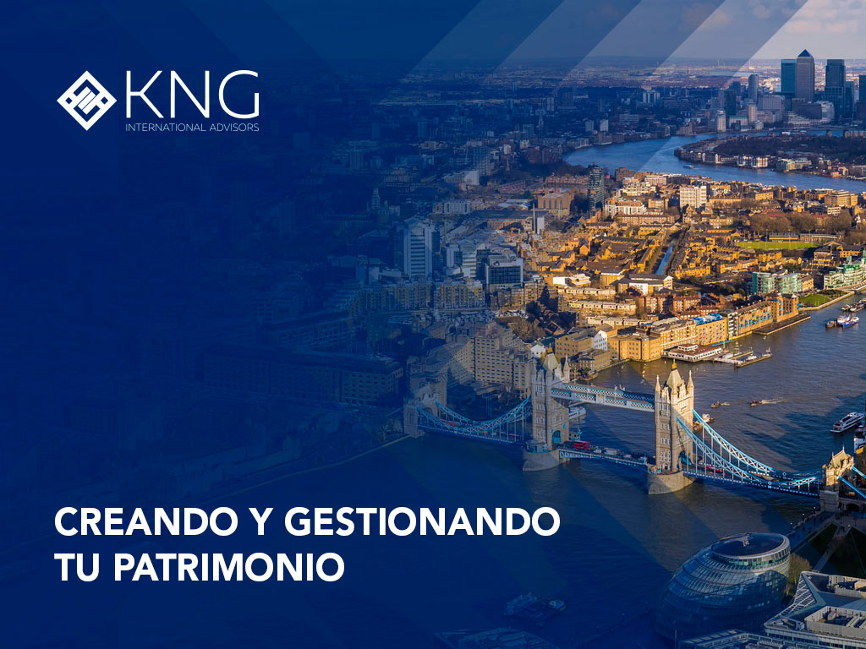
Thank you for your Attention
End of the Presentation

