Slide 1


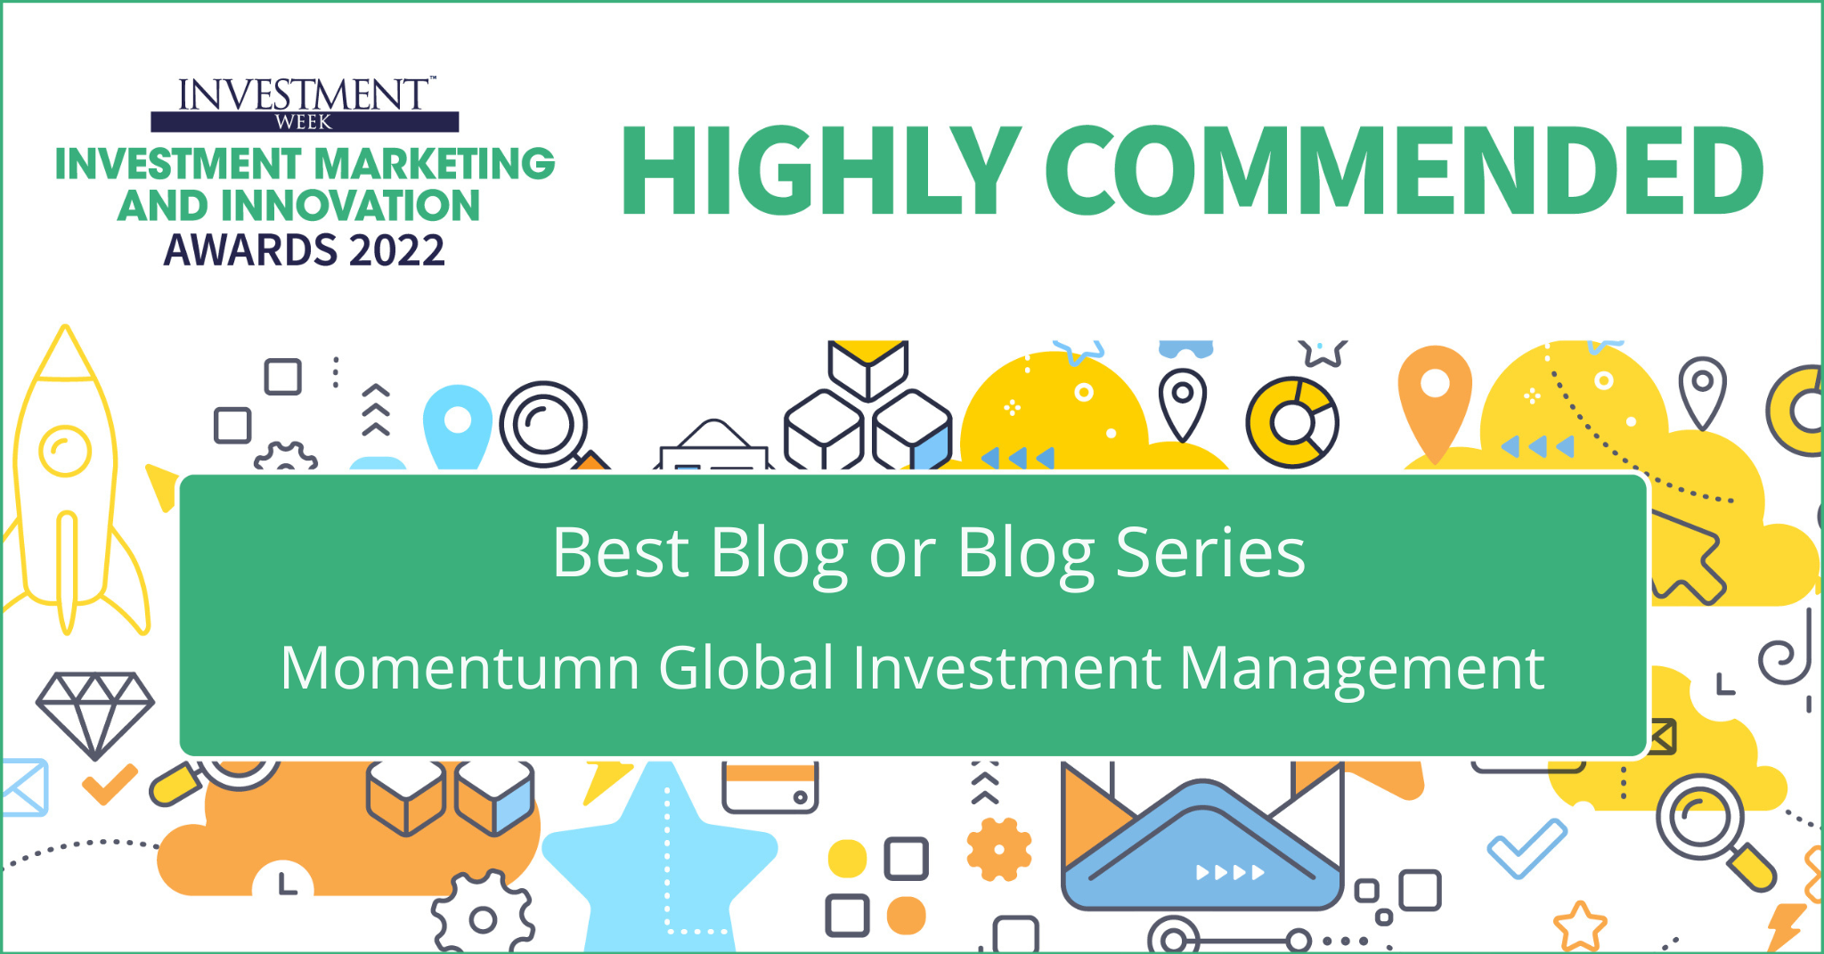

Momentum GF Global Sustainable Equity Fund
September 2022

Slide 2
Momentum Global Investment Management ‘MGIM’

Slide 3




Our Credentials
Momentum Global Investment Management
Founded in
1998
$5.3Bn
AUM
Core focus on
Multi-Asset
Boutique approach
with global backing
Source: Momentum Global Investment Management as at 31 August 2022.

Slide 4
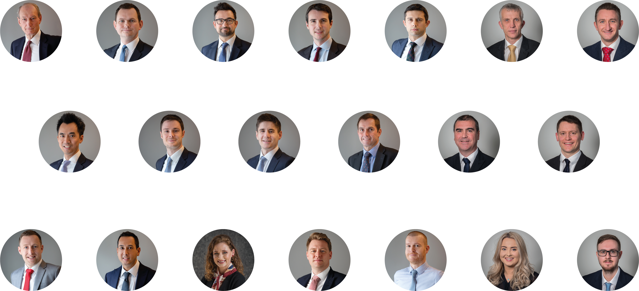
Investment Management Team
Glyn Owen
Investment Director
Andrew Hardy, CFA
Director of Investment Management
Alex Harvey, CFA
Senior Portfolio Manager & Investment Strategist
Richard Stutley, CFA
Portfolio Manager
Robert White, CFA
Senior Analyst
Richard Parfect
Fund Manager
Mark Wright, CFA
Fund Manager
Stephen Nguyen, CFA
Portfolio Strategist
Lorenzo La Posta, CFA
Portfolio Manager
Jackson Franks
Analyst
David Lashbrook, CFA
Director of MAREF
Gary Moglione
Fund Manager
Tom Delic
Fund Manager
Sean Colgan
Systems & Data Management Analyst
Kevin Seepaul
Head of Systems &
Data Management
Natalie Harrison
Global Fund Specialist
Greg White
Senior Dealer
James Jones
Senior Dealer
Gabby Byron
Investment Services Executive
Matt Connor
Investment Analyst

Slide 5
Momentum
Global Sustainable Equity Fund

Slide 6

Momentum GF Global Sustainable Equity Fund
Systematic. Multi-factor. ESG.
Actively managed strategy
Broadly diversified by sectors, countries and style factors
Aims to outperform the MSCI World Index…
…whilst maintaining at least a 20% improvement on sustainability metrics
Systematic portfolio construction
Article 8 Fund under EU Sustainable Finance Disclosure Regulation (’SFDR’)
Daily traded/priced UCITS fund, with AUM of $365m*
Estimated Ongoing Charge Figure (OCF) of 1.20%**
*As at 30 September 2022 **Share Class (A) as at September 2022.

Slide 7
Harvesting style risk premia…
The strategy focuses on stocks with the most attractive style characteristics
(Low) Valuation
(High) Quality
(Strong positive) Momentum
These three targeted factors have consistently outperformed over the long term, evidenced by academic research and realised strategy returns
Their low to negative correlation with each other also creates a strong diversification benefit
Source: Momentum Global Investment Management, Factset, February 2022. For illustrative purposes only.

Slide 8
…whilst integrating sustainability
Article 8 ‘ESG integrated’ status under EU SFDR
ESG related objectives hard-coded into the fund mandate:
>20% reduction in environmental footprint vs. MSCI World Index, across:
Greenhouse gases (scope 1 and 2 emissions)
Water usage
Waste generation
>20% improvement in portfolio ESG score vs MSCI World Index
Absolute exclusion of businesses with revenue derived from areas including:
Coal production
Tobacco products
Palm oil production
Firearms production

Slide 9
Portfolio style weightings vs. selected sustainable / ESG integrated peers
Results in well balanced style exposure
Source: Momentum Global Investment Management, Morningstar, February 2022, for illustrative purposes only.

Slide 10



Footprint intensity
WASTE
GENERATION
WATER
USE
26.5%
BELOW
58.6%
M³/mUSD invested
2,513.4 compared to 6,064.9
21.9 compared to 29.8
BELOW
22.4%
BELOW
tCO2eq/
mUSD invested
40.5 compared to
52.2
Tons/mUSD invested
GREENHOUSE GAS EMISSIONS SCOPE 1&2
Source: Momentum Global Investment Management, Robeco. Positioning as of September 2022. All Data is measured vs. MSCI World Index

Slide 11
An active fund
Top Active Weights positioning to 30 September 2022
Active Share
Measures how different the portfolios is from benchmark
Top Overweight
Benchmark portfolio
Stock A
Stock B
Stock C
Stock D
Stock E
72%
overlap
Stock G
Stock F
Top Underweight
28%
active share
Stock H
Momentum GF
Global Sustainable Equity
Source: Momentum Global Investment Management, Robeco. Positioning as of 30 September 2022.

Slide 12
Highly Diversified
Country Allocations allocations to 30 September 2022
Regional Allocations allocations to 30 September 2022
Country Allocation | Portfolio (%)
United States | 70.4
Japan | 6.4
United Kingdom | 4.7
France | 3.4
Canada | 3.0
Switzerland | 2.4
Australia | 1.9
Germany | 1.8
Netherlands | 1.5
Italy | 0.9
Sweden | 0.7
Spain | 0.6
Denmark | 0.5
Singapore | 0.5
Hong Kong | 0.5
Norway | 0.2
Finland | 0.2
Israel | 0.1
Belgium | 0.1
New Zealand | 0.1
Portugal | 0.0
Austria | 0.0
Ireland | 0.0
Source: Momentum Global Investment Management, Robeco. Positioning as of 30 September 2022.

Slide 13
Highly Diversified
Top Ten Holdings positioning to 30 September 2022
Sector allocation positioning to 30 September 2022
Stock | Portfolio
Apple Inc | 4.6%
Microsoft Corporation | 3.6%
Amazon.com Inc | 2.3%
Alphabet Inc A | 1.4%
Tesla Inc | 1.3%
Alphabet Inc C | 1.2%
UnitedHealth Group Incorporated | 1.1%
Exxon Mobil Corporation | 0.8%
Berkshire Hathaway Inc B | 0.7%
Nestle SA | 0.7%
Source: Momentum Global Investment Management, Robeco. Positioning as of 30 September 2022.

Slide 14
Performance (Share Class A)
Developed markets track record performance to September 2022
Net Performance (Cumulative) to 30 September 2022
Risk/return of the strategy since 2004*.
Tracking error
1.2%
Outperformance
-0.3%
Information ratio
-0.2
Net Cumulative Performance (Annualised) to 30 September 2022
1yr | 3yrs | 5yrs | 10yrs | Since Inception
-18.0% | 3.1% | 3.7% | 7.7% | 7.7%
Source: Robeco. Performance shown is the live track record for the Robeco Global Developed Enhanced Indexing Equities composite to April 2020, a similar strategy to our Global Sustainable Equity Fund, after April 2020 performance is that of the Momentum GF Global Sustainable Equity Fund. The fund was launched on 19 May 2020. Performance is shown net of management fees in USD terms for Share Class A. Benchmark is MSCI World Index Net Return. Past performance is not indicative of future returns. *Since Inception date November 2004.
Net Discrete Performance to 30 September 2022
Sep 21 – 22 | Sep 20 - 21 | Sep 19 - 20 | Sep 18 - 19 | Sep 17 - 18
-18.0% | 27.7% | 4.8% | -1.1% | 10.7%

Slide 15
Performance (Share Class I)
Developed markets track record performance to September 2022
Net Performance (Cumulative) to 30 September 2022
Risk/return of the strategy since 2004*.
Tracking error
1.2%
Outperformance
0.5%
Information ratio
0.4
Net Cumulative Performance (Annualised) to 30 September 2022
1yr | 3yrs | 5yrs | 10yrs | Since Inception*
-17.4% | 4.0% | 4.6% | 8.5% | 8.6%
*The Momentum GF Global Sustainable Equity Fund Share Class R. Historical performance is composed of the following components: 1) Prior to 19 May 2020 (Nov 2004 to May 2020) is the live track record for the Robeco Global Developed Enhanced Indexing Equities composite; 2) 19 May 2020 to 06 June 2021 is that of the Momentum GF Global Sustainable Equity Fund Share Class I; 3) 7 June 2021 to present is that of the Fund Class I. Performance is net of management fees in USD terms and have been adjusted to incorporate the prevailing fees for Class I. Benchmark is the MSCI World Index Net Return. Past performance is not indicative of future returns. Since Inception date November 2004.
*Since Inception date 07 June 2021.
Net Discrete Performance to 30 September 2022
Jun 21 - 22 | Jun 20 - 21 | Jun 19 - 20 | Jun 18 - 19 | Jun 17 - 18
-17.4% | 28.9% | 5.6% | -0.3% | 11.5%

Slide 16

Summary
Systematic approach ensures consistent factor exposure which drives outperformance
Proven ability to deliver through a range of market environments
Broadly diversification limits idiosyncratic risk
Low cost, yet a truly active strategy
ESG integration without style or sector concentration
These attributes make the
Momentum GF Global Sustainable Equity Fund
- an ideal core solution -
for developed market equity exposure

Slide 17
Sustainability

Slide 18



Sustainable Finance Disclosure Regulation
SFDR
The SFDR goes hand in hand with the EU Sustainable Finance Action Plan. It aims to promote sustainable investment and a new fund taxonomy to create a level playing field across the whole EU.
Momentum GF Global Sustainable Equity Fund attained
Article 8 status
effective 01 October 21
ARTICLE 6 FUNDS
ARTICLE 8 FUNDS
ARTICLE 9 FUNDS
Cannot promote ESG characteristics
ESG integrated
Sustainable Objective

Slide 19
Q3 2022
Voting & Engagement
Withhold, 1
Abstain, 7
Other, 1
48
shareholder meetings
603
votes cast
Company | Voting Highlight
Sainsbury | ShareAction co-filed a resolution, the first of this kind in the UK, asking the company to pay the real Living Wage to all workers by becoming a Living Wage accredited employer. Robeco supported the resolution for numerous reasons. By formalizing the payment of living wages through the Living Wage accreditation will ensure accountability to continue paying it in the future. Additionally, this accreditation could become a competitive advantage for the company in the current tight labor market, particularly given that many of its peers do not seem to be accredited organizations. This could signal a commitment to higher and more fair wages, making easier to attract and retain employees. Although the resolution failed to pass it opened up the dialogue on the social commitment of companies in the industry amidst the cost of living crisis.
… and more | …
Source: Robeco, as of September 2022.

Slide 20



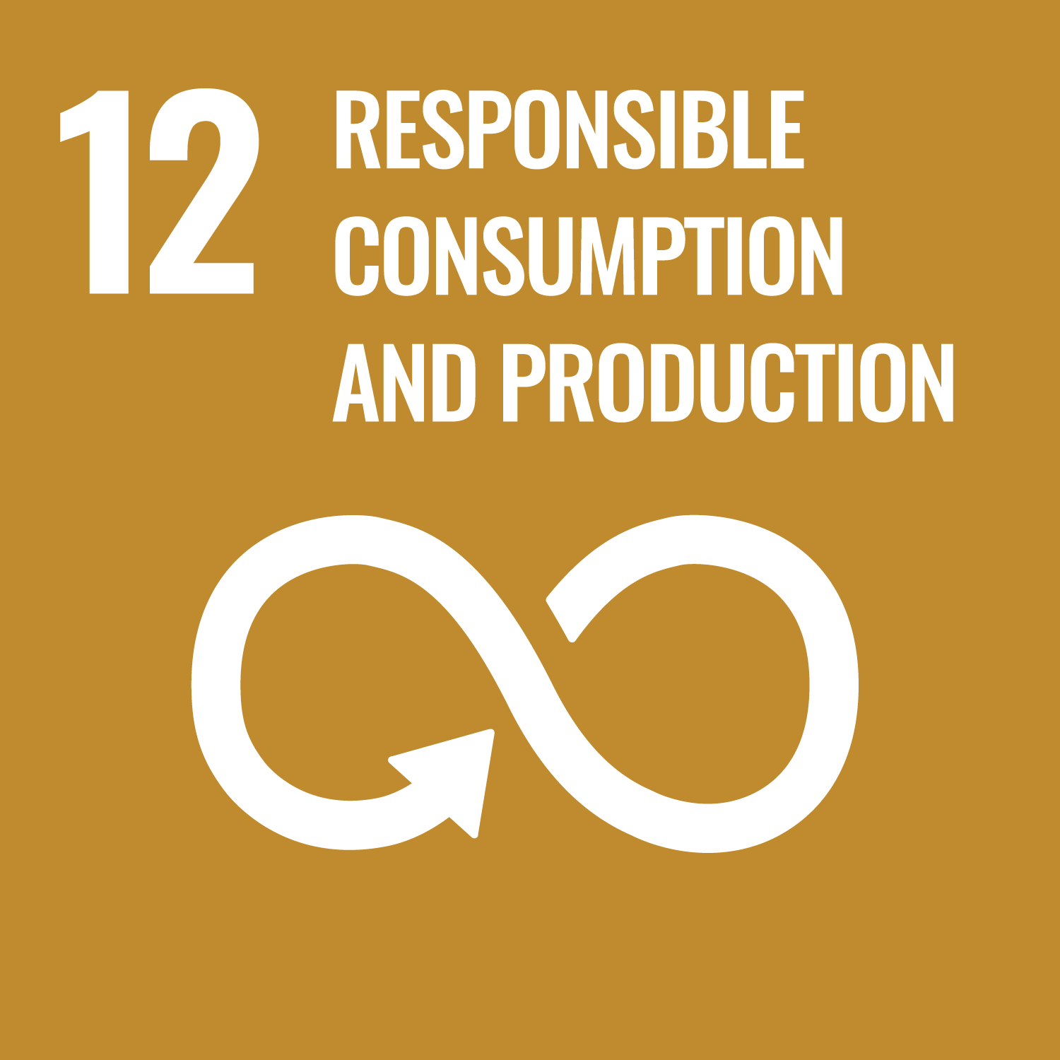













Parts of the portfolio with positive impact on achieving global prosperity
Sustainable Development Goals
Basic needs: 28%
Healthy planet: 9%
Sustainable society: 85%
Robust institutions: 4%
Equality & opportunity: 22%
The numbers in percentage indicate the aggregate portion of the portfolio having a positive impact towards any of the SDGs included in a certain category. Source: Robeco, as of 30 September 2022.

Slide 21
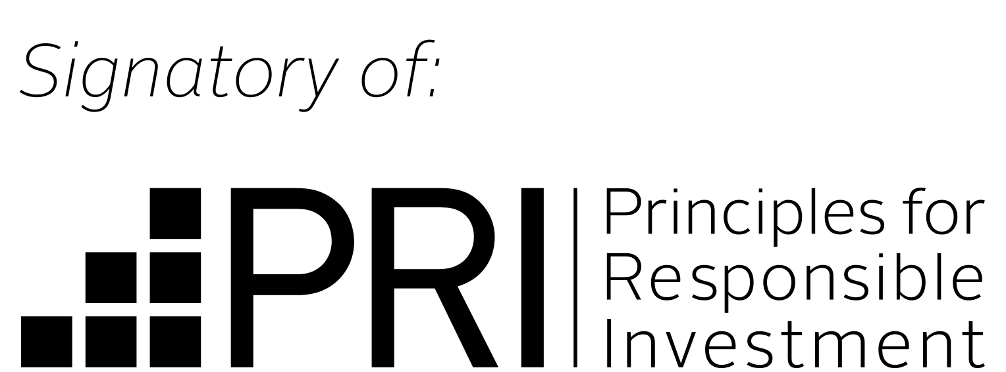

Our goal posts to support responsible investments
Responsible investing at Momentum
Investments are allocated to well-governed and sustainable companies
Responsible investment
Report progress
Regulation and codes
Advocacy
Seek disclosure
Active owners
ESG integration
Report progress on and discuss responsible investments with clients
Contribute to creating a well-balanced economy
Support bodies promoting responsible investment (UN PRI and UK Stewardship Code)
Disclosing information creates accountability and engagement
Our Responsible Investment Committee oversees policies, practices and goals
Supporters of:
Source: Momentum Global Investment Management

Slide 22
Appendix

Slide 23
Key Features
01.
02.
03.
Actively managed global equity strategy available at a very low, passive like cost level.
Focused on businesses with better than average ESG (environment, social, governance) scores…
…and with lower environmental footprints (greenhouse gases, waste and water impact)
04.
05.
06.
Well diversified across all major developed market sectors and regions, with approximately 760 direct stock holdings
Multi-style approach (growth, value, quality, size) designed to outperform the MSCI World index over a rolling 3-year period
Strategy implemented by Robeco, a world class quantitative investment specialist
ABOUT ESG
ESG refers to three factors which are central to a class of investing also known as “sustainable investing.” This approach to investing incorporates a detailed assessment of a business’s governance practices as well as its long-term impact on society and the environment. While these are mostly non-financial factors, businesses with higher ESG standards are considered to be less risky and more likely to succeed in the long run.

Slide 24







Positive / negative screening
Unbiased scoring
Materiality
Enhanced engagement
Sustainability inside
20% lower
environmental footprint
20% better
ESG Score
E
S
G
ACCESS DENIED*
Global Compact
Breaches
Tobacco
Coal
Controversial weapons
Military contracting
Firearms
Nuclear
Power
Palm
Oil
* No exposure to businesses deriving significant revenue from controversial areas. Revenue threshold for exclusion varies per activity but is 10% or less for all listed areas, except 30% in the case of nuclear power (production)

Slide 25




Systematic Style Exposure
ESG & Quality
Value
Size
Growth
Designed to capture the market return and, in addition, benefit from well-rewarded factor premiums while avoiding non-rewarded risks
Higher allocations than the benchmark to stocks with attractive characteristics
This systematic approach aims to deliver stable outperformance after costs compared to capitalization weighted market indices, with a low tracking error
Factors tested over time and used since inception of the enhanced index strategy in 2004

Slide 26
Portfolio Construction
Enhanced-index approach
=
benchmark as starting point + tilt in favour of attractive stocks
< 0.5%
Deviation at stock level
< 0.5%
Deviation at country or sector level
Monthly
Rebalancing
750
Average number of holdings
30-40%
Active share
1.5-2%
Tracking error
Source: Robeco, Momentum Global Investment management for illustrative purposes only.

Slide 27
Robeco overview
Based in Rotterdam, with 17 offices worldwide
Around 900 employees, of which >200 are investment professionals and >40 are quant professionals
Founded in 1929 as Rotterdamsch Beleggings Consortium
Fully owned by ORIX, a Japanese business conglomerate listed on the Tokyo and New York Stock Exchanges with a market cap of over $20bn.
As of December 2021, the firm managed EUR 201bn:
EUR 84.1bn in quantitative strategies
EUR 195bn in ESG-integrated (environmental, social and corporate governance) strategies
Operating in equities, fixed income and asset allocation
A+ / A score in UN PRI (Principles for Responsible Investment) assessment
Source: Robeco.

Slide 28
25 years of experience in quantitative strategies
About Robeco
1994
1998
Stock Selection Model in Developed Markets
Quant Asset Allocation
1999
Credit Selection Model
2001
Stock Selection Model in Emerging Markets
2002
Launched Core Quant Equities
2006
Launched Conservative
(Low Volatility) Equities
2012
Launched Factor Investing Equities
(2012 Momentum, 2013 Value, 2015 Multi-Factor, 2016 Quality)
2012
Launched Factor Investing Credits

Slide 29
Cautious Pioneers
About Robeco
“
“
Every investment strategy should be research driven (Wim Rauwenhoff, Robeco’s first director (1933 – 1960))
Pioneers:
One of the leaders in quantitative investing for over 25 years
Investing in emerging markets since 1933
First high yield fund in continental Europe
One of the first main asset managers to integrate ESG considerations
Cautious:
Constantly integrating fundamental, quantitative and sustainability research
Strong academic links: many researchers have PhD and/or collaborate with universities
Relentless research: any idea must be tested, proven and constantly improved

Slide 30
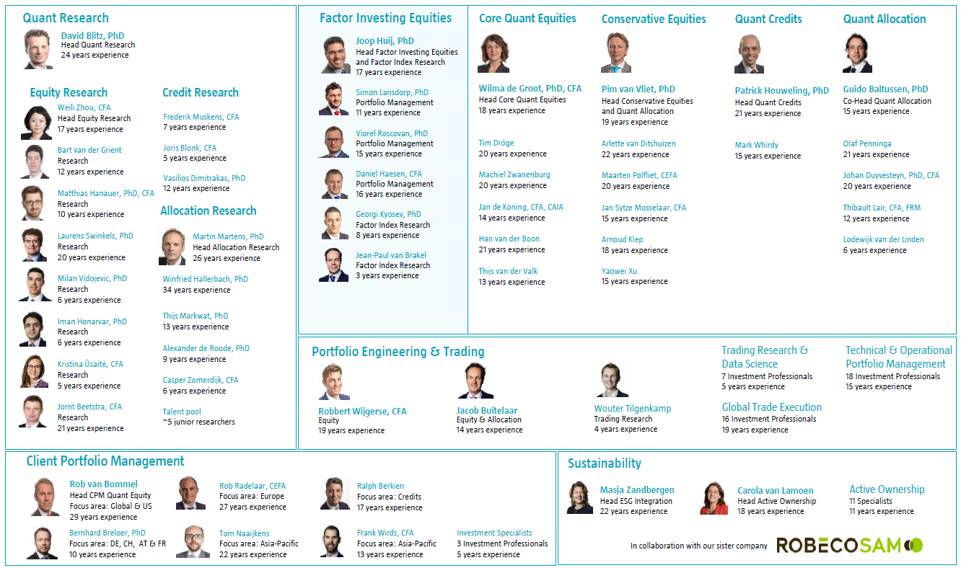
Extensive resource and experience
About Robeco
Source: Robeco

Slide 31



Contact Details & Important Information
Talk to us
+44 (0)207 618 1806
Email us
distributionservices@momentum.co.uk
Visit our website
www.momentum.co.uk
This document is only intended for use by the original recipient, either a Momentum Global Investment Management Limited (MGIM) client or prospective client and does not constitute investment advice or an offer or solicitation to buy or sell. This document is not intended for use or distribution by any person in any jurisdiction in which it is not authorised or permitted, or to anyone who would be an unlawful recipient. The original recipient is solely responsible for any actions in further distributing this document, and in doing so should be satisfied that there is no breach of local legislation or regulation. This document should not be reproduced or distributed except via original recipients acting as professional intermediaries. This document is not for distribution in the United States.
Prospective investors should take appropriate advice regarding applicable legal, taxation and exchange control regulations in countries of their citizenship, residence or domicile which may be relevant to the acquisition, holding, transfer, redemption or disposal of any investments herein solicited. Any opinions expressed herein are those at the date this document is issued. Data, models and other statistics are sourced from our own records, unless otherwise stated. We believe that the information contained is from reliable sources, but we do not guarantee the relevance, accuracy or completeness thereof. Unless otherwise provided under UK law, MGIM does not accept liability for irrelevant, inaccurate or incomplete information contained, or for the correctness of opinions expressed.
The value of investments in discretionary accounts, and the income derived, may fluctuate and it is possible that an investor may incur losses, including a loss of the principal invested. Past performance is not generally indicative of future performance. Investors whose reference currency differs from that in which the underlying assets are invested may be subject to exchange rate movements that alter the value of their investments. For additional risks and disclosures, please refer to the minimum disclosure document available on www.momentum.co.uk
The Momentum GF Global Sustainable Equity Fund is a sub-fund of the Momentum Global Funds SICAV, which is domiciled in Luxembourg and regulated by the Commission de Surveillance du Secteur Financier. The Fund conforms to the requirements of the European UCITS Directive. Prior to investing, investors should read the Key Investor Information Document (KIID) and seek professional investment advice where appropriate. The KIIDs and the Prospectus are available in English at momentum.co.uk
MGIM is the Investment Manager, Promoter and Distributer for the Momentum Global Funds SICAV. MGIM (Company Registration No. 3733094) has its registered office at The Rex Building, 62 Queen Street, London EC4R 1EB. MGIM is authorised and regulated by the Financial Conduct Authority in the United Kingdom (registration no.232357). (SC, A, I, & H)

Slide 32
Contact Details & Important Information
Email us
natalie.harrison@momentum.co.za
Nkosana.nzima@momentum.co.za
Visit our website
www.momentum.co.uk
Talk to us
+44 (0)207 618 1806
This document is only intended for use by the original recipient, either a Momentum Global Investment Management Limited (MGIM) client or prospective client and does not constitute investment advice or an offer or solicitation to buy or sell. This document is not intended for use or distribution by any person in any jurisdiction in which it is not authorised or permitted, or to anyone who would be an unlawful recipient. The original recipient is solely responsible for any actions in further distributing this document, and in doing so should be satisfied that there is no breach of local legislation or regulation. This document should not be reproduced or distributed except via original recipients acting as professional intermediaries. This document is not for distribution in the United States.
Prospective investors should take appropriate advice regarding applicable legal, taxation and exchange control regulations in countries of their citizenship, residence or domicile which may be relevant to the acquisition, holding, transfer, redemption or disposal of any investments herein solicited. Any opinions expressed herein are those at the date this document is issued. Data, models and other statistics are sourced from our own records, unless otherwise stated. We believe that the information contained is from reliable sources, but we do not guarantee the relevance, accuracy or completeness thereof. Unless otherwise provided under UK law, MGIM does not accept liability for irrelevant, inaccurate or incomplete information contained, or for the correctness of opinions expressed. For additional risks and disclosures, please refer to the minimum disclosure document available on www.momentum.co.uk
Collective investments are generally medium to long term investments. The value of units may go down as well as up and past performance is not necessarily a guide to the future. Collective investments are traded at ruling prices. Commission and incentives may be paid and, if so, would be included in the overall costs. All performance is calculated on a total return basis, after deduction of all fees and commissions and in US dollar terms. Forward pricing is used. The Fund invests in other collective investments, which levy their own charges. This could result in a higher fee structure for the Fund. Fluctuations in the value of the underlying funds, the income from them and changes in interest rates mean that the value of the Fund and any income arising from it may fall, as well as rise, and is not guaranteed. Deductions of charges and expenses mean that you may not get back the amount you invested. The fees charged within the Fund and by the managers of the underlying funds are not guaranteed and may change in the future.
The Momentum GF Global Sustainable Equity Fund is a sub-fund of the Momentum Global Funds SICAV, which is domiciled in Luxembourg and regulated by the Commission de Surveillance du Secteur Financier. The Fund conforms to the requirements of the European UCITS Directive. Momentum Global Investment Management Limited (MGIM) is the Investment Manager, Promoter and Distributer for the Momentum Global Funds SICAV. Prior to investing, investors should read the Key Investor Information Document (KIID) and seek professional investment advice where appropriate. The KIIDs and the Prospectus are available in English at momentum.co.uk. MGIM (Company Registration No. 3733094) has its registered office at The Rex Building, 62 Queen Street, London EC4R 1EB. MGIM is authorised and regulated by the Financial Conduct Authority in the United Kingdom, and is exempt from the requirements of section 7(1) of the Financial Advisory and Intermediary Services Act 37 of 2002 (FAIS) in South Africa, in terms of the FSCA FAIS Notice 141 of 2021 (published 15 December 2021). For complaints relating to MGIM’s financial services, please contact distributionservices@momentum.co.uk.© MGIM 2021. (SC R)

Slide 33
Thank you

