Slide 1

Guinness Sustainable Global Equity Fund
This is a marketing communication. Please refer to the prospectus and KIID for the Fund before making any final investment decisions.
This document is presented to you in your capacity as a Professional Client and is not for general distribution to Retail Clients. Should you receive this document as a Retail Client you should disregard its content and take no action based upon it.
Q4 2022
Portfolio Managers: Launch: 15th December 2020
Joseph Stephens, CFA
Sagar Thanki, CFA Assets Under Management: $13mn (as of 30.09.2022)

Slide 2
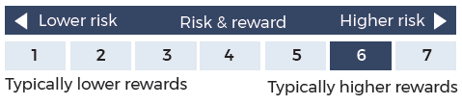
Risk & performance
Guinness Sustainable Global Equity Fund
Risk: The Guinness Sustainable Global Equity Fund is an equity fund and invests in stocks of companies with sustainable products and practices. Investors should be willing and able to assume the risks of equity investing. The value of an investment and the income from it can fall as well as rise as a result of market and currency movement, and you may not get back the amount originally invested. Details on the risk factors are included in the Funds’ documentation, available on our website (guinnessgi.com/literature).
Guinness Global Equity Income Fund:
The risk and reward indicator shows where the fund ranks in terms of its potential risk and return. The higher the rank the greater the potential reward but the greater the risk of losing money. The shaded area in the table shows this fund’s rank. The fund is ranked as higher risk as its price has shown high fluctuations historically. This is based on how investments have performed in the past and you should note that the fund may perform differently in the future and its rank may change. Historical data may not be a reliable indicator for the future.
Performance: Past performance does not predict future returns.
Investors should note that fees and expenses are charged to the capital of the Fund. This reduces the return on your investment by an amount equivalent to the Ongoing Charges Figure (OCF). The fund performance shown has been reduced by the current OCF of 0.89% per annum. Returns for share classes with different OCFs will vary accordingly. Performance returns do not reflect any initial charge; any such charge will also reduce the return.
The fund is actively managed with the MSCI World Index used as a comparator benchmark only.

Slide 3
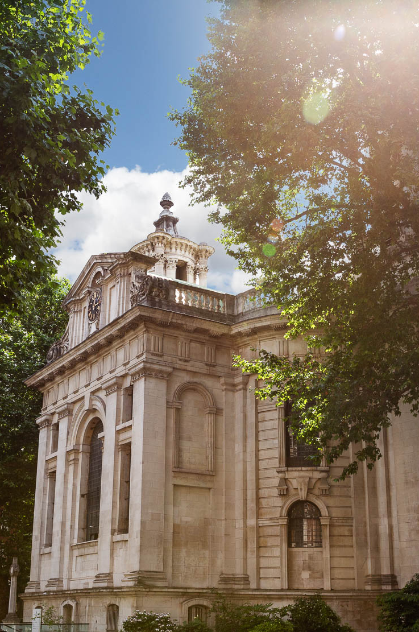
ABOUT US
High-conviction, long-only equities
Founded in 2003, headquartered in London
$6bn AUM (Guinness Group assets 30.09.2022)
UCITS, US Mutual Funds, Separately Managed accounts
60 employees
100% employee-owned
Investment strategies:
Equity Income
Growth
Sustainable
Multi-asset
Ventures

Slide 4
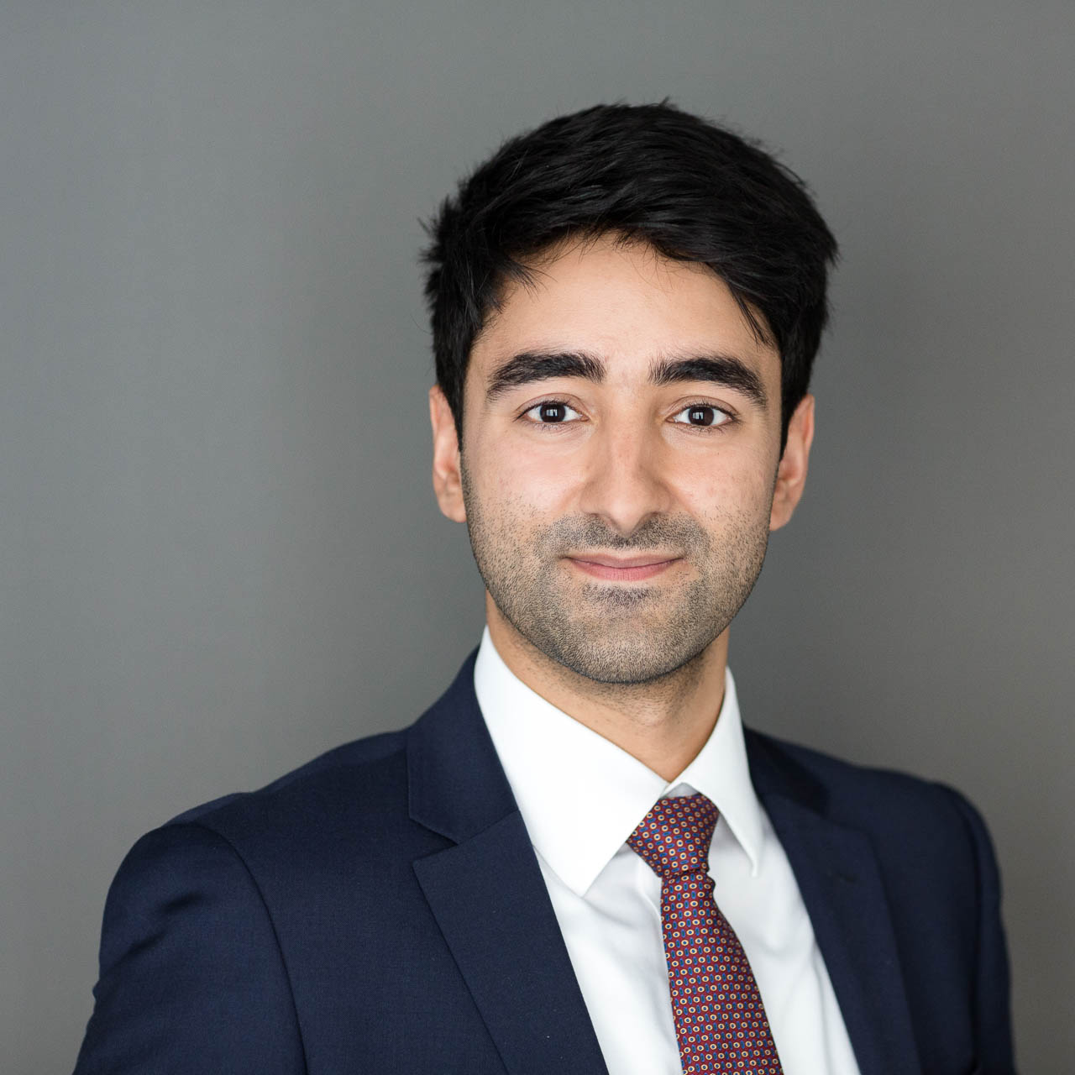
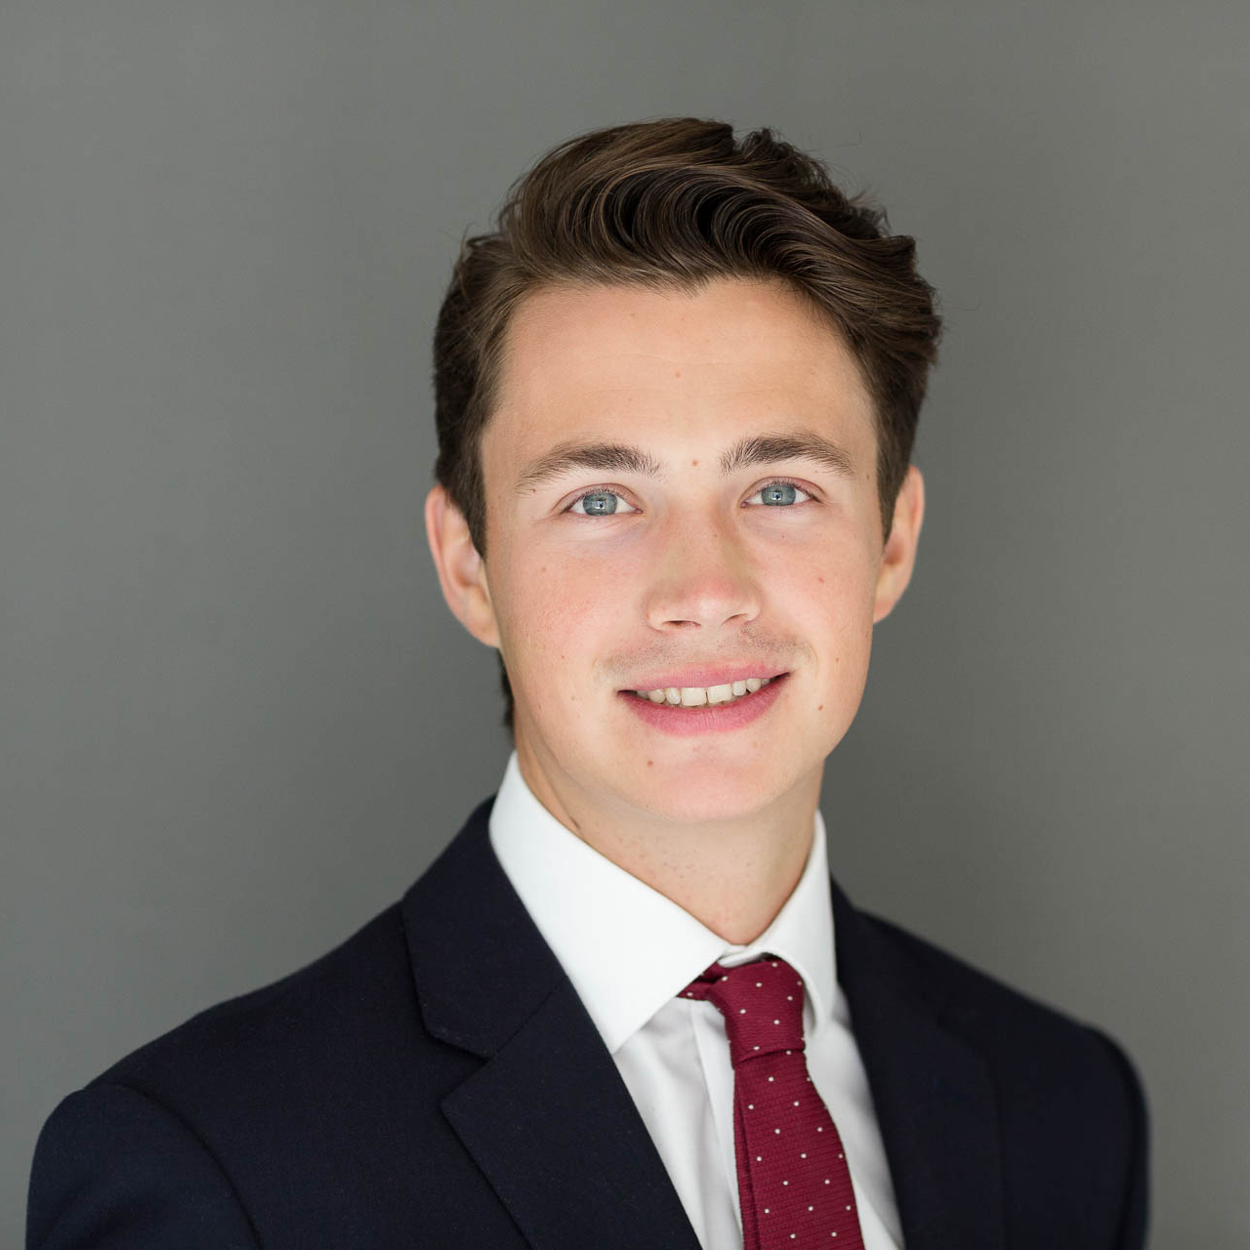

Team
Guinness Sustainable Global Equity Fund
Sagar Thanki, CFA
Portfolio Manager
Joseph Stephens, CFA
Portfolio Manager
Francesca Wheble
Responsible Investment Analyst
Joined Guinness Global Investors in 2017 ​
Investment Analyst on the Global Equity Income and Global Innovators funds
Prior to joining Guinness, Sagar worked at Bloomberg as an Equity and Portfolios Product Specialist, within the Financial Analytics and Sales department.​
Sagar started his career at Barclays Wealth as an Equity Analyst, working in Discretionary Portfolio Management.
He graduated from Selwyn College, University of Cambridge, with a Master’s degree in Economics and has received a Diploma in Investment Management, having passed the IMC Certificate and CFA Certificate in ESG Investing. He is also a CFA Charterholder.
Joined Guinness Global Investors in 2018​
Investment Analyst on the Global Equity Income and Global Innovators funds
Prior to joining Guinness, Joseph interned at Goldman Sachs within the Operations department.
Joseph has a Master’s degree in Investment Management from Henley Business School, and a Master’s degree in Mathematics from University of Bath. ​
Joseph has passed the CFA Certificate in ESG Investing and is also a CFA Charterholder.
Joined Guinness Global Investors in 2021
Firm-wide responsible investment resource
Interned at Fundsmith LLP in investment management and at Vespa Capital as an ESG consultant.
Graduated from the University of Exeter with a degree in Business and Management with proficiency in Entrepreneurship in 2020.

Slide 5
Philosophy
Guinness Sustainable Global Equity Fund
Quality
Sustainability
Growth
Conviction
We focus on companies with a long history of persistently high & improving return on capital
We focus on balance sheet strength and avoid highly leveraged companies
Exclusionary
We exclude companies which produce harmful products, and which have poor ESG practices
Sustainability Assessment
We seek companies aligned to our sustainability themes, and which score well on our ESG scorecard
We look for companies that can grow profitably without the need for significant external capital.
We aim to avoid overpaying for future growth
The Fund is fully-invested and typically has 30 equally weighted positions
We target a low turnover with an average 3 – 5 year investment horizon
Concentrated portfolio of high-quality, mid-cap focused, growth companies,
with sustainable products and practices

Slide 6
Quality
What do we mean by Quality?
Quality
Established Compounders
Emerging Compounders
10 consecutive years of >10% Return on Capital
10% is well above the average real cost of capital, and leaves only the top quartile of all listed companies globally
10 years ensures we only capture companies which have weathered different economic cycles
10 consecutive years, rather than an average, avoids companies with (i) high average but low current ROC, and (ii) highly cyclical ROC
5 consecutive years of >10% ROC
and y.o.y growth in ROC
Many growing companies do not have 10 years of history, or have not yet matured enough to have created value for such a long history
High probability that Emerging Compounders become future Established Compounders

Slide 7
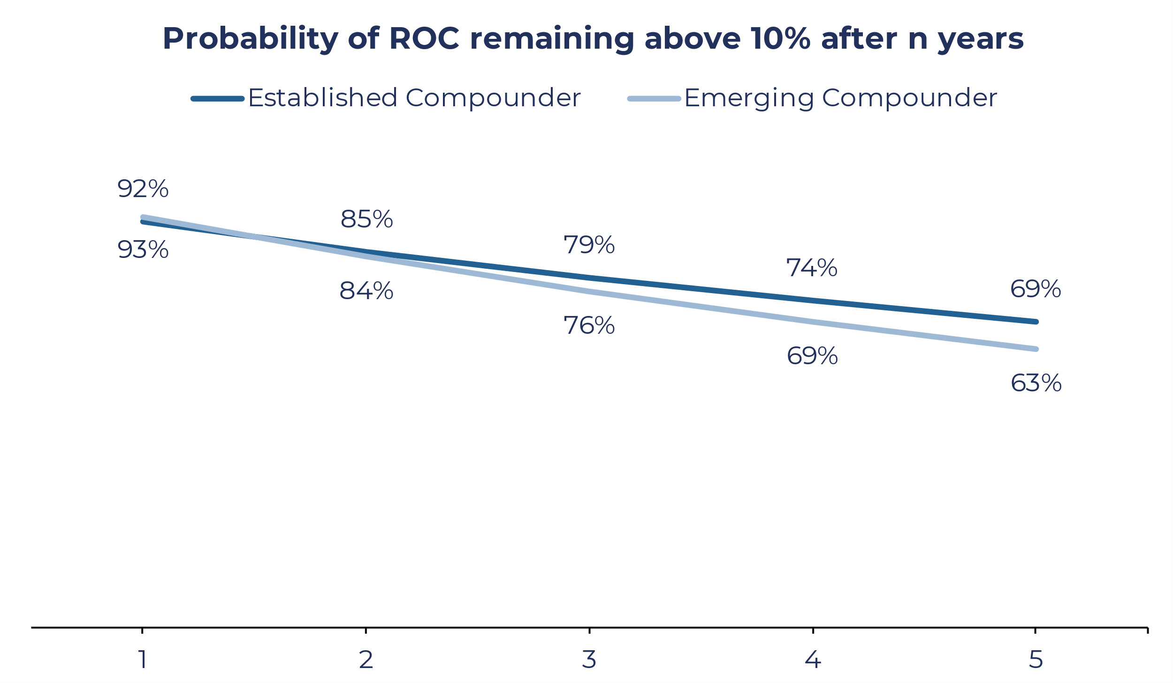
Quality
High, persistent or growing ROC are powerful leading indicators of continuing high returns
Established Compounders → High, persistent ROC is a powerful leading indicator of continuing high returns
Emerging Compounders → High, growing ROC is a powerful leading indicator of continuing high returns
63% probability that an Emerging Compounder becomes an Established Compounder
Emerging Compounders are growing their ROC faster and have a better than average chance of becoming the next Established Compounders
Source: Guinness Global Investors, CS HOLT

Slide 8
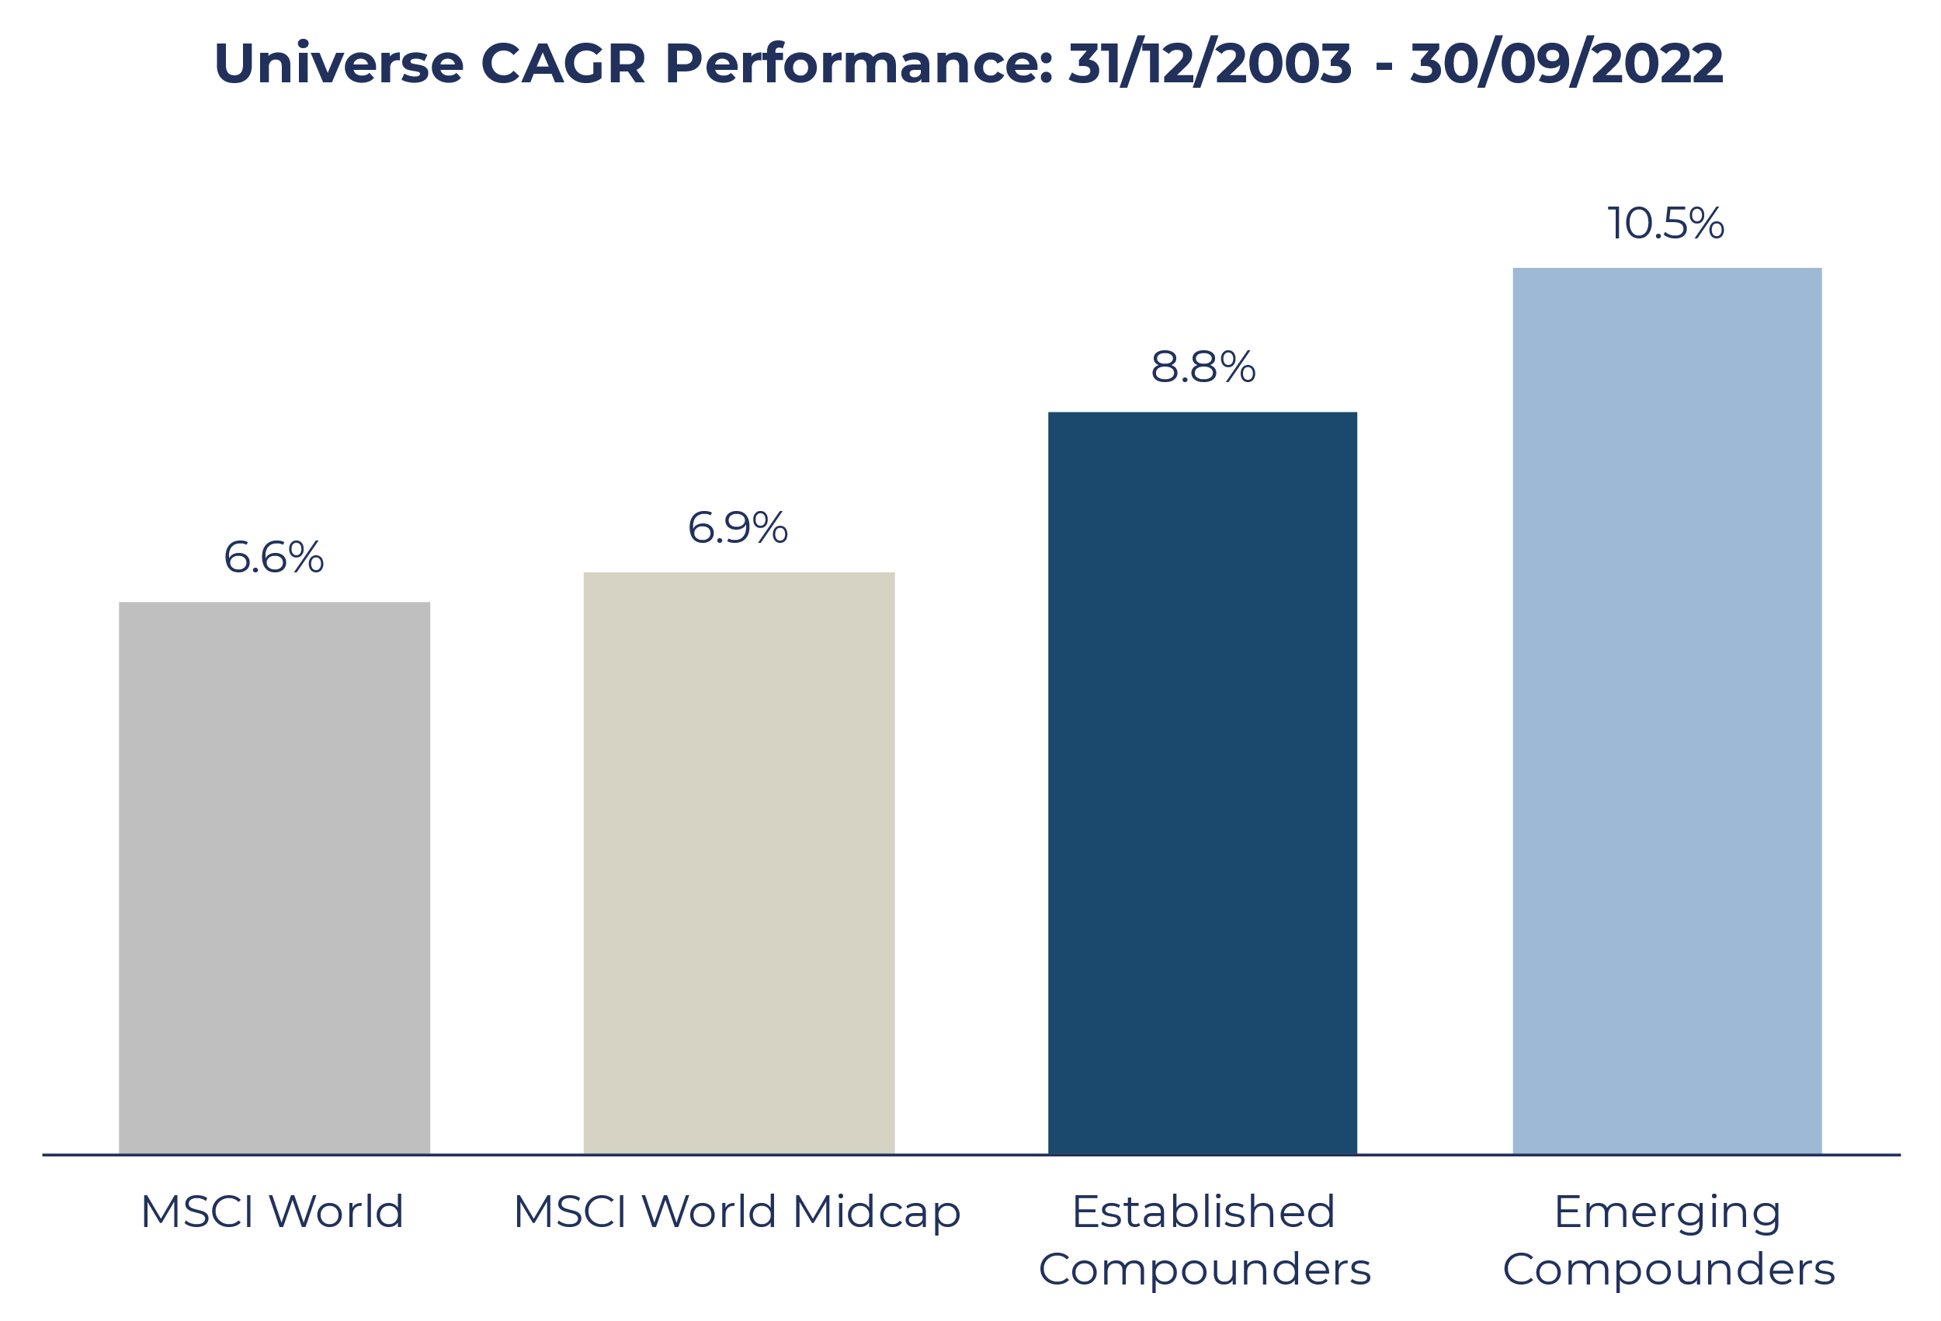
Quality
How does this translate into performance?
Past performance does not predict future returns
Both Established and Emerging Compounders have outperformed the MSCI World and MSCI World Midcap Indices
Emerging Compounders have outperformed Established Compounders by 1.7% p/a
Source: Guinness Global Investors, Bloomberg.
Backtesting based on quarterly total returns, USD
The value of this investment and any income arising from it can fall as well as rise as a result of market and currency fluctuations as well as other factors.
Compound Annual Growth Rate (CAGR)

Slide 9
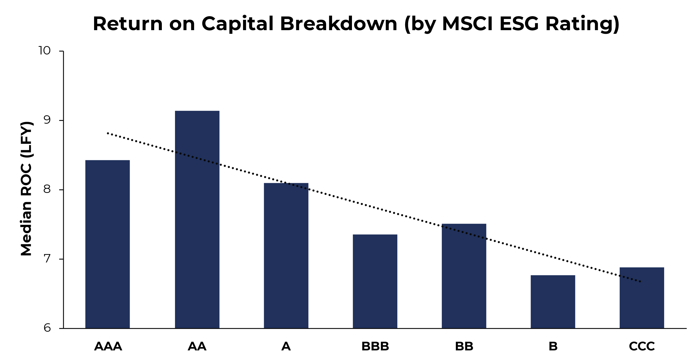
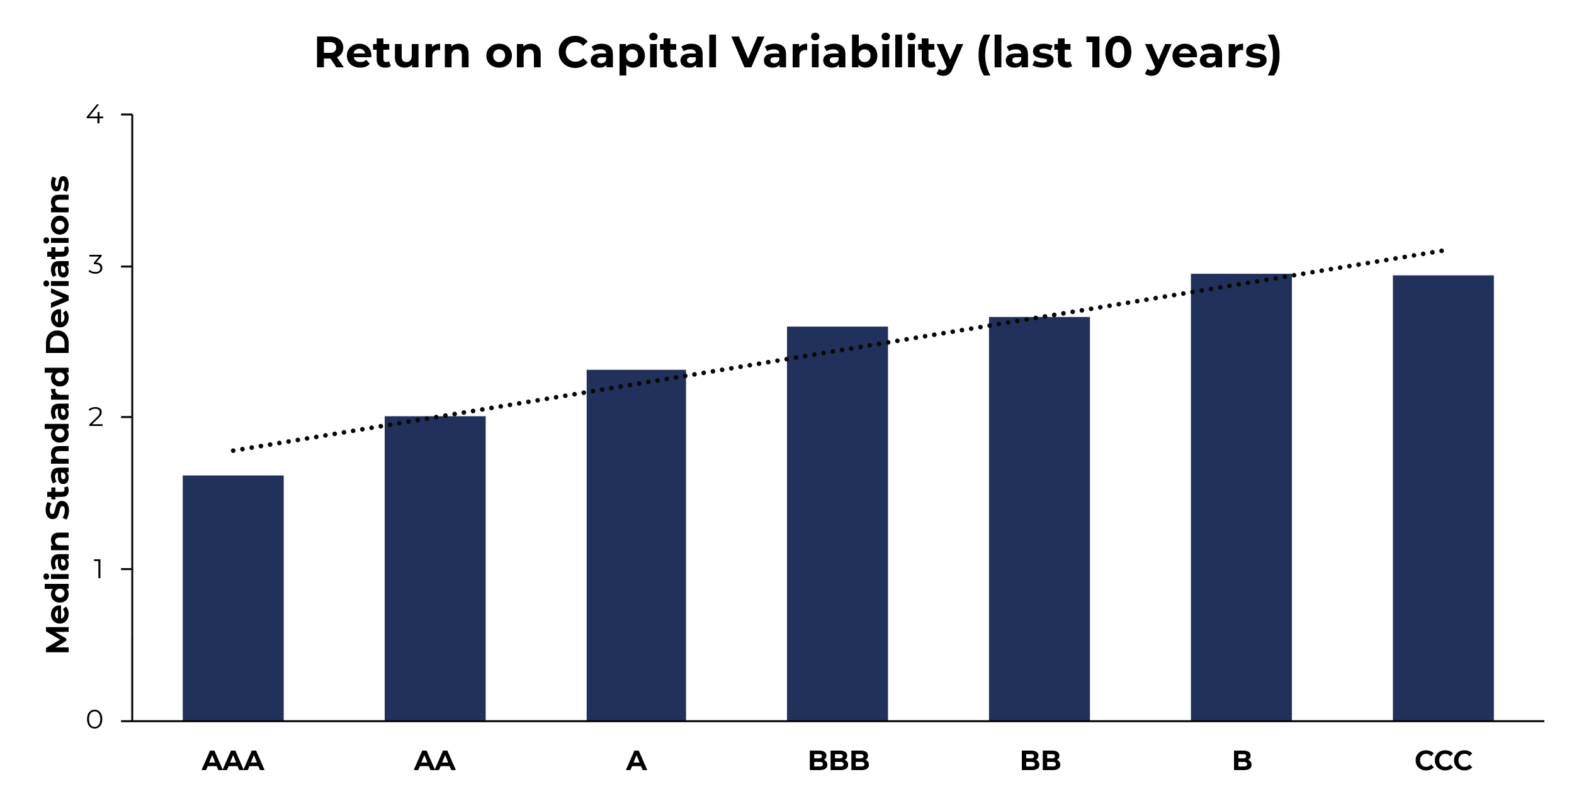
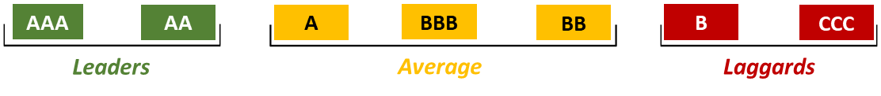
Sustainability
Quality and Sustainability are positively correlated…
Companies with a higher ROC and lower ROC variability tend to have better ESG ratings
Source: Guinness Global Investors, CS HOLT, MSCI ESG

Slide 10
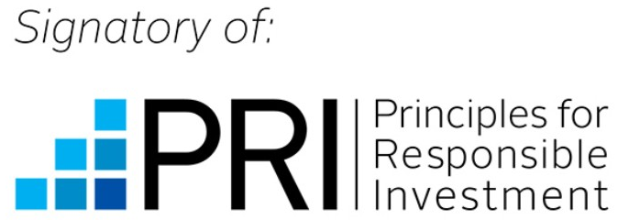
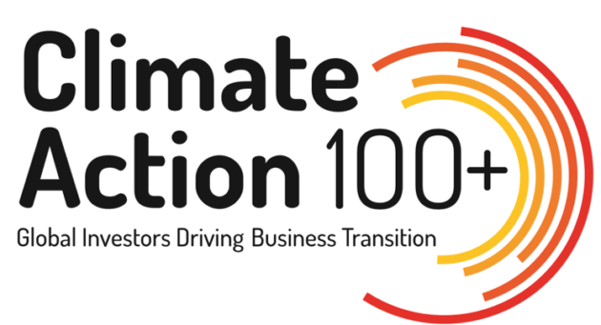
Sustainability
What do we mean by Sustainability?
Firm level
Guinness Global Investors are proud signatories of the United Nations PRI and Climate Action 100+
Investment level
Fund level
Universe Construction
Fundamental Analysis
Proxy Voting
Company Engagement
Exclusionary
Sustainability Assessment
Shareholder activism can influence specific ESG practices, particularly governance
We seek to influence our companies to improve data disclosure and better their ESG practices
Product
Practice
Product
Practice
Coal
Fossil Fuels
Gambling
Nuclear
Palm Oil
Tobacco
Weapons
Exclude ESG Laggards
Do the company’s revenues align with long-term sustainable themes?
Does the company have good E, S and G practices, as per our scorecard?
Are practices improving

Slide 11








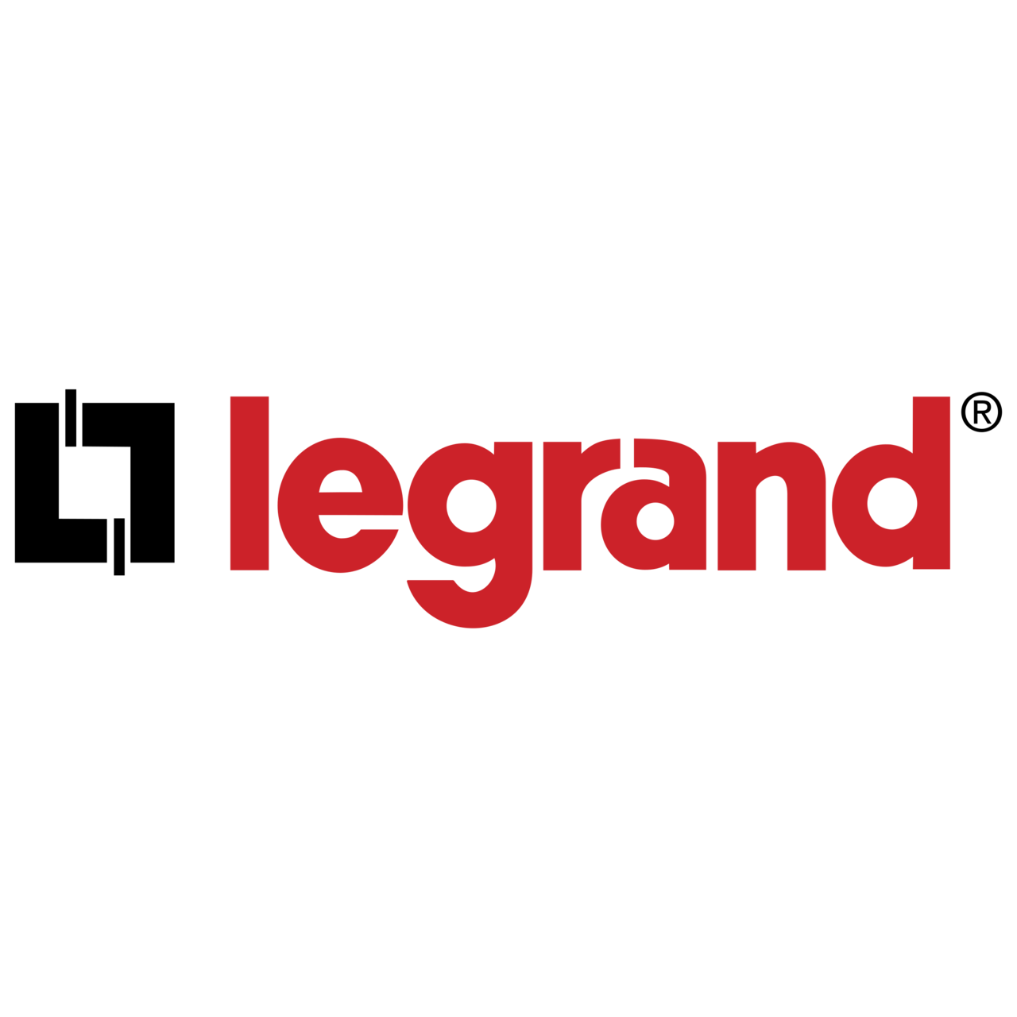

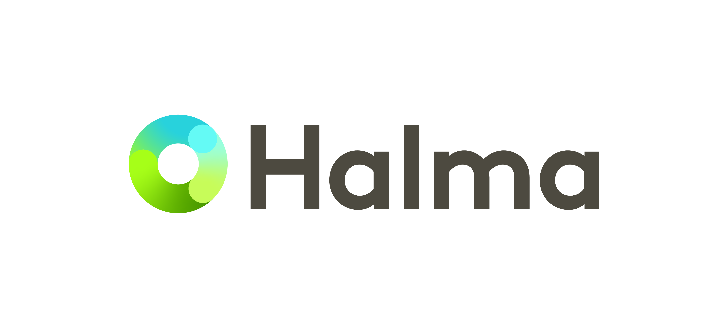

Sustainability
Sustainability Themes
Themes cover investment opportunities created as part of the broad sustainability transition
The Fund aims to invest in companies whose primary businesses align with sustainable themes
Sustainable Themes help steer PRODUCT ALIGNMENT
Health & Wellbeing
Pharmaceuticals | Wellbeing
MedTech | Safety
Productivity & Connectivity
Productivity | Cloud Computing
IoT | Communications
Resource Efficiency
Clean Energy | Water Efficiency
Water Management

Slide 12
Sustainability
Where do we fit within the ESG Landscape?
Guinness Sustainable Global Equity Fund

Slide 13
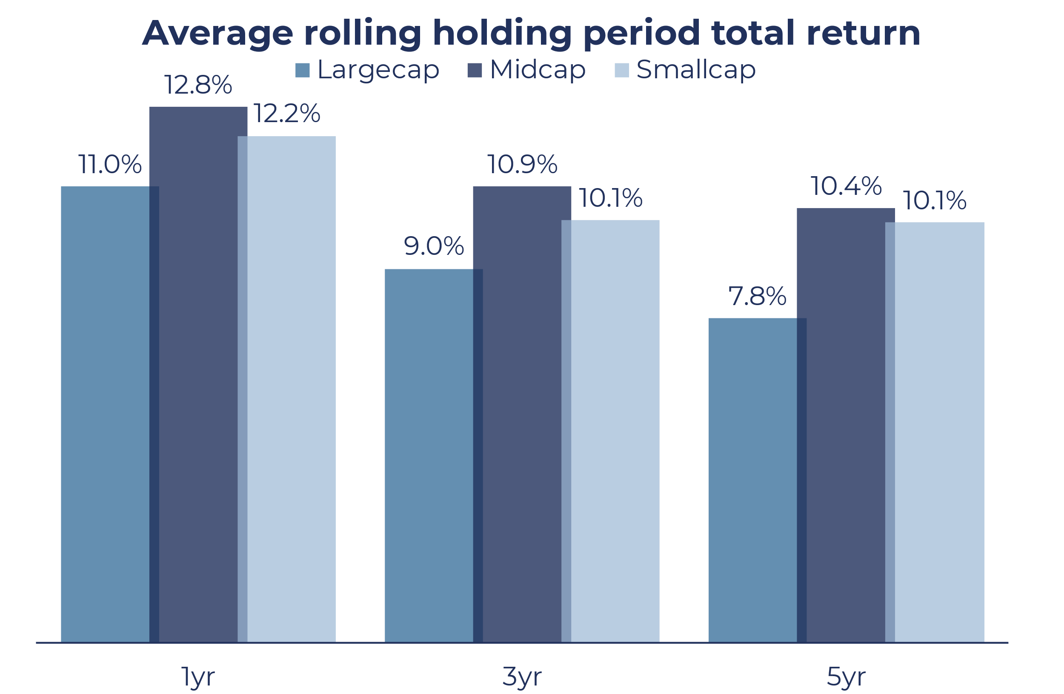
Growth
Why do we focus on midcaps for growth?
Mid-caps have outperformed large & small-caps over the long-term...
…whilst exhibiting better risk adjusted returns
Source: Bloomberg. Period analysed: 1st Jan 1996 – 30th September 2022, monthly series, USD.
Data based on S&P indices as a proxy (S&P 500 Index vs S&P Mid Cap 400 Index vs S&P Small Cap 600 Index), due to data availability/ Bloomberg limits

Slide 14
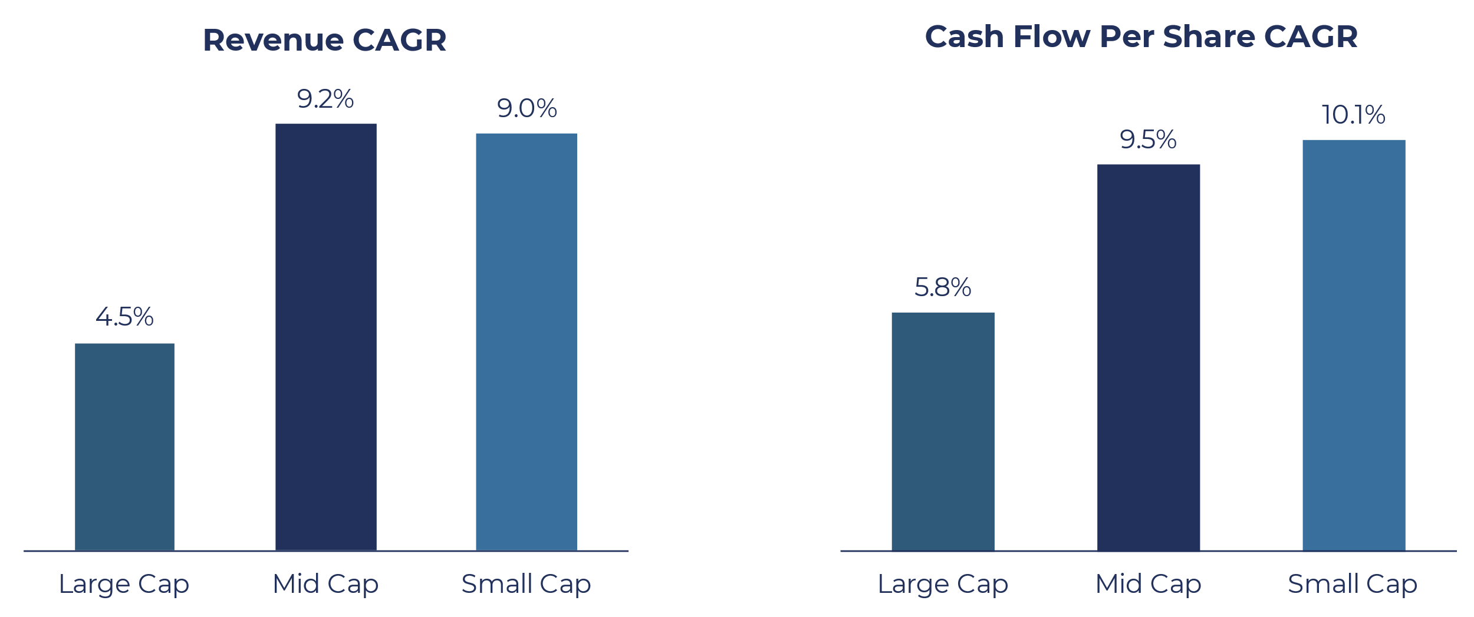
Growth
Mid-caps have outperformed because their revenues and cashflows grew faster
Mid-caps have grown in line with small caps and significantly faster than large caps
Source: Bloomberg. Period analysed: 1st Jan 1996 – 30th September 2022, monthly series, USD.
Data based on S&P indices as a proxy (S&P 500 Index vs S&P Mid Cap 400 Index vs S&P Small Cap 600 Index),
due to data availability/ Bloomberg limits

Slide 15
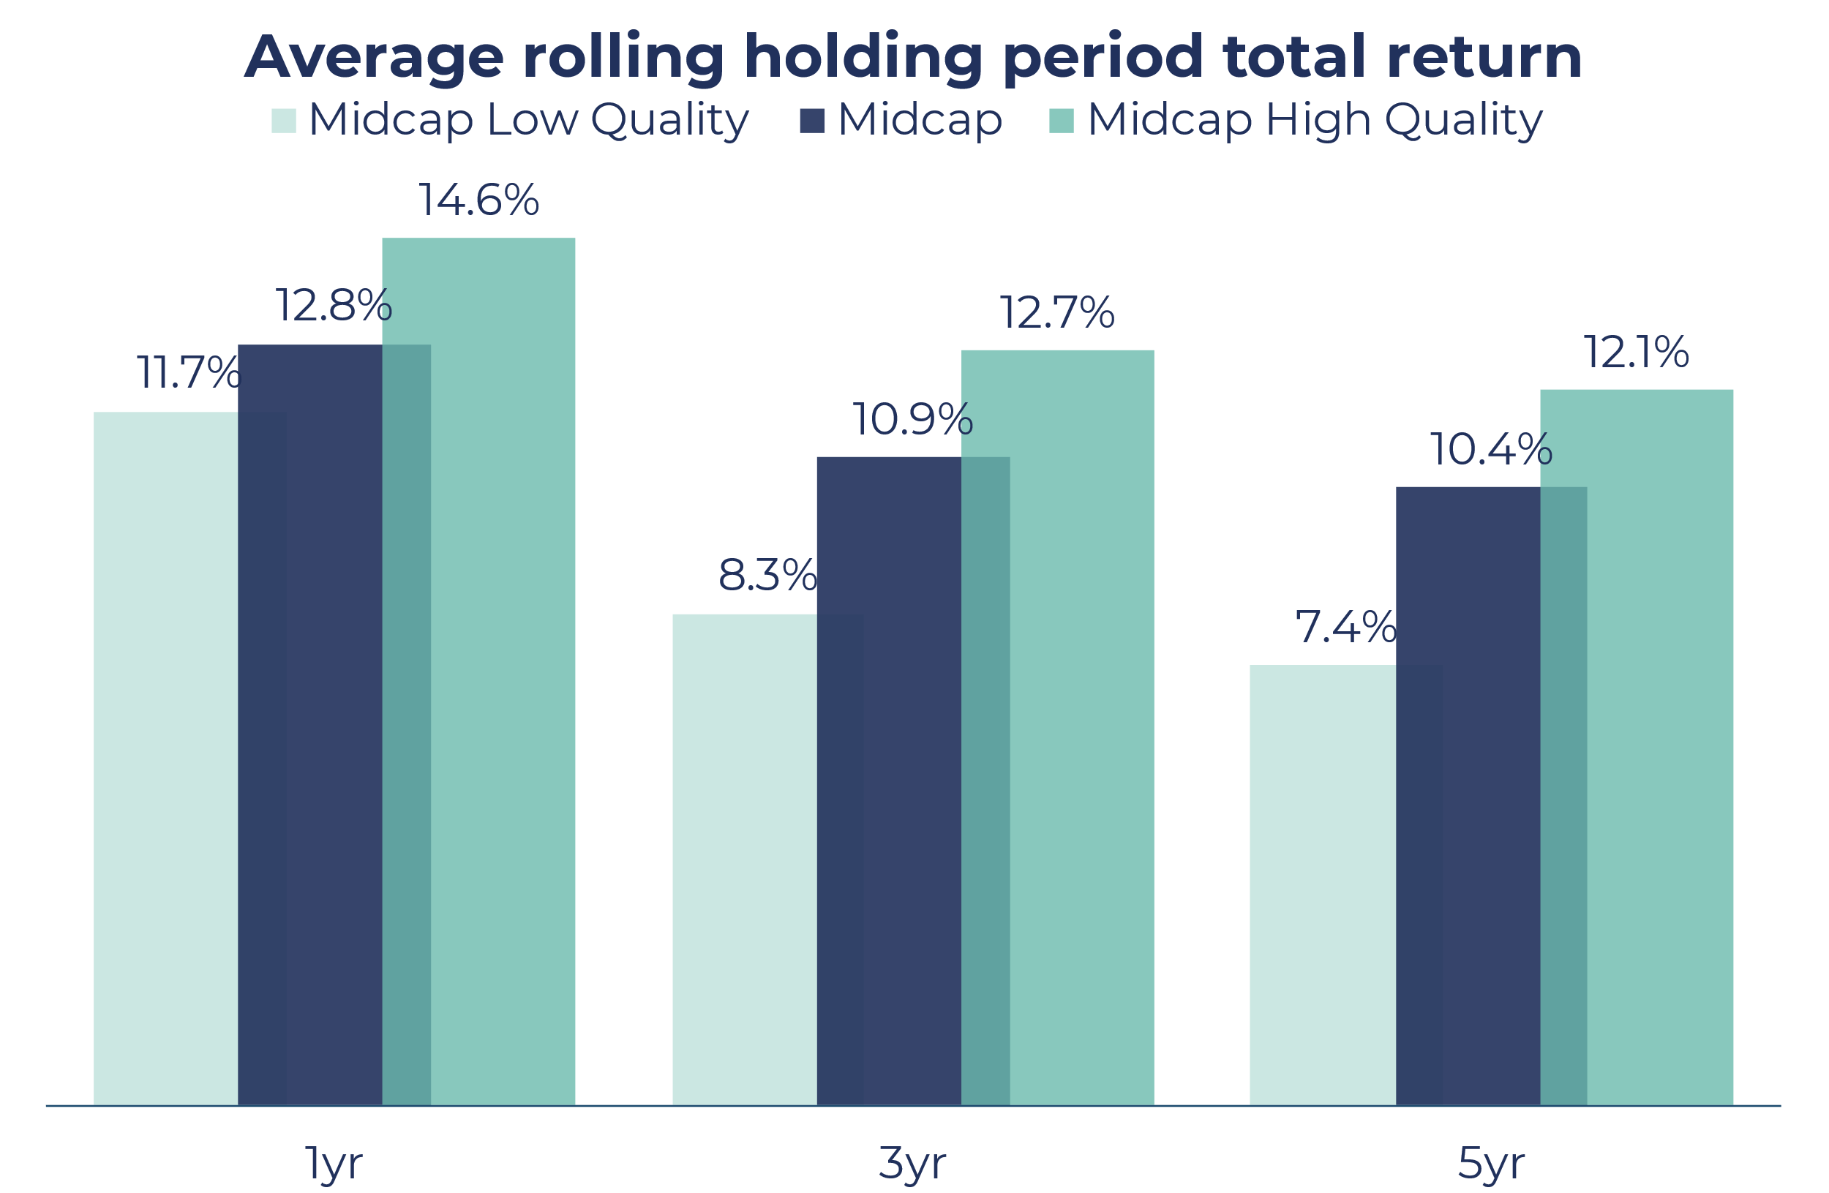
Growth
Within mid-caps, quality outperforms further
High quality mid-caps outperform low quality mid-cap companies…
…whilst exhibiting better risk adjusted returns
Source: Bloomberg. Period analysed: 1st Jan 1996 – 30th September 2022, monthly series, USD
Quality score is based on Return on Capital and Financial Leverage
Data based on S&P indices as a proxy, due to data availability/ Bloomberg limits:
Midcap High Quality = S&P MidCap 400 Quality Index = top quantile scoring constituents from the S&P MidCap 400 Index.
Midcap Low Quality represented by the bottom quantile scoring constituents from the S&P MidCap 400 Index.

Slide 16
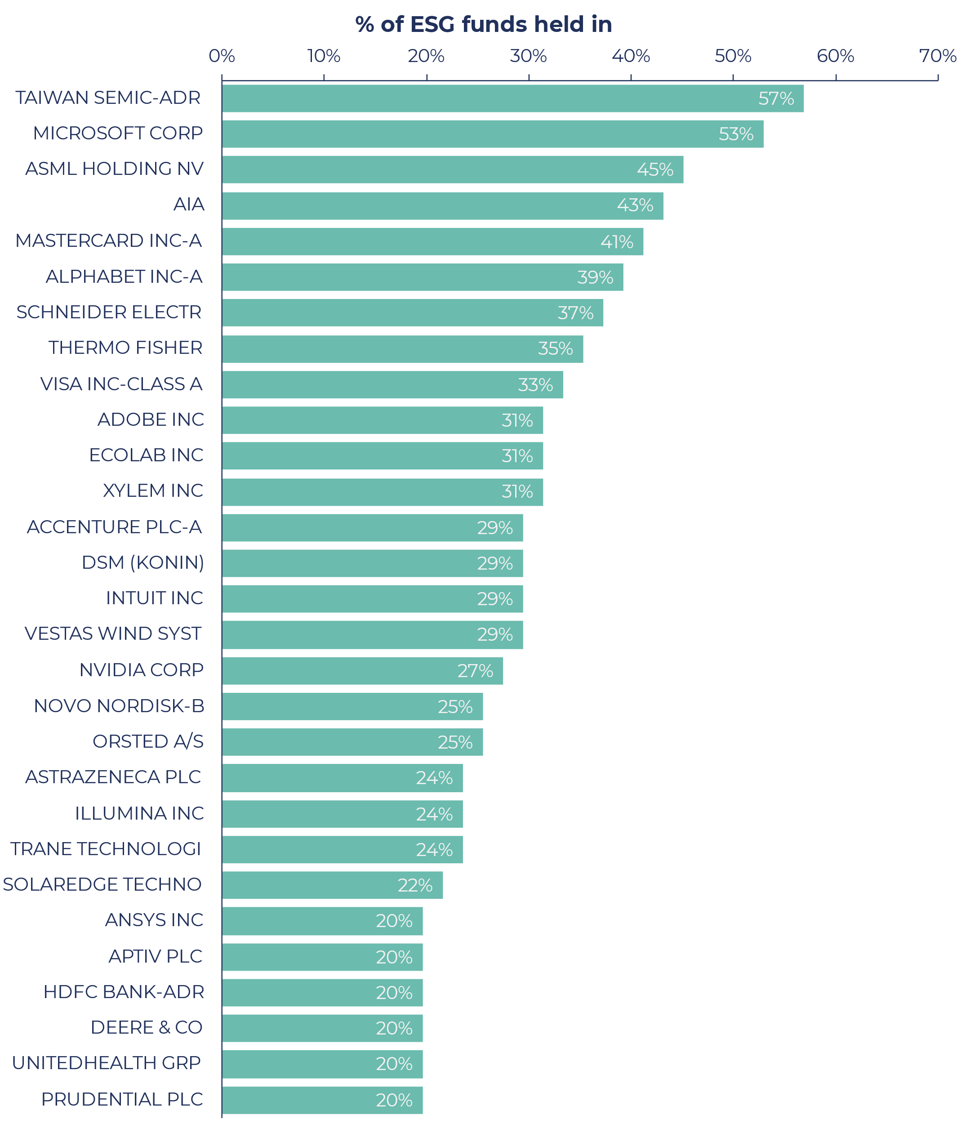
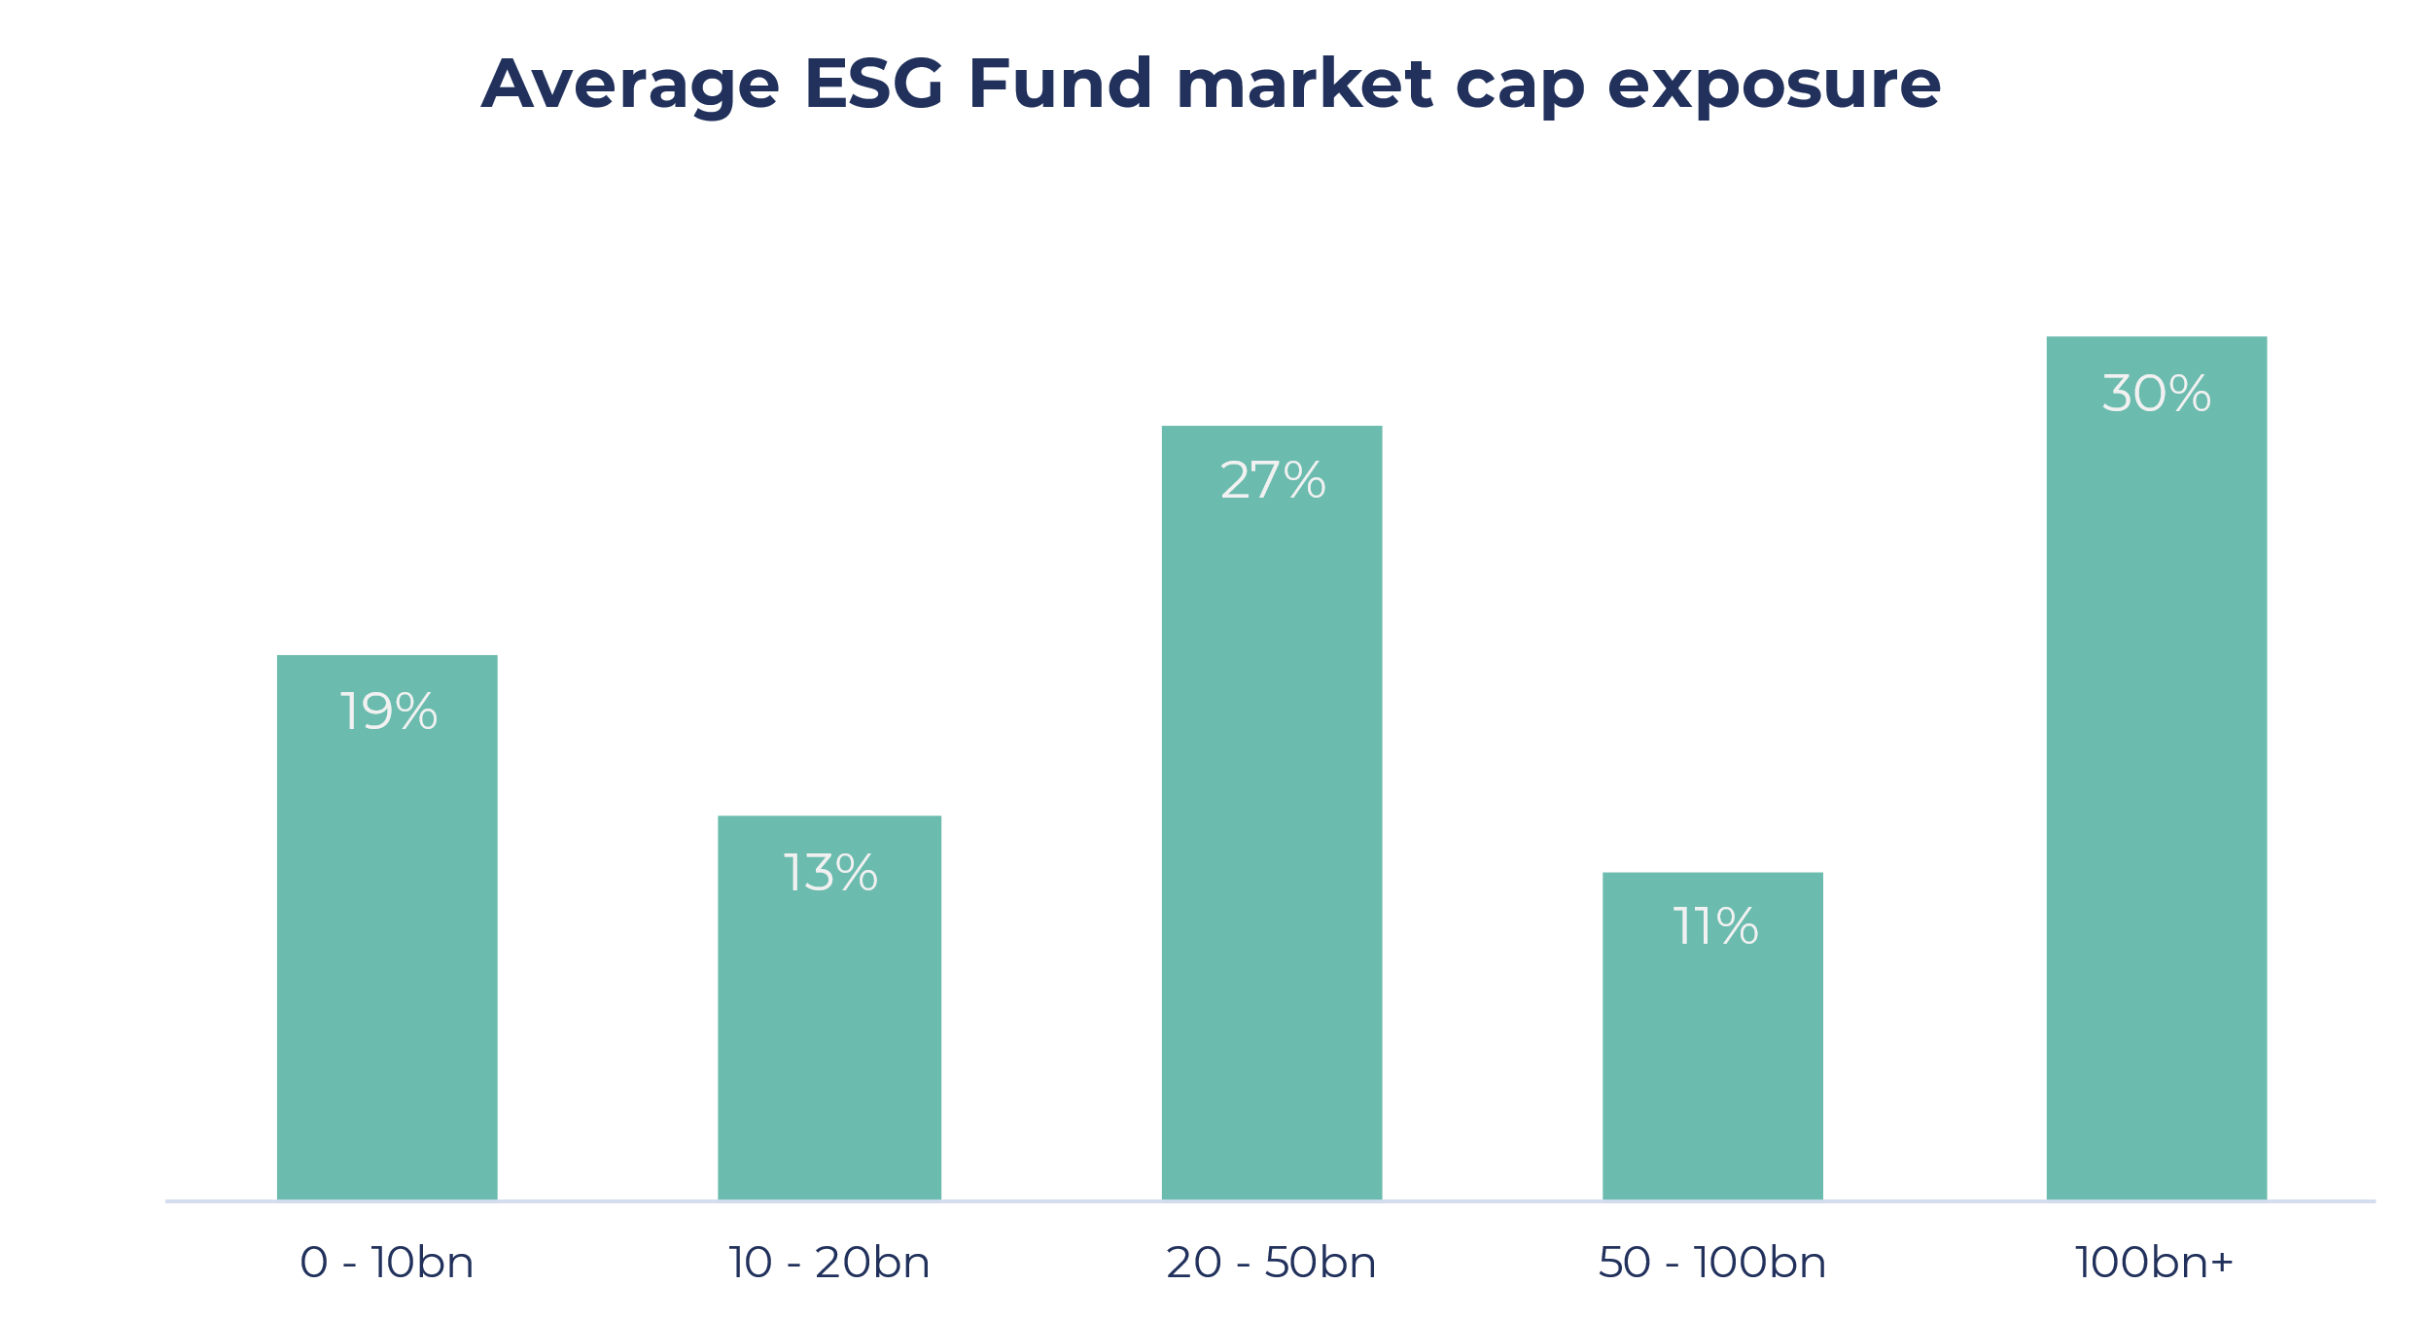
Why invest in mid-caps in the ESG space?
‘ESG’ funds are crowded into large cap companies
57% of peer funds* hold TSMC, whilst 53% hold Microsoft
On average, peer funds have 68% of their portfolios invested in companies with a market cap >$20bn
Of the c.900 distinct companies within peer funds, only 11% make it into our universe
Source: Guinness Global Investors, Bloomberg, Financial Express, USD (data as of 30.09.2022). *A custom universe of 65 funds created by screening the IA Global Sector for all Responsible, Sustainable and Impact funds

Slide 17
Guinness Sustainable Global Equity Fund
Summary
High ROC level and low variability is positively correlated with ESG ratings
Sustainability
Focus on products & practices, and align to themes
Exclusionary at universe level
Sustainability Assessment at stock selection stage
Growth
Higher EPS and Sales growth found in mid-caps
Mid-caps have outperformed over the long run
Mid-caps are currently attractively valued
Quality
Both Established & Emerging compounders have highly persistent ROC and have shown outperformance against the benchmark
Within mid-caps, quality outperforms
Pure-play companies exposed to sustainable themes exhibit secular growth and tend to be smaller in size

Slide 18
Universe
Universe Construction Process
Developed market listed companies (market cap >$1bn) - c. 4,000
Established + Emerging Quality Compounders
Strong Balance Sheet
Quality Universe - c. 650
Exclude companies producing harmful products
Exclude companies which have poor ESG practices: (MSCI ESG Laggards: ratings B & CCC)
Sustainable Quality Universe - c. 580
Market Cap $1–$20bn
Sustainable Quality Midcap Universe
C. 450

Slide 19
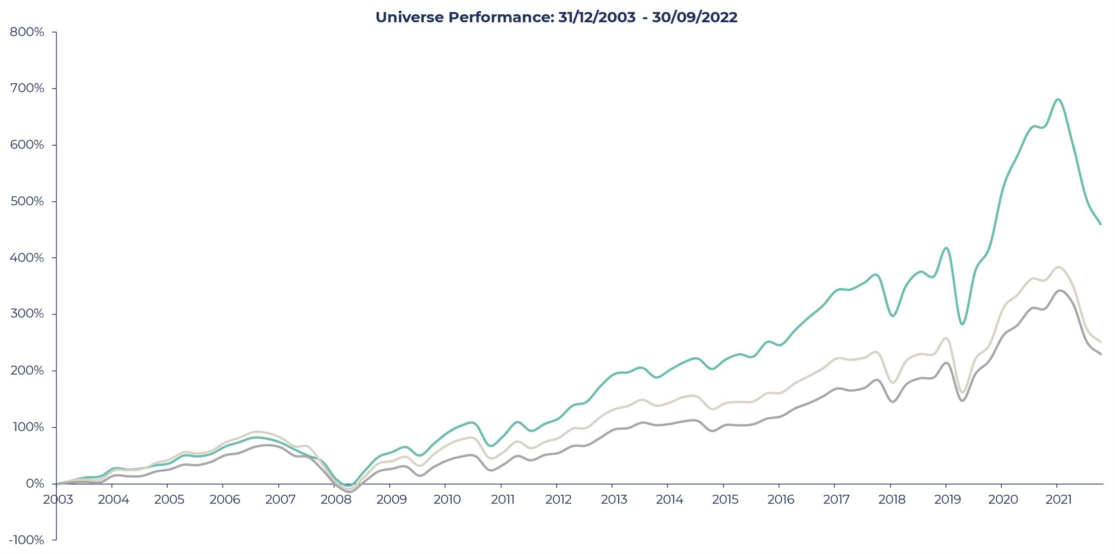
Universe
Backtesting our universe shows strong outperformance
Past performance does not predict future returns
Sustainable Global Equity universe outperformed the MSCI World Index by 3.0% p/a, and MSCI World Midcap Index by 2.7% p/a (all in USD)
…whilst also exhibiting better risk-adjusted returns
460%
251%
230%
Source: Bloomberg. Period analysed: 1st Jan 1996 – 30th September 2022, quarterly series, USD. The performance of the Universe is based on an annual screen of globally listed companies back to 2003 to deliver an annual index of companies which generate consistently high returns on capital. The graph shows the performance of a simple strategy of buying all companies in the universe each year, and is based on an equally weighted portfolio, total return with quarterly rebalancing, and does not include the costs of dealing. Total return in USD. The performance of the Sustainable Global Equity Universe is not indicative of the future performance of the Guinness Sustainable Global Equity Fund.

Slide 20
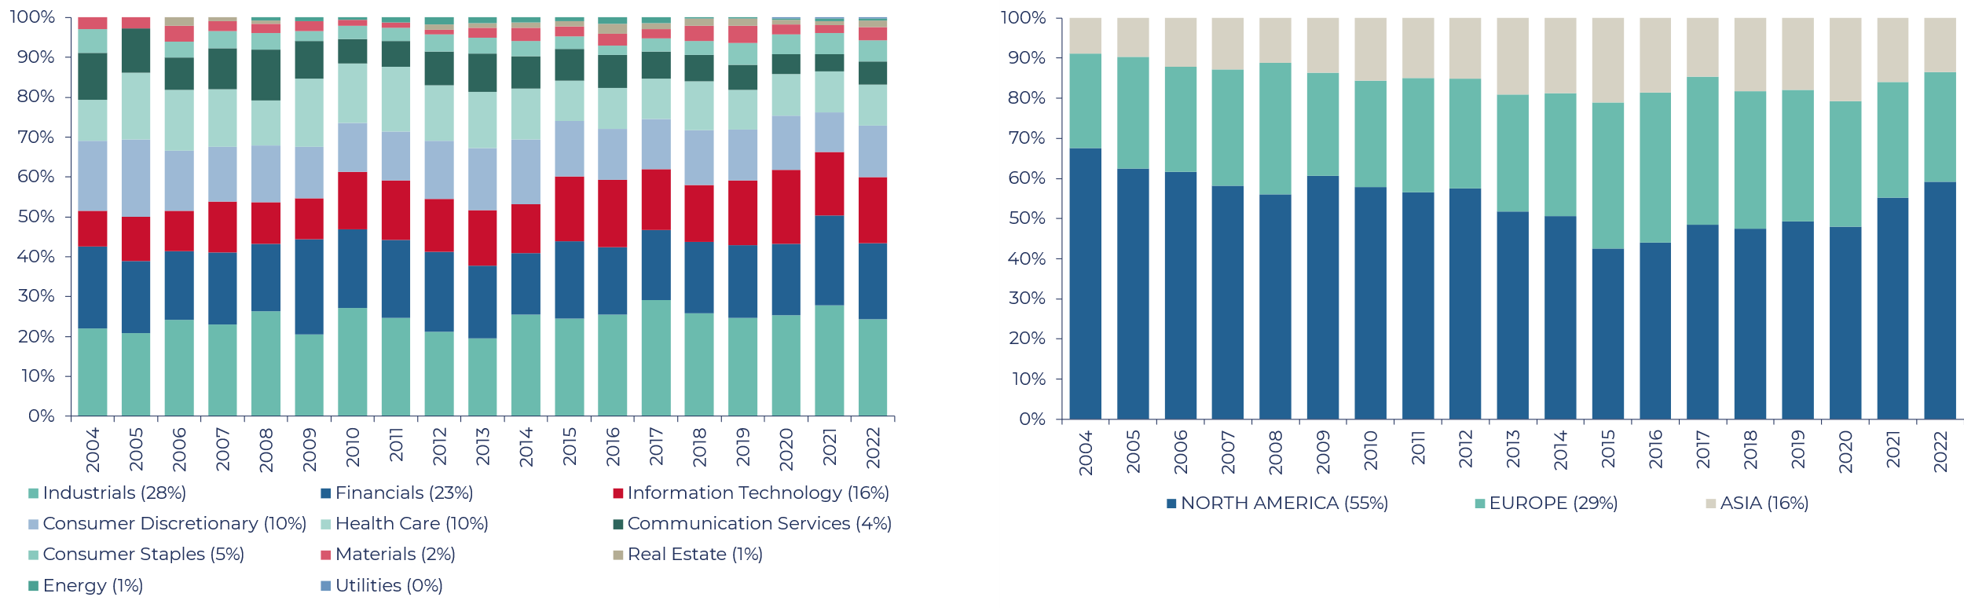
Universe
Sector And Regional Distribution
Well diversified and stable distribution across sectors
Little to no exposure in asset heavy / regulated / commodity-based sectors: Real Estate, Energy, Utilities, Materials
North America dominates; however, this has been diminishing over time
There is an increasing weight from Asia
Source: Guinness Global Investors (data as of 30.09.2022)

Slide 21
Investment Process
Systematic, Repeatable, Robust
Sustainable Global Equity Universe
(~450 companies)
Prioritisation / Idea generation
Quality, Sustainability, Growth
Fundamental analysis
Proprietary modelling, Assessment of return potential, Risk analysis, Competitive advantage, ESG analysis
Reject
Weak business, poor allocator of capital, industry in decline, material ESG risks
Watch list
Like the business, don’t like the valuation
Add to Portfolio
(30 companies)
Better risk/return than a current holding

Slide 22
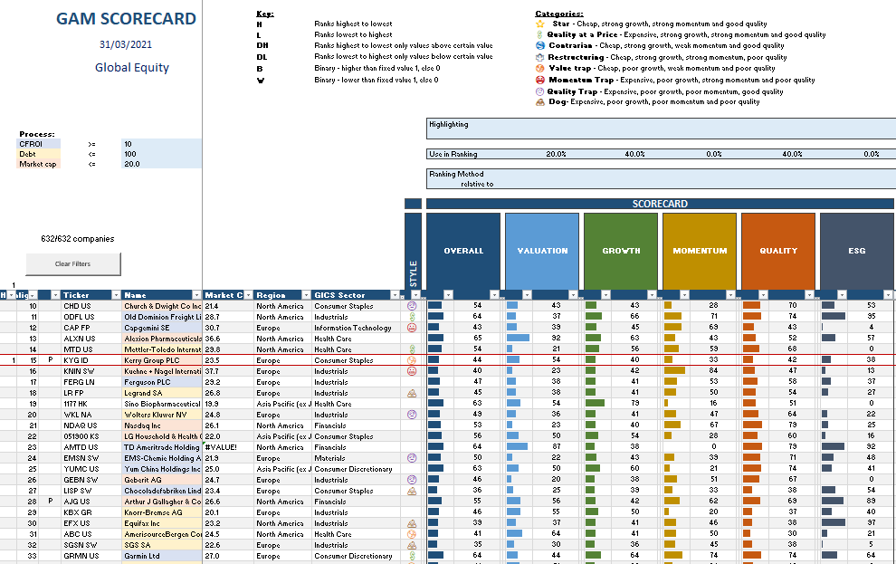
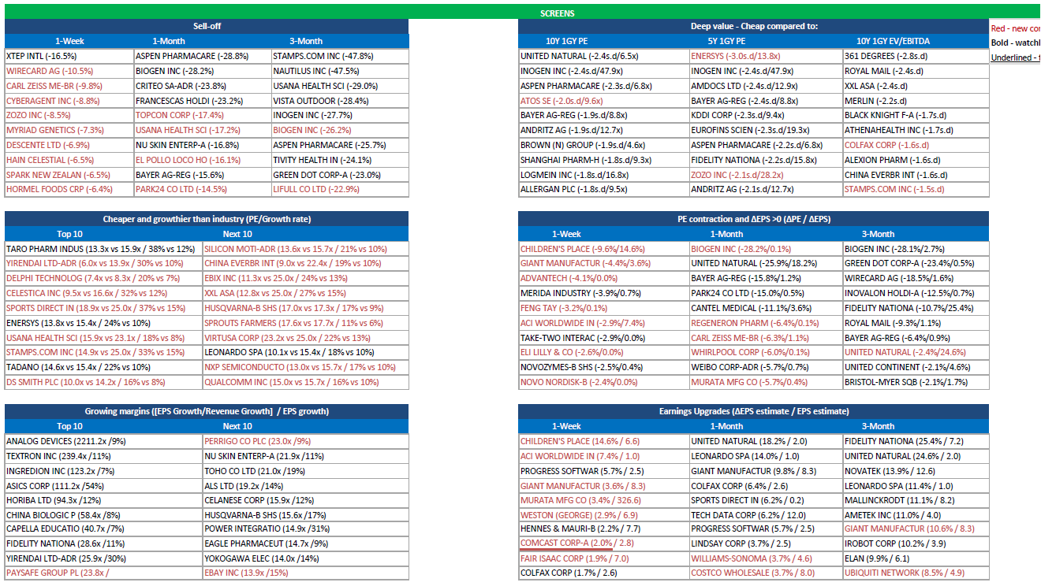
Prioritisation / Idea generation
Prioritising companies for further due diligence
Fundamental Scorecard
Scoring companies vs universe based on:
Valuation
Growth
Momentum
Quality
ESG
Weekly market movement screens
Screens to capture opportunities based on:
Largest price sell-offs
Companies now trading below average historic valuation
Largest earnings upgrades
Largest valuation compressions

Slide 23
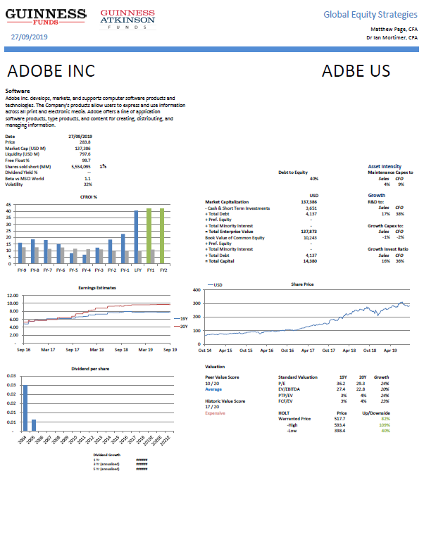
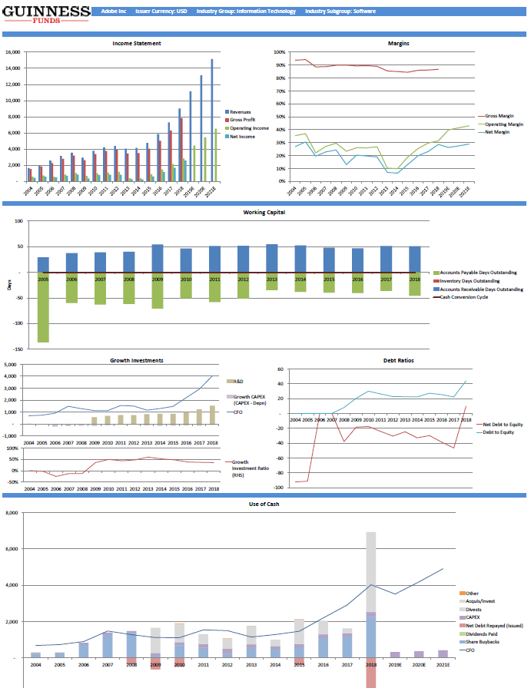
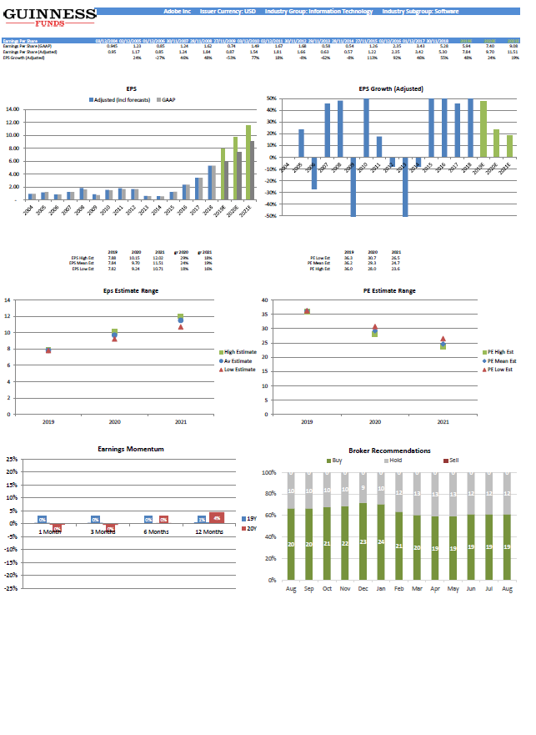
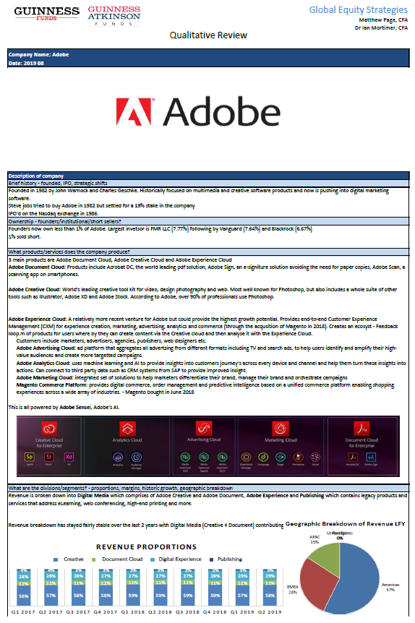
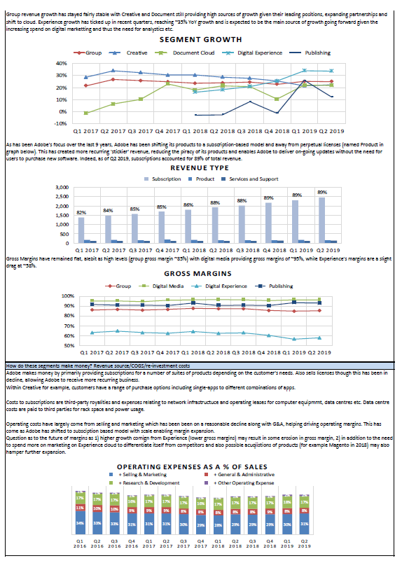
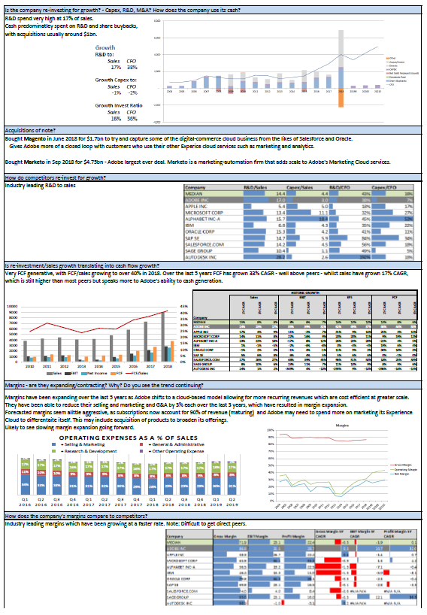
Fundamental Analysis
Proprietary Company Modelling And Due Diligence
Financial Model
Understand the business model
Understand the risks
Understand the dividend
Analyse valuation relative to history and peers
example
Qualitative Assessment
Understand company’s products & services
Analyse historic and future growth drivers
Understand industry trends and identify the company’s competitive advantages
Investigate company-specific issues
Undertake an ESG assessment
example

Slide 24
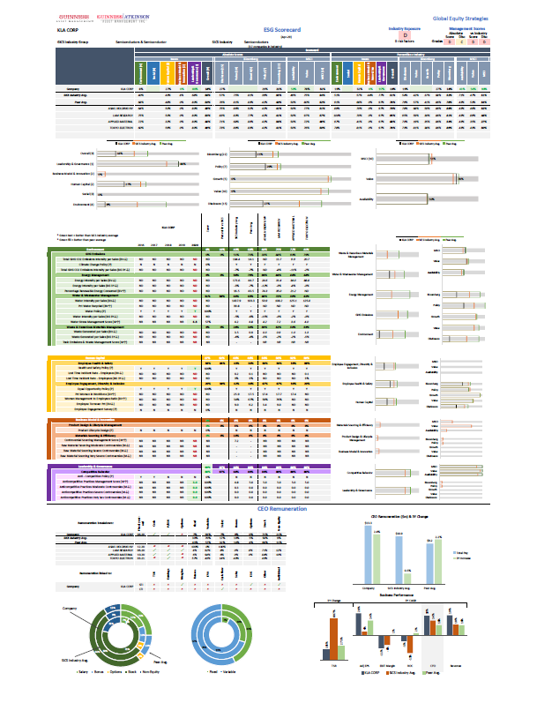
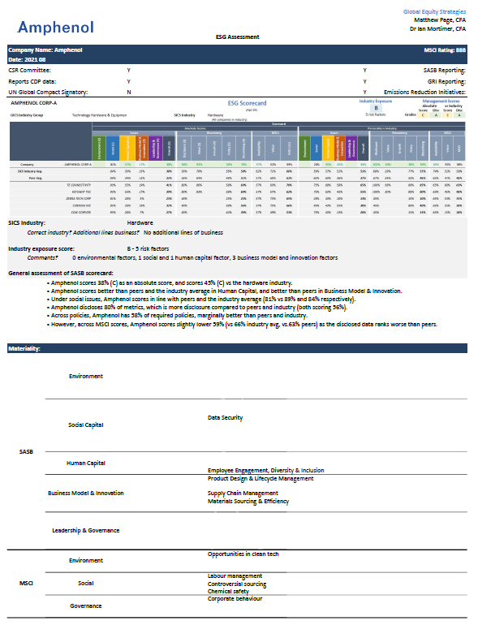
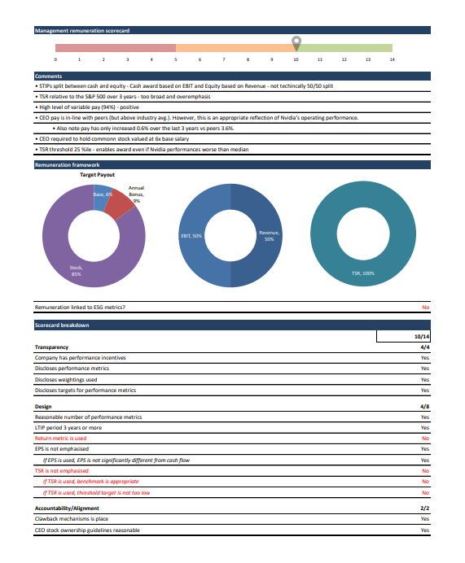
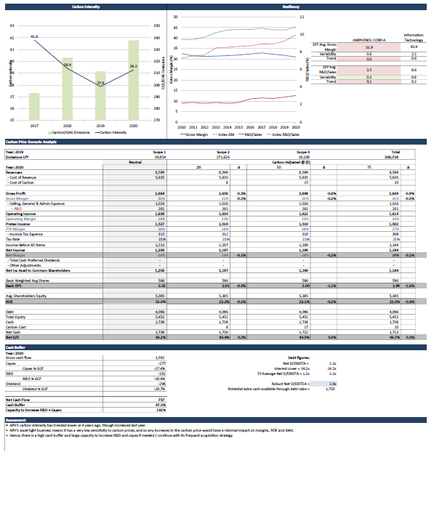
Fundamental Analysis
Sustainability Assessment
ESG Scorecard
Based on the Sustainability Accounting Standards Board’s (SASB) materiality matrix
Analyse a company’s ESG practice based on material metrics relative to its industry, peers, and history
Transparency into drivers of overall scores – across each of SASB’s 5 pillars and across disclosure, value, growth and policy metrics – again vs industry and peers
Qualitative Assessment
Assess materiality and fairness of ESG scores
Assess magnitude of risk factors and company efforts to mitigate these
Assess changes in ESG disclosure & scores over time
Delve deeper into understanding management remuneration
Deeper understanding of sustainability theme alignment – risks & opportunities
This can form the basis for proxy voting and engagement
example
We are proud signatories of the United Nations PRI.

Slide 25
Portfolio
Portfolio Construction
Holdings & Sizing
30 companies in portfolio (typically)
Equally weighted
Rebalancing effect: Trim winners, top up underperformers
One in, one out: Strong sell discipline, no long tail of small positions
Limit stock specific risk: No large weights in just one or two positions
High active share: Genuinely index agnostic
Diversification
Diversified globally and across sectors
Maximum 30% in any one industry
Turnover
Low turnover of positions
3 – 5 year average holding period
Macro/ Top-down
Fundamentally driven stock selection – index agnostic
Consider macro factors at the company level
Regularly assess concentration risks in portfolio

Slide 26
Portfolio
Sell Discipline
Quality
Weakening return on capital profile
Balance sheet becomes stretched
Sustainability
Material ESG risks or engages in exclusionary product/services
Growth
Slowing growth with no obvious catalysts for future reacceleration
Company no longer offering compelling upside / multiple re-rating
Conviction
Original reason for purchase no longer holds
New idea more compelling

Slide 27
Portfolio
Portfolio Breakdown
Source: Guinness Global Investors, Bloomberg (data as at 30.09.2022)
By receipt of this presentation document in either hard or soft copy, the recipient agrees not to copy, disclose, disseminate or use this information other than in their own fund selection process. Note: this portfolio data is Confidential Information that, until the 10th day of each month, is not in the public domain.

Slide 28
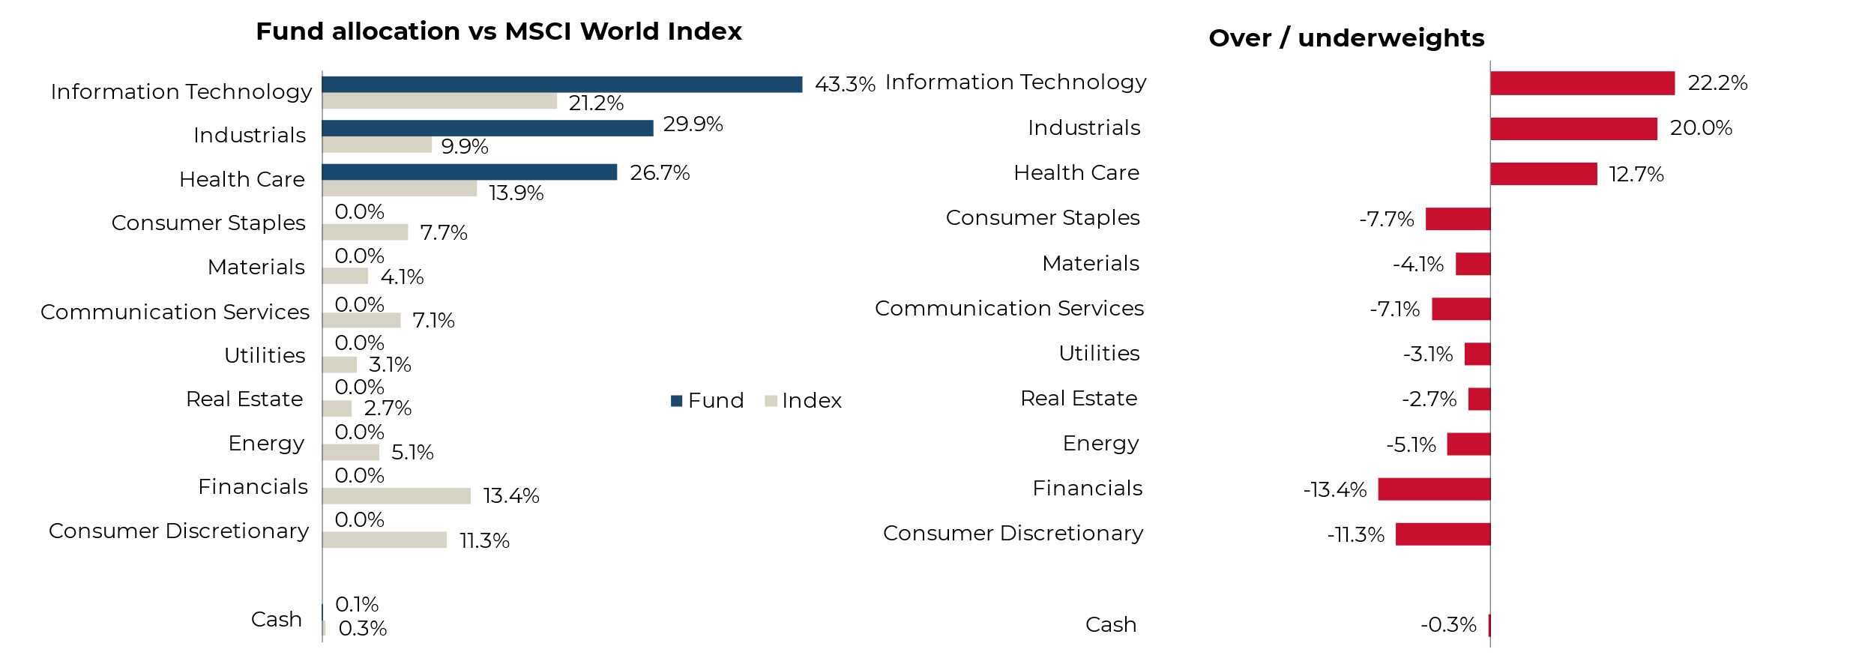
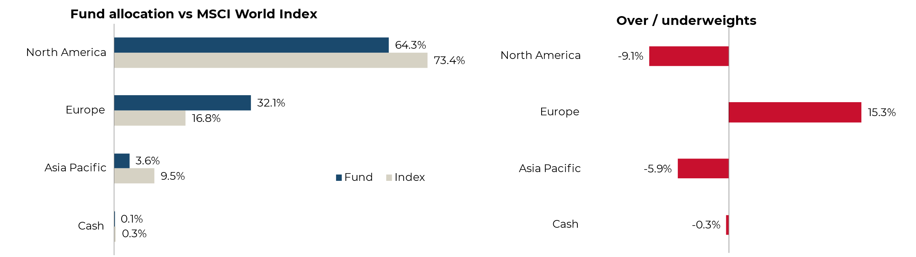
Portfolio
Breakdown Vs MSCI World Benchmark
SECTOR ALLOCATION
Overweight (and only exposures to) IT, Industrials, Healthcare
Quality filter removes the majority of commoditised, regulated areas such as Real Estate, Utilities, Energy, Materials
Sustainable and Midcap filters remove the majority of the remaining sectors
REGIONAL ALLOCATION
Underweight US; no exposure to Japan
Overweight Europe, UK, Asia-Pac ex Japan
Source: Guinness Global Investors, Bloomberg (data as at 30.09.2022)

Slide 29
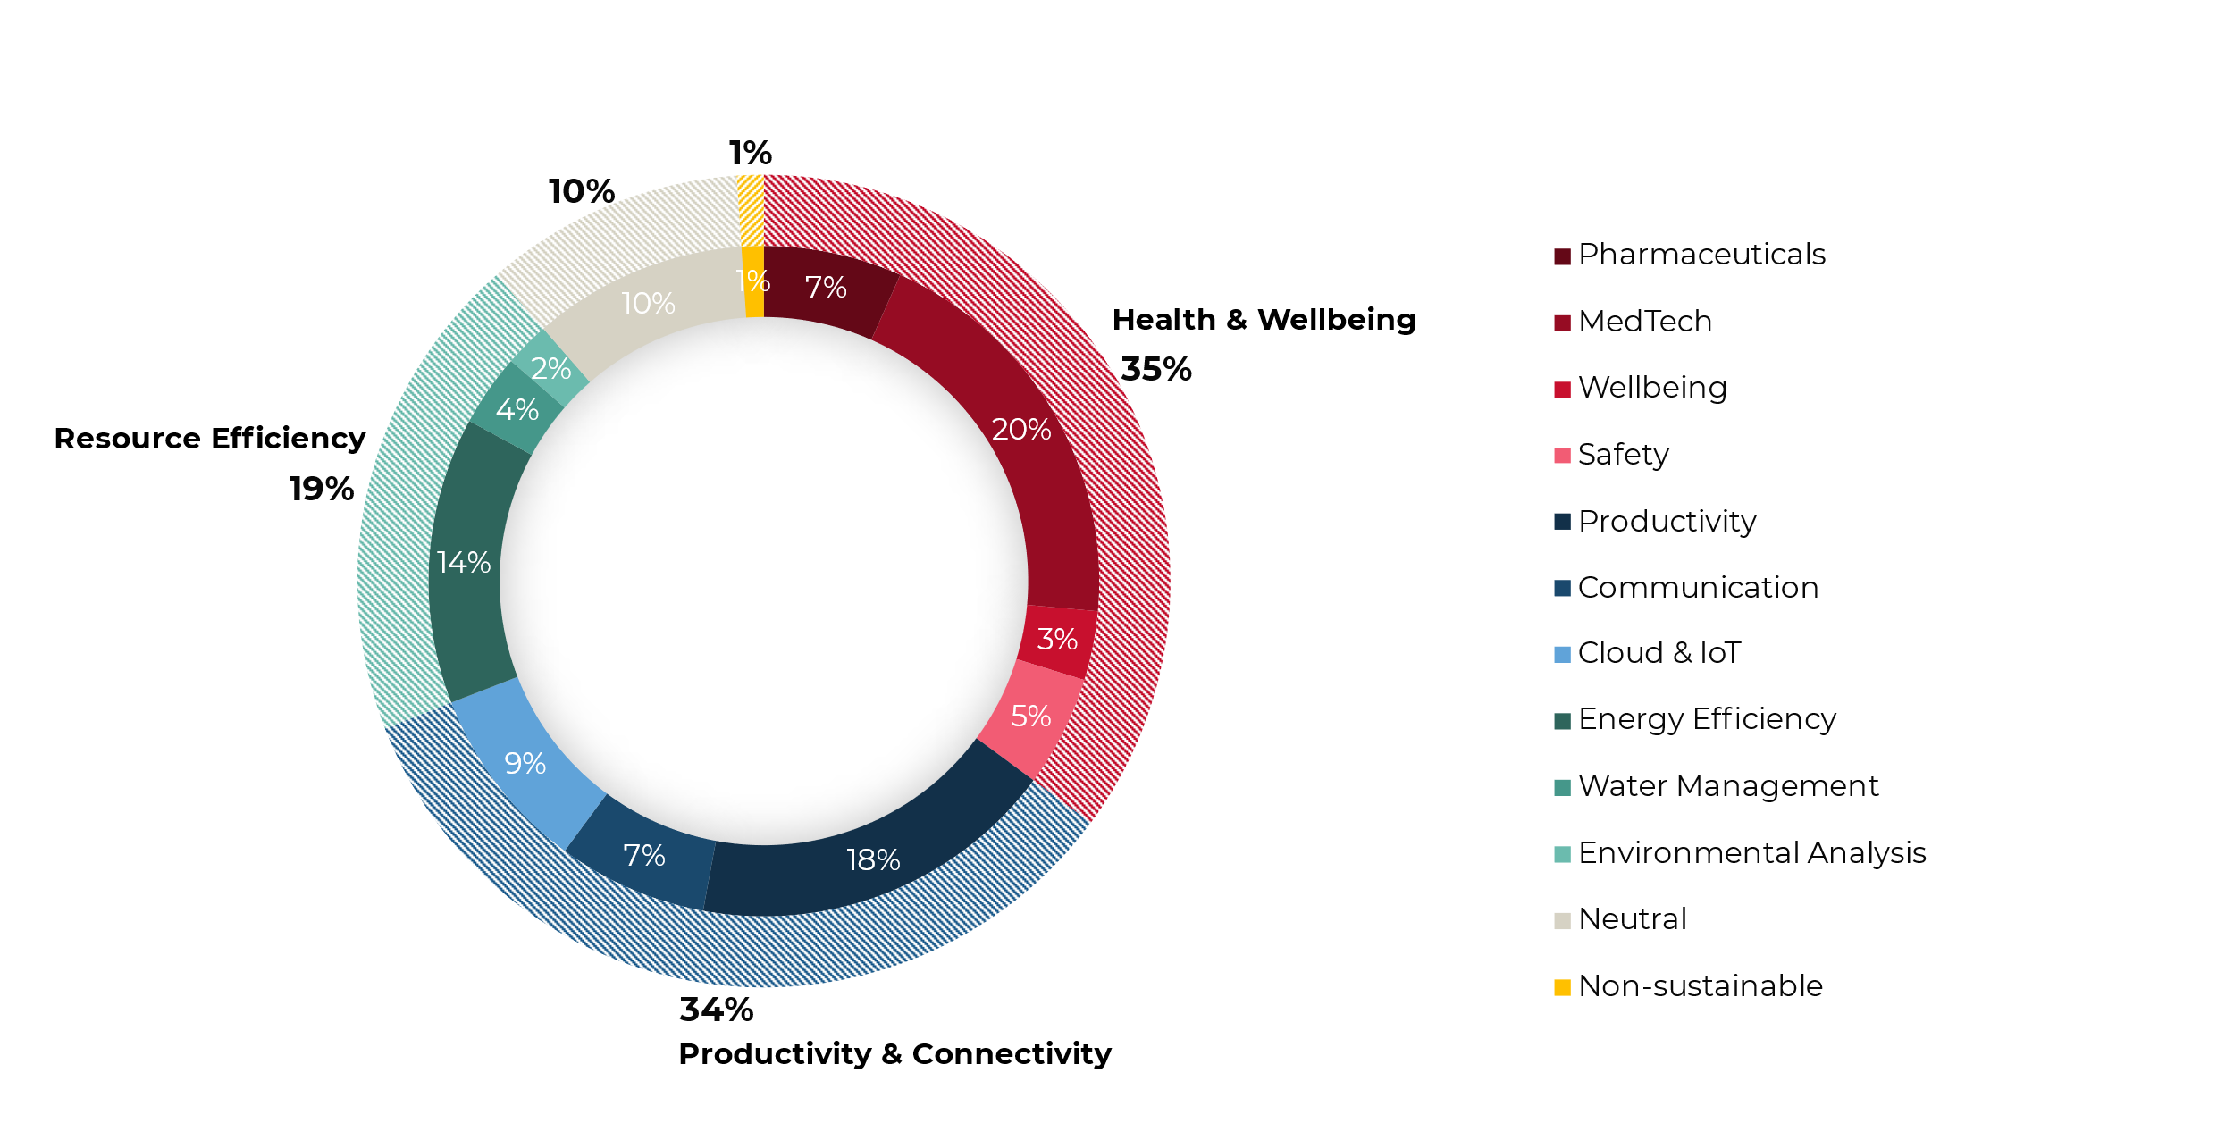
Portfolio
Thematic Exposure
Across themes, the portfolio is well diversified
Source: Guinness Global Investors, Bloomberg (data as at 30.09.2022)

Slide 30
Portfolio
Thematic Exposure
Across themes, the portfolio is well diversified
Source: Guinness Global Investors, Bloomberg (data as at 30.09.2022)

Slide 31
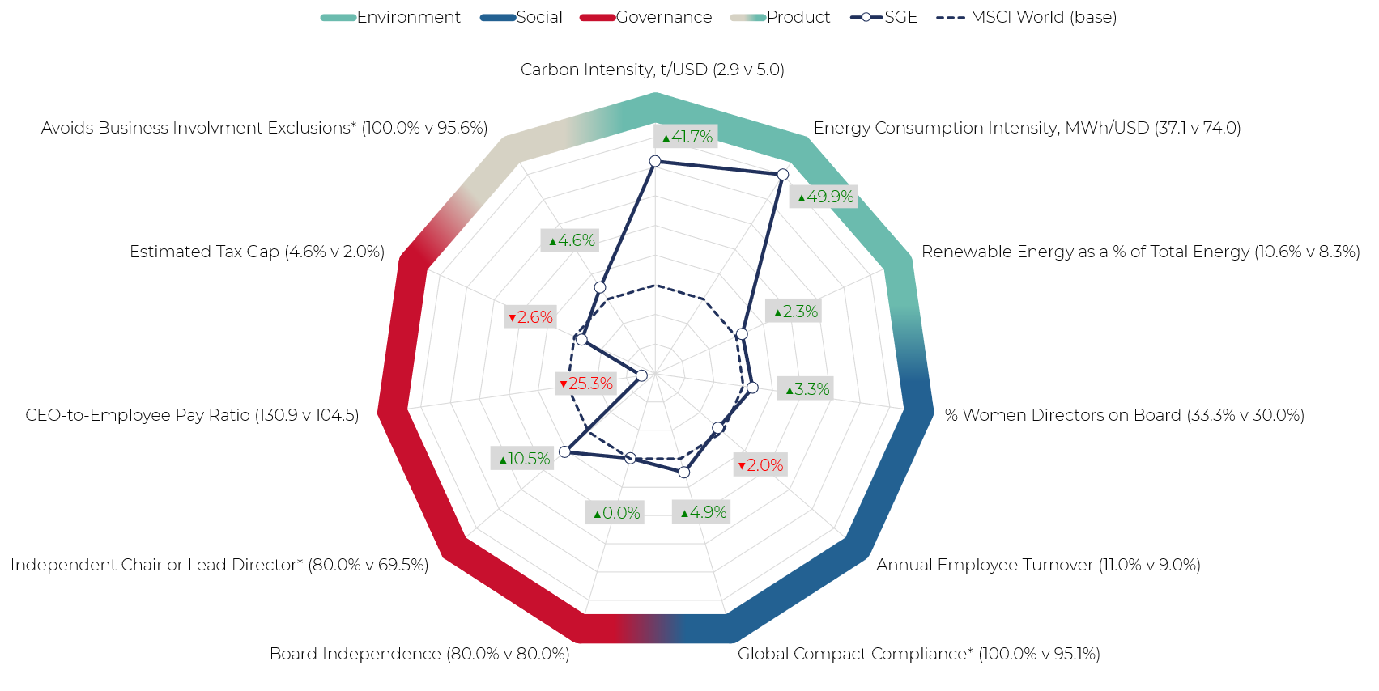
Portfolio
Sustainability Footprint
The fund performs better than the MSCI World on 8/11 of the below metrics, with weaknesses seen as areas of potential engagement
Source: Guinness Global Investors, company data; Sustainability footprint, data as at 30.09.2022, median holding except *indicating proportion of fund/benchmark meeting criteria

Slide 32
Portfolio
Statistics - Are We Doing What We Say We Will Do?
 | Fund | MSCI World
Return-on-capital | ▲14.9% | 7.2%
Net debt/equity | ▼23.7% | 67.3%
EBIT Margin | ▲20.9% | 14.6%
Carbon intensity (tons)/USD | ▼3.2 | 5.1
Energy consumption intensity MWh/USD | ▼38.6 | 78.3
Renewable Energy as a % of total energy | ▲17.0% | 7.3%
% Women Directors on board | ▲30.0% | 30.0%
Annual employee turnover | ▲11.0% | 8.0%
Global Compact Compliance | ▲100.0% | 95.2%
Board Independence | ▲78.6% | 78.6%
Independent chair or lead director | ▲86.7% | 68.0%
CEO-to-employee pay ratio | ▲107.4x | 98.7x
Estimated tax gap | ▲4.5% | 1.7%
Trailing 5-year sales growth (annualised) | ▲10.6% | 3.5%
Trailing 5-year EPS growth (annualised) | ▲14.8% | 13.3%
Estimated 1-year Forward EPS Growth | ▲7.8% | 6.5%
PE (2022e) | ▲17.8x | 14.3x
Number of stocks | 30 | 1551
Active share | 99% | -
Quality
Sustainability
Growth
Conviction
Source: Guinness Global Investors, Bloomberg (data as at 30.09.2022)

Slide 33
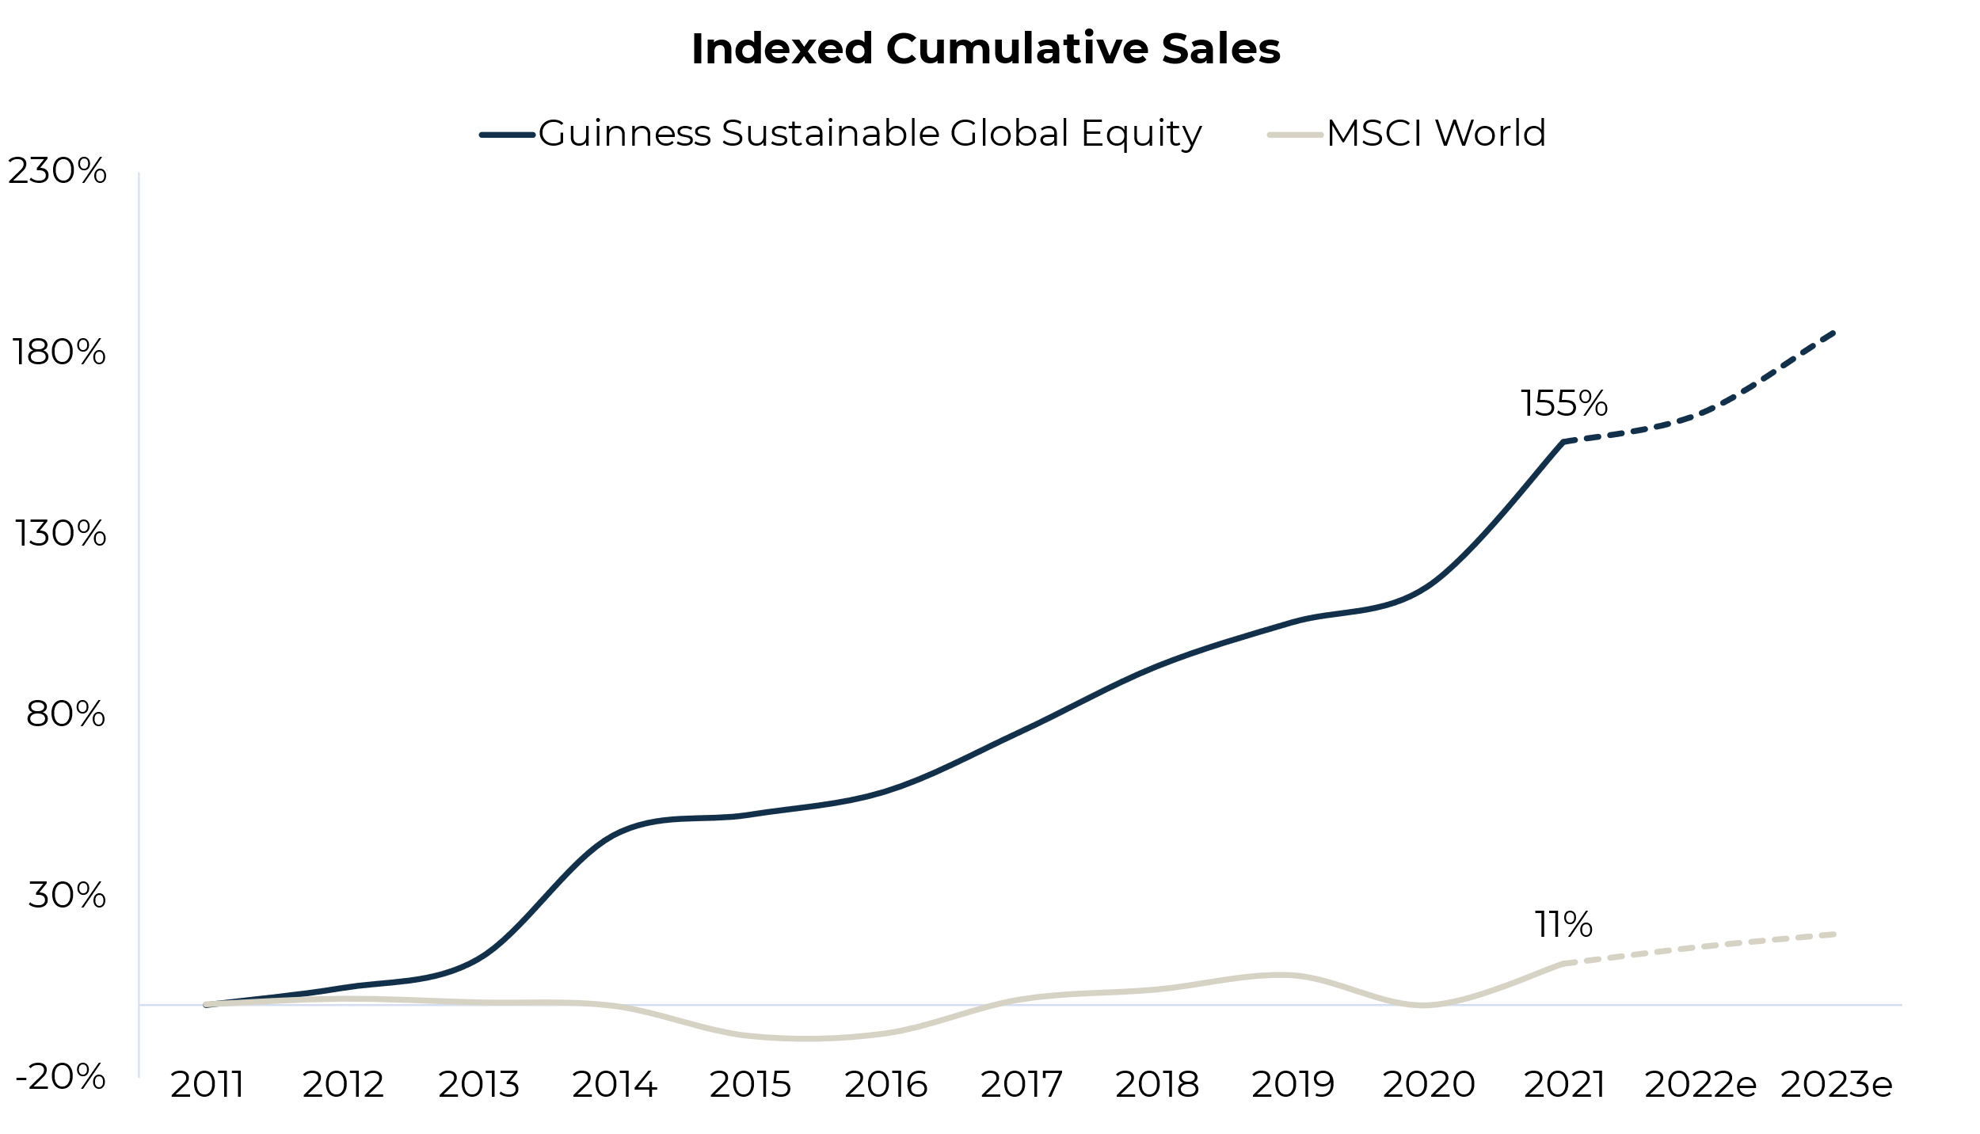
We Are Positioned In High Growth Companies…
Outlook
Focus on structural growth has led to significantly higher sales for Fund holdings.
Over the last 10 years, Fund sales have increased by 155% compared to the only 11% for the MSCI World Index.
Market is expecting 2-year sales CAGR of 8% for the Fund versus 4% for the MSCI World Index.
Source: Guinness Global Investors, Bloomberg (data as of 30.09.2022)

Slide 34
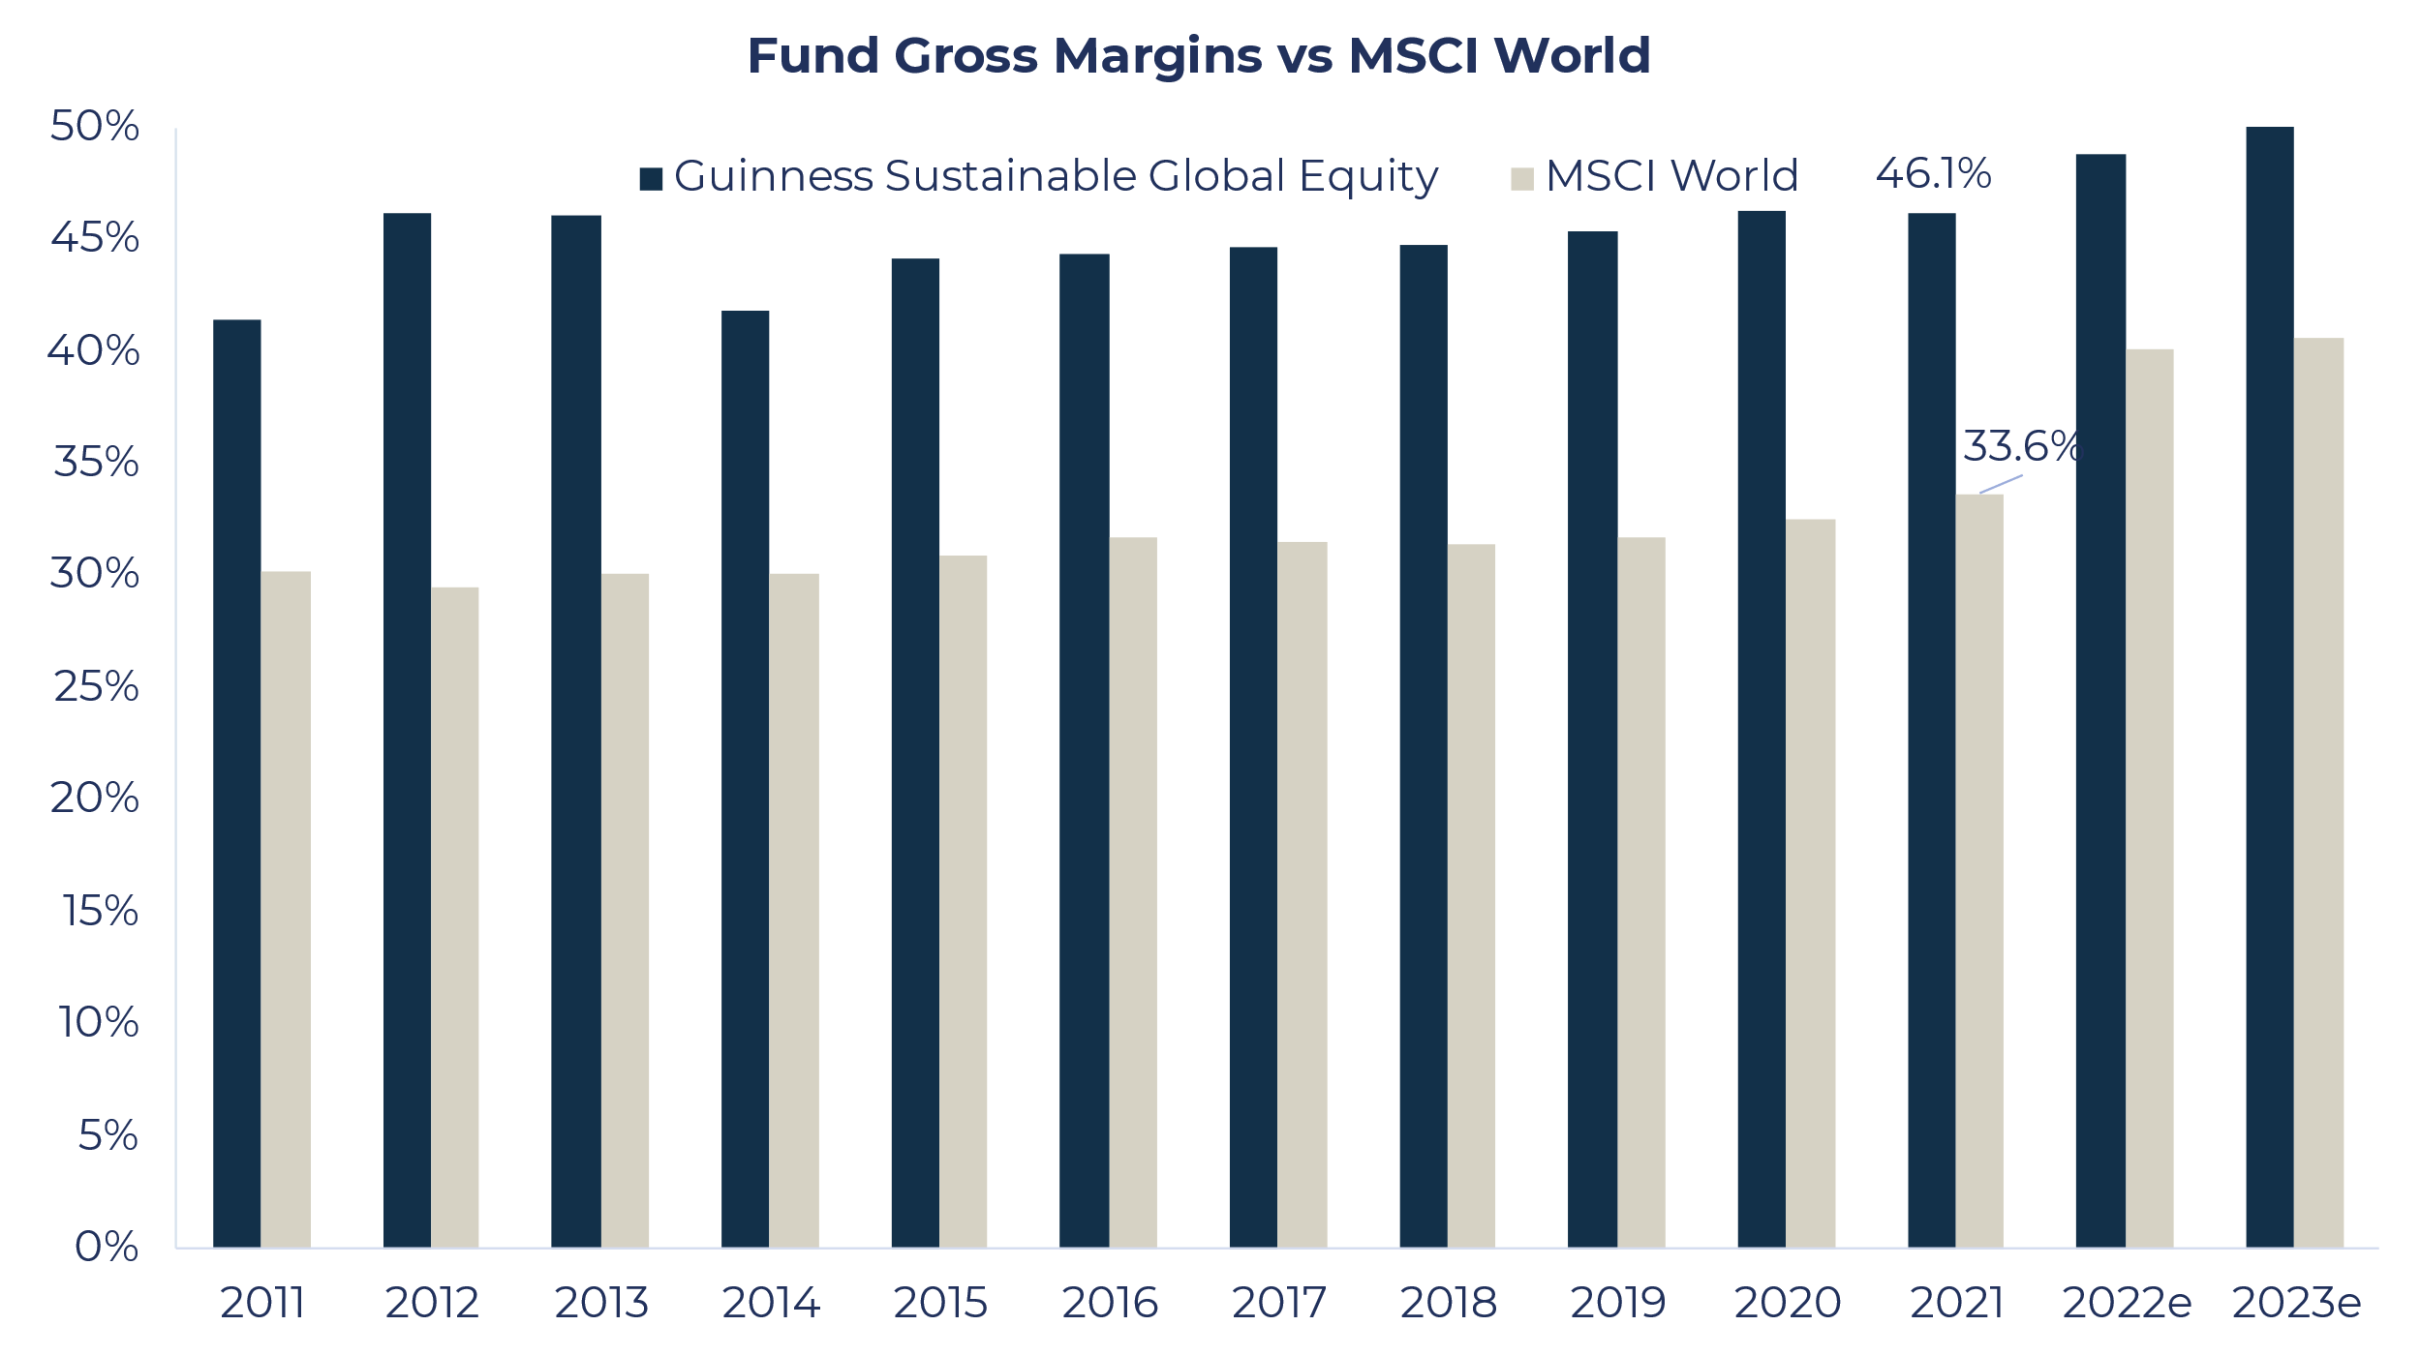
…That Are Highly Profitable…
Outlook
Fund constituents have larger gross margins – 46.1% for the Fund versus 33.6% for the MSCI World Index in 2021.
Sales growth is therefore happening at higher margins.
Better pricing power is vital as inflationary pressures persist.
Source: Guinness Global Investors, Bloomberg (data as of 30.09.2022)

Slide 35
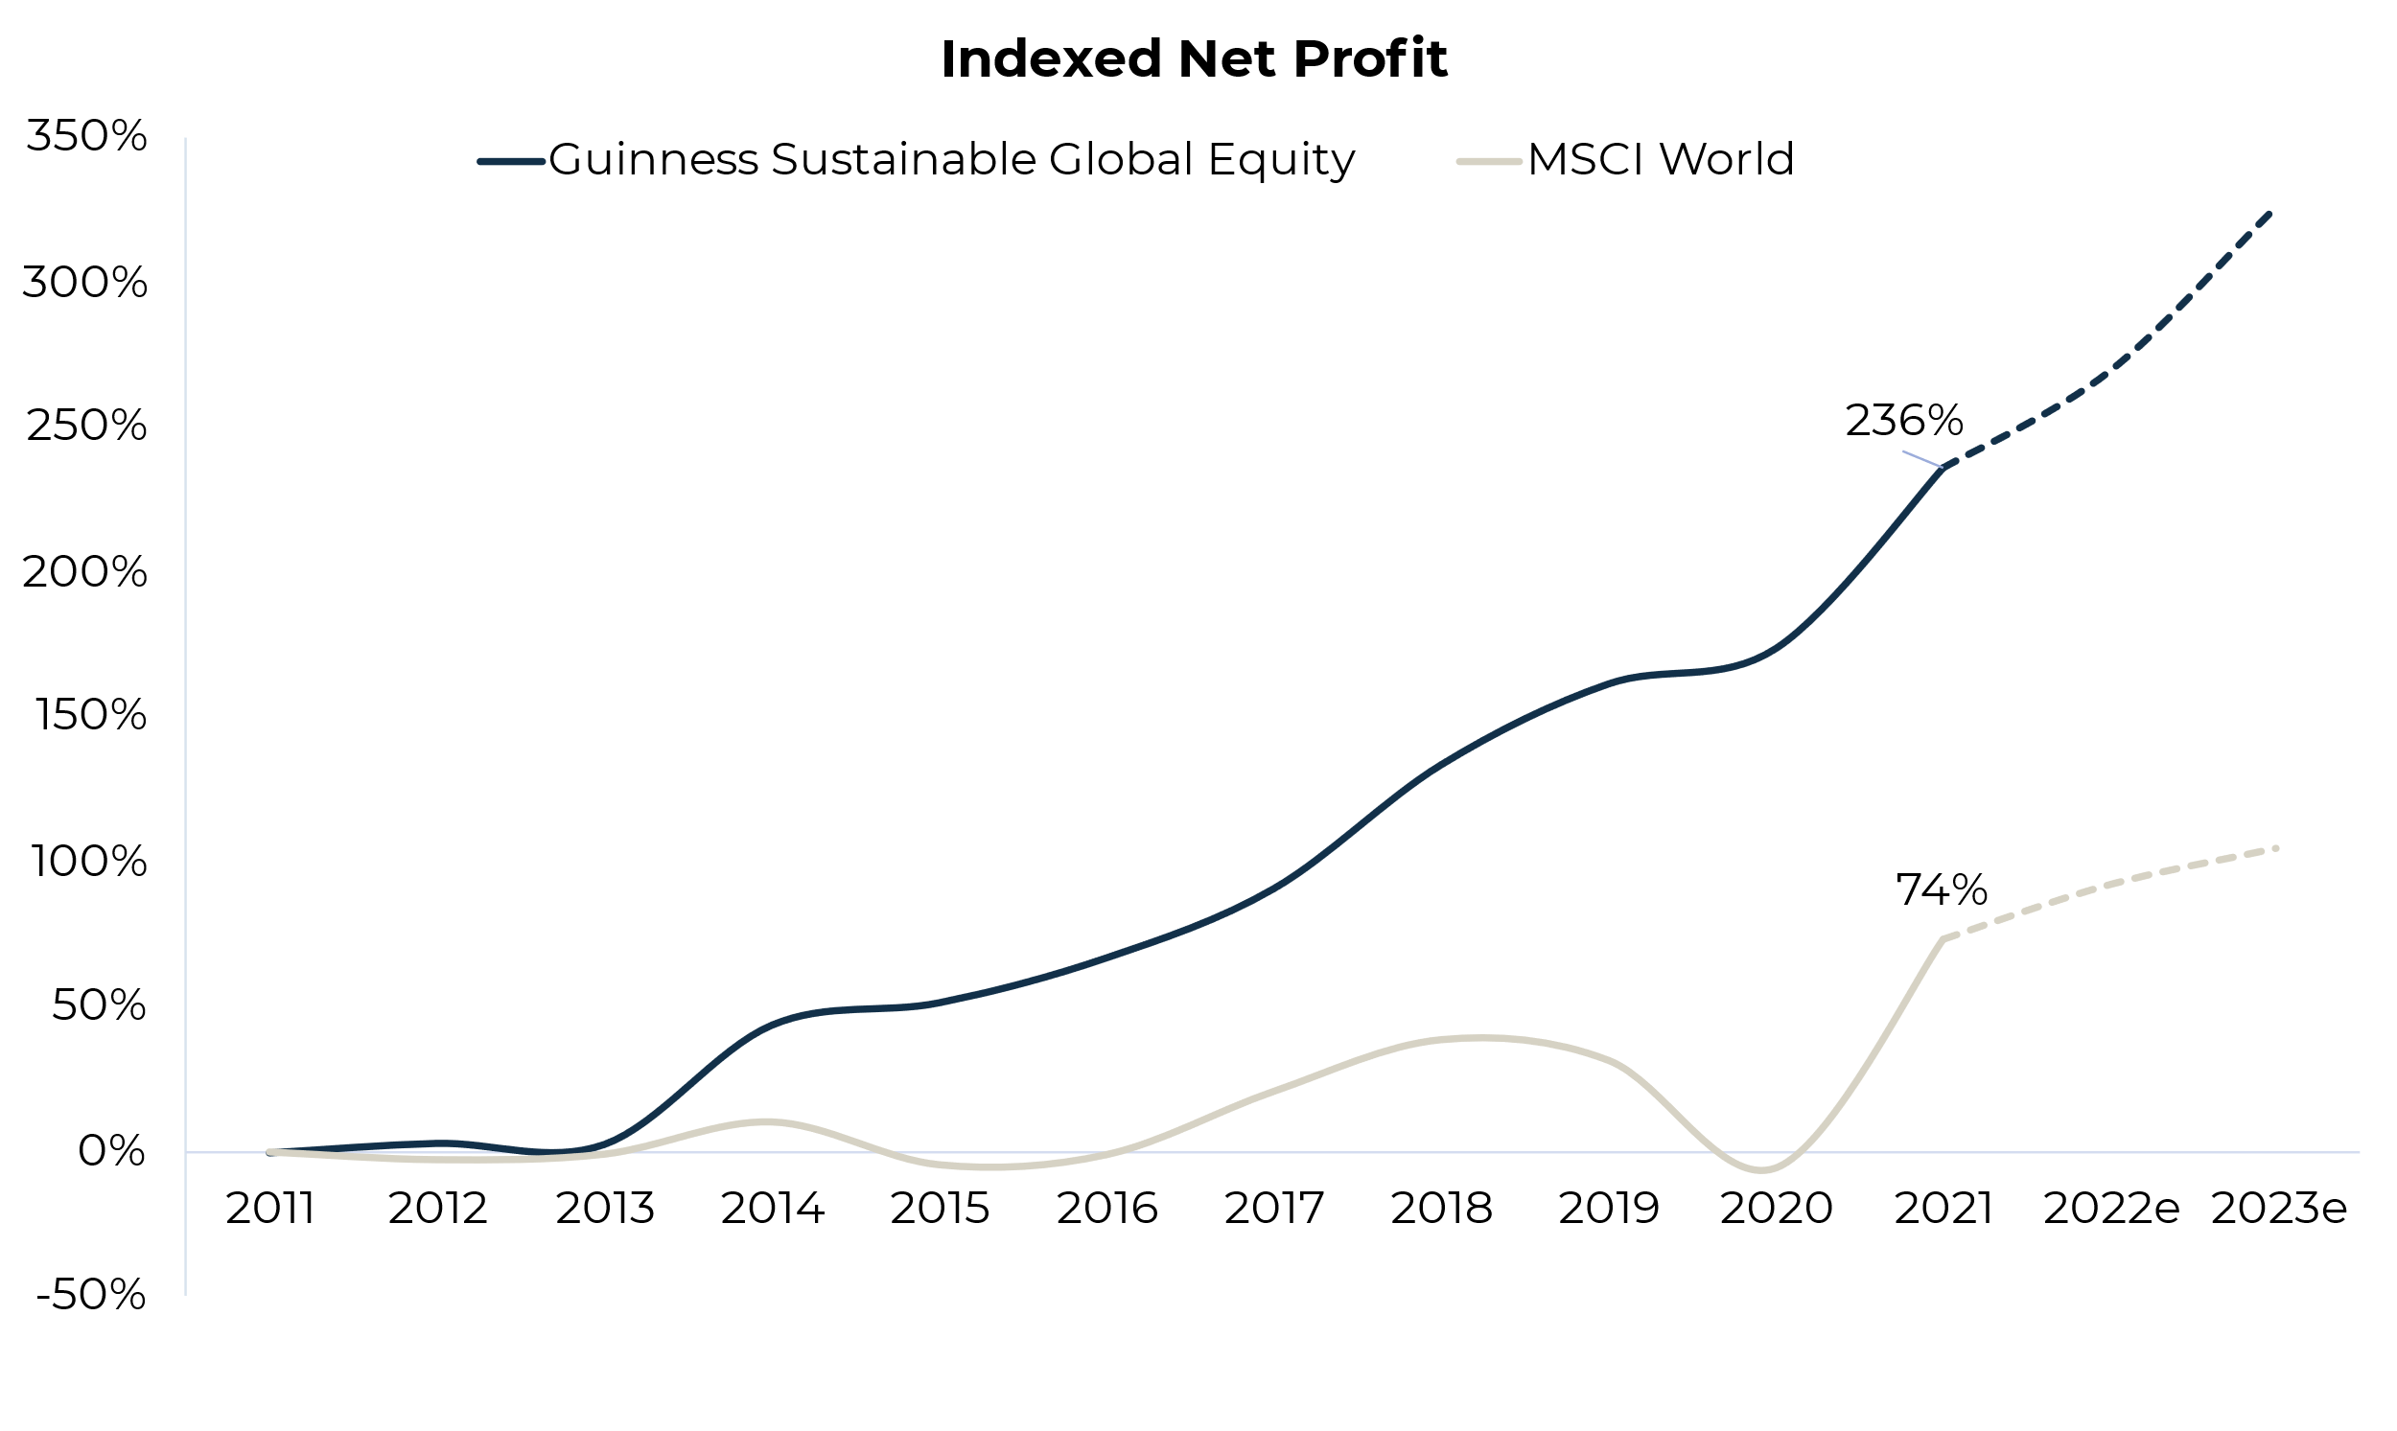
…Which Translates Into Higher Profit Growth
Outlook
Compounding effect from high revenue growth at high profitability:
Focus on structural growth AND quality has led to significantly higher net profits for Fund holdings.
Over the last 10 years, Fund profits have increased by 236% compared to only 74% for the MSCI World Index.
162% profit growth differential over 10 years
Source: Guinness Global Investors, Bloomberg (data as of 30.09.2022)

Slide 36
Fund positioning
Fund Positioning vs ESG Peer Funds
On average,
The Fund trades at a discount vs the median peer fund*, based on 1-year forward P/E and P/B ratios
The Fund's holdings have higher historical Sales and EPS growth vs peer funds*
The Fund's holdings have better quality characteristics vs peer funds*, despite being mid-cap focused
Better
Source: Guinness Global Investors, Bloomberg, USD (data as of 30.09.2022). *A custom universe of 65 funds created by screening the IA Global Sector for all Responsible, Sustainable and Impact funds which have similar investment policies and risk profiles to the Guinness Sustainable Global Equity Fund

Slide 37
Guinness Sustainable Global Equity Fund
Important information
Issued by Guinness Global Investors, a trading name of Guinness Asset Management Limited, which is authorised and regulated by the Financial Conduct Authority.
This report is primarily designed to inform you about Guinness Sustainable Global Equity Fund. Any investment decision should take account of the subjectivity of the comments contained in the report. It is provided for information only and all the information contained in it is believed to be reliable but may be inaccurate or incomplete; any opinions stated are honestly held at the time of writing but are not guaranteed. The contents of the document should not therefore be relied upon. It should not be taken as a recommendation to make an investment in the Fund or to buy or sell individual securities, nor does it constitute an offer for sale.
Documentation
The documentation needed to make an investment, including the Prospectus, the Key Investor Information Document (KIID) and the Application Form, is available in English from the website guinnessgi.com, or free of charge from:-
the Manager: Link Fund Manager Solutions (Ireland) Ltd, 2 Grand Canal Square, Grand Canal Harbour, Dublin 2, Ireland;
the Promoter and Investment Manager: Guinness Asset Management Ltd, 18 Smith Square, London SW1P 3HZ.
LFMSI, as UCITS Man Co, has the right to terminate the arrangements made for the marketing of funds in accordance with the UCITS Directive.
Investor Rights
A summary of investor rights in English is available here: https://www.linkgroup.eu/policy-statements/irish-management-company/
Residency
In countries where the Fund is not registered for sale or in any other circumstances where its distribution is not authorised or is unlawful, the Fund should not be distributed to resident Retail Clients. THIS INVESTMENT IS NOT FOR SALE TO U.S. PERSONS.
Structure & regulation
The Fund is a sub-fund of Guinness Asset Management Funds PLC (the “Company”), an open-ended umbrella-type investment company, incorporated in Ireland and authorised and supervised by the Central Bank of Ireland, which operates under EU legislation. The Fund has been approved by the Financial Conduct Authority for sale in the UK. If you are in any doubt about the suitability of investing in this Fund, please consult your investment or other professional adviser.
Switzerland
This is an advertising document. The prospectus and KIID for Switzerland, the articles of association, and the annual and semi-annual reports can be obtained free of charge from the representative in Switzerland, Carnegie Fund Services S.A., 11, rue du Général-Dufour, 1204 Geneva, Switzerland, Tel. +41 22 705 11 77, www.carnegie-fund-services.ch. The paying agent is Banque Cantonale de Genève, 17 Quai de l'Ile, 1204 Geneva, Switzerland.
Telephone calls will be recorded and monitored.
31/12/2021, USD

