Slide 1

Guinness
Sustainable Energy Fund
This is a marketing communication. Please refer to the prospectus and KIID for the Fund, which contain detailed information on its characteristics and objectives, before making any final investment decisions.
This document is presented to you in your capacity as a Professional Client and is not for general distribution to Retail Clients.
Should you receive this document as a Retail Client you should disregard its content and take no action based upon it.
Jonathan Waghorn (Co-manager)
Will Riley, CA (Co-manager)
Jamie Melrose, CFA, CAIA (Analyst)
November 2022

Slide 2
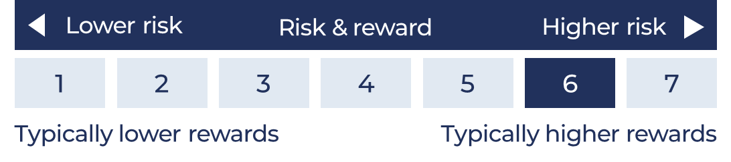
Risk & Performance
Guinness Sustainable Energy Fund
Risk: The Guinness Sustainable Energy fund is an equity fund. Investors should be willing and able to assume the risks of equity investing. The value of an investment and the income from it can fall as well as rise as a result of market and currency movement, and you may not get back the amount originally invested. The Fund invests only in companies involved in the energy sector; they are therefore susceptible to the performance of that one sector, and can be volatile. Details on the risk factors are included in the Funds’ documentation, available on our website (guinnessgi.com/literature). ​
Guinness Sustainable Energy Fund:
The risk and reward indicator shows where the funds rank in terms of their potential risk and return. The higher the rank the greater the potential reward but the greater the risk of losing money. The shaded area in the table shows this fund’s rank. The Sustainable Energy Fund is ranked as 6 because its volatility has been measured as above average to high. This is based on how investments have performed in the past and you should note that the fund may perform differently in the future and its rank may change. Historical data may not be a reliable indicator for the future.
Performance: Past performance is not a guide to future returns. ​
Investors should note that fees and expenses are charged to the capital of the fund. This reduces the return on your investment by an amount equivalent to the Ongoing Charges Figure (OCF). The fund performance shown has been reduced by the current OCF of 0.68% per annum. Returns for share classes with different OCFs will vary accordingly. Performance returns do not reflect any initial charge; any such charge will also reduce the return.
The Fund is actively managed with the MSCI World Index used as a comparator benchmark only.

Slide 3
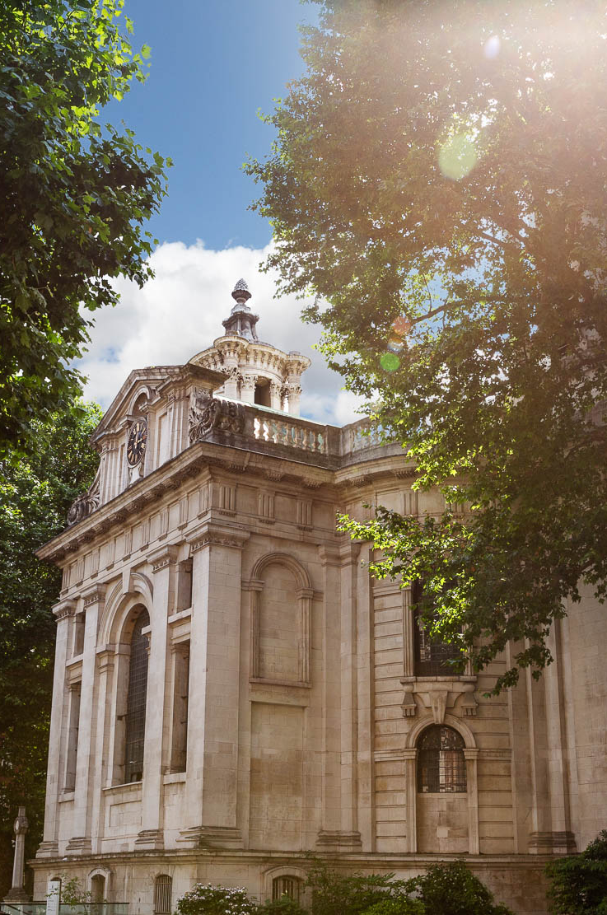
1
1
ABOUT
Guinness Sustainable
Energy Fund
Fund invests globally in companies engaged in the generation and storage of sustainable energy and the electrification and efficiency of energy demand
Proven long-term track record in global energy fund management over 23 years
Managers of:
  Investec Global Energy Fund 1998 - 2008
  Guinness Global Energy Fund 2008 – today
  Guinness Alternative Energy Fund 2007 – 2019
  Guinness Sustainable Energy Fund 2019 - today
Concentrated portfolio of 30 equally-weighted positions with a value bias. We believe our focus on our 30 best ideas contributes to our outperformance versus other funds
1
1

Slide 4
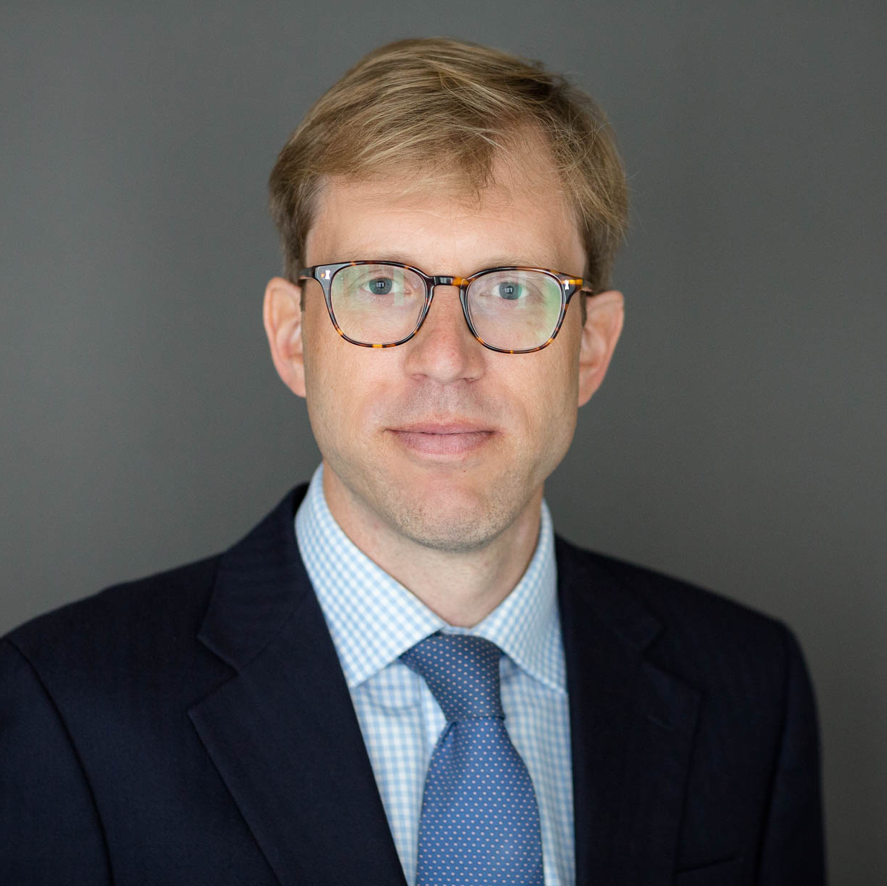
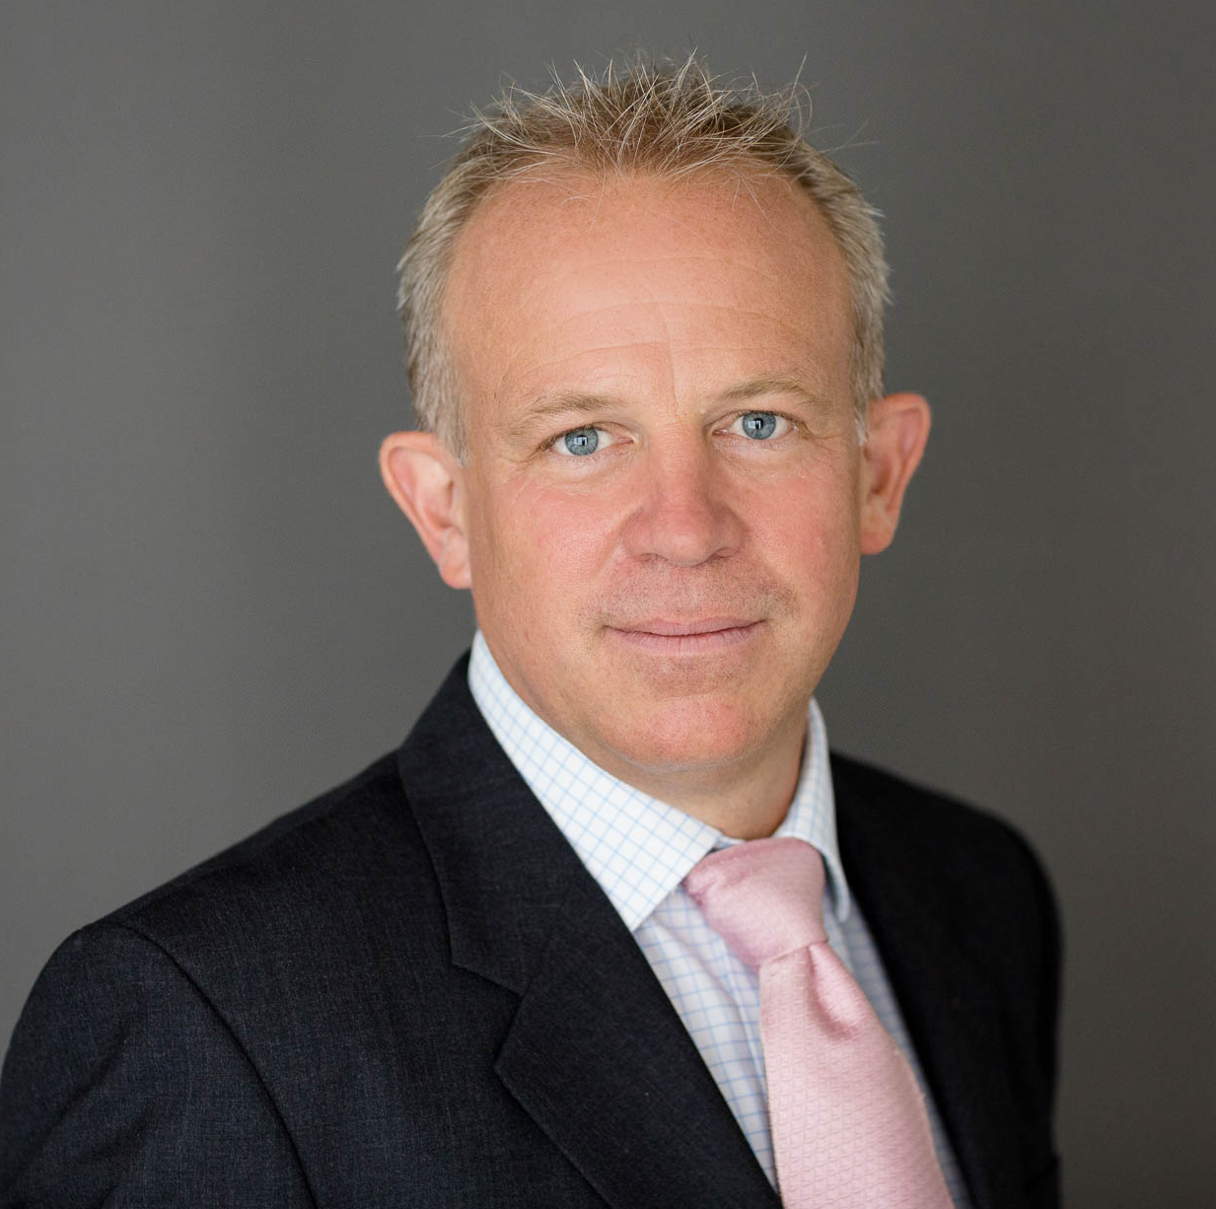
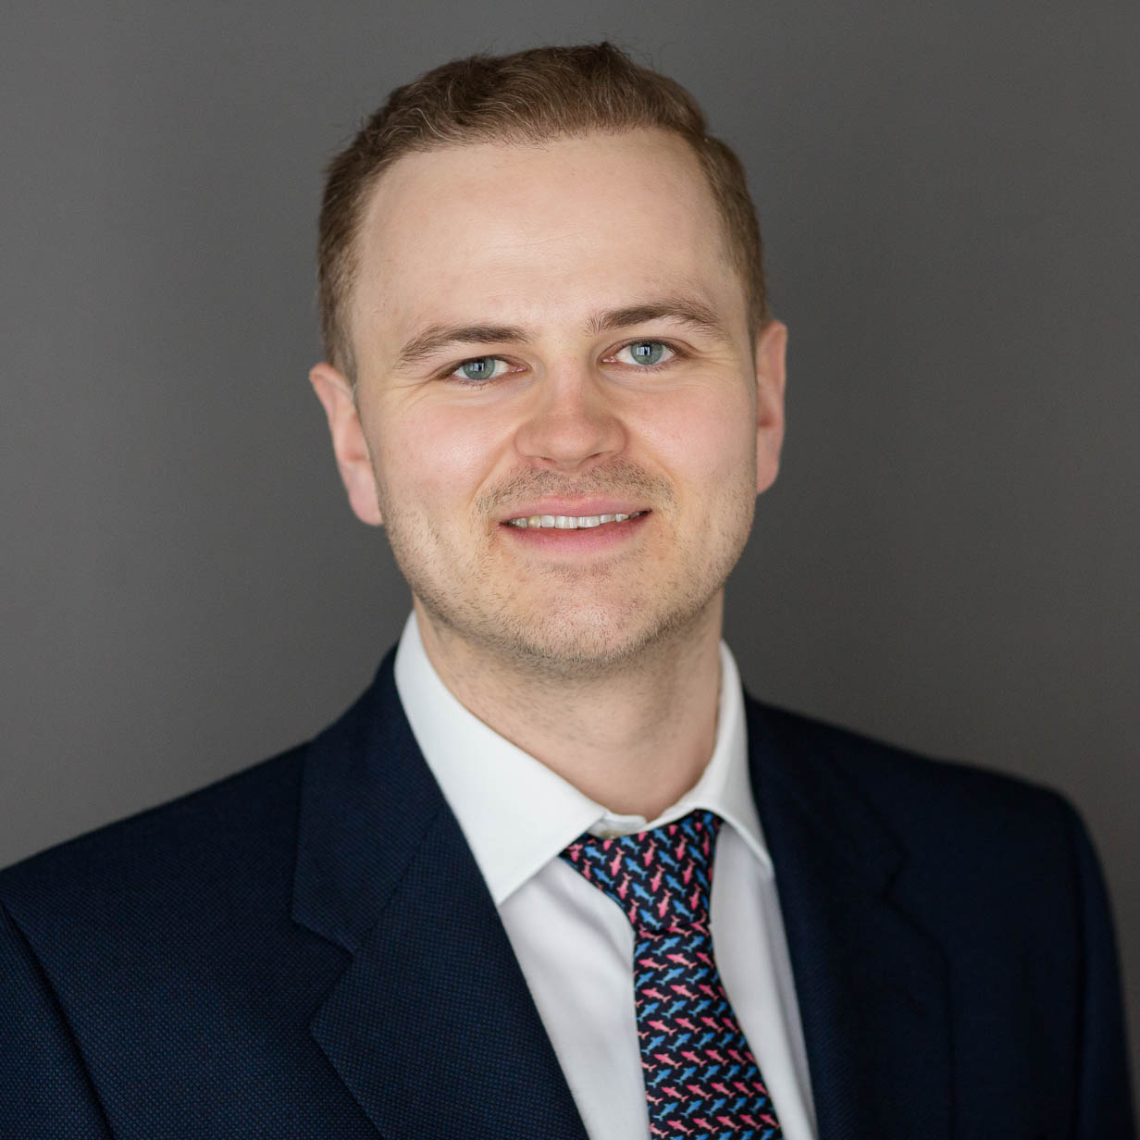


Investment team biographies
Guinness Sustainable Energy Fund
Will Riley
CA (Co-manager)
Jonathan Waghorn
(Co-manager)
Jamie Melrose
CFA, CAIA (Analyst)
Dan Hobster
(Analyst)
Francesca Wheble
(Responsible Investment Analyst)
  Joined Guinness Global Investors in 2007
  Company valuation expert for PwC 2000-2007
  Qualified as a Chartered Accountant in 2003
  Graduated from Cambridge University with a Masters degree in Geography in 1999
  Joined Guinness Global investors in 2013
  Co-portfolio manager of the Investec Global Energy Fund from February 2008 to May 2012
  Co-head of energy equity research at Goldman Sachs from 2000-2008
  Drilling engineer in Dutch North Sea for Shell
  Joined Guinness Global Investors in 2019
  Investment Manager in Sustainable Ownership at Railpen from 2016-2019
  Thematic Analyst in Equity Research at Berenberg from 2014-2016
  Graduated from the University of Bath with a degree in Mathematics in 2014
  Joined Guinness Global Investors in 2022
  Global Cyclical Analyst at TT International
  Graduated from Oxford University with a degree in Politics, Philosophy and Economics.
  Joined Guinness Global Investors in 2021
  Internship at Fundsmith LLP in investment management and at Vespa Capital as an ESG consultant
  Graduated from the University of Exeter with a degree in Business and Management with proficiency in Entrepreneurship in 2020

Slide 5
Characteristics of the Guinness Sustainable Energy Fund
Guinness Sustainable Energy Fund
Single sector | Companies engaged in the generation and storage of sustainable energy and the electrification and efficiency of energy demand. Strategy excludes companies engaged in the extraction of oil, natural gas and coal
High conviction | Equally weighted, concentrated portfolio (30 positions)
Fully invested | No cash management, FX hedging or derivatives
Unconstrained | Benchmark agnostic
Global | Diversified globally
Investment type | Listed equities (long-only), low turnover
Fund structure | Dublin OEIC (UCITS IV); daily dealing; no performance fees
Launch date | 19 December 2007

Slide 6




Our investing solution to the Sustainable Energy transition
Guinness Sustainable Energy Fund
The Guinness Sustainable Energy Fund prioritises returns whilst delivering concentrated exposure to companies playing a key role in global de-carbonisation
The Fund’s holdings map most directly to four of the UN’s sustainable development goals
The Fund is classified as Article 9 for the purpose of the EU SFDR

Slide 7
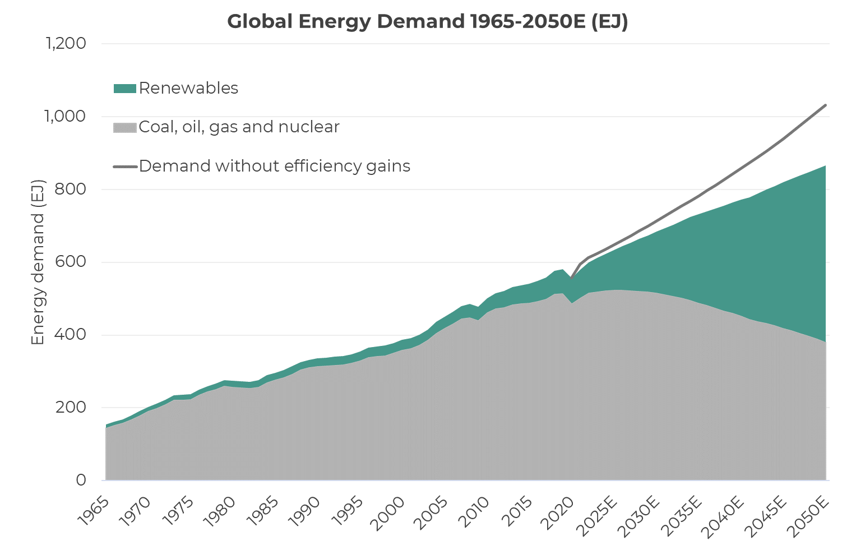
The energy transition: efficiency & renewables at expense of fossil fuels
Guinness Sustainable Energy Fund
  Efficiency
  Renewables growth
  Fossil fuel reduction
Source: BP; Guinness Global Investors estimates

Slide 8
Why will the sustainable energy transition occur?
Guinness Sustainable Energy Fund
Over the next thirty years, the world will transition to a sustainable energy system. The key factors driving the transition are:
Population and GDP growth put a significant strain on today’s energy supply
Climate change The world will reduce carbon emissions via cleaner energy
Pollution Governments will drive air pollution out of cities via cleaner energy
Energy security Sustainable energy tends to be distributed, will lower reliance on energy imports
Economics Sustainable sources of energy will be cheaper than the incumbents
The Russian invasion of Ukraine is likely to accelerate the energy transition

Slide 9
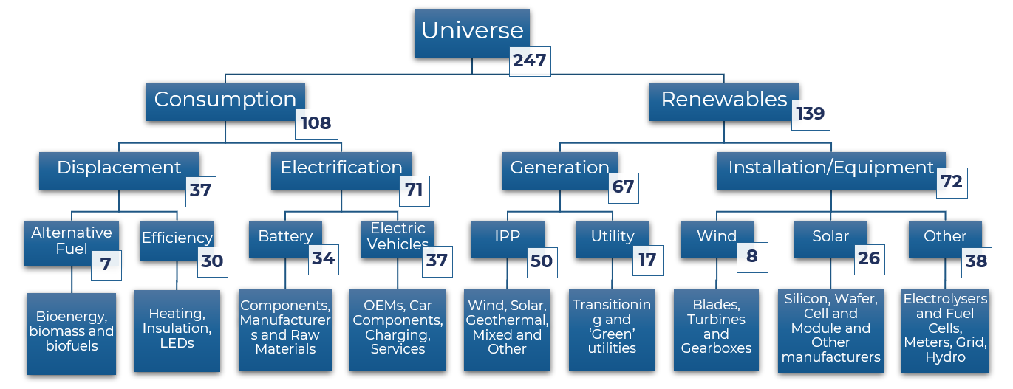
Guinness’ classification of Sustainable Energy universe
Guinness Sustainable Energy Fund
Our universe includes around 250 relevant companies that have >$500mn market capitalisation
Our universe has grown from around 200 companies to 250 companies over the last 3 years
Source: Guinness Global Investors, August 31 2022

Slide 10
Investment process and style
Guinness Sustainable Energy Fund
Our stock selection process is 50% top down and 50% bottom up
Top down (50%)
Rigorous in-house analysis of sustainable energy industry data Analysis of the key drivers of growth, scarcity, barriers to entry and economics informs our weighting to our internally generated Sustainable Energy subsectors Informs our sub-sector allocation between displacement, electrification, generation and installation
Bottom up (50%)
Two stage selection of the best stocks to populate our top down themes: Disciplined screening process Regular screening of a universe of around 250 global sustainable energy stocks (market cap of >$500m) using our in-house model. Our screen considers valuation, quality, earnings momentum and price momentum Detailed financial modelling Ideas are taken from our screens and a detailed financial model is created to establish whether we have conviction to buy or sell

Slide 11
Process: screening prioritises stocks for in-depth analysis
Guinness Sustainable Energy Fund
Each month we rank our universe of c.250 stocks based on four fundamental criteria to identify companies that demonstrate:
  Value
  Quality (high return on capital)
  Positive earnings momentum
  Positive stock price momentum
Stocks are scored 1-10 on each of the 4 criterion and then ranked
Screening allows prioritisation of stocks for deeper due diligence
It helps to maintain our objectivity when considering the energy universe - we are not constrained to stocks we already know well
It also helps with our sell discipline, by highlighting companies in the portfolio that are scoring poorly, either because value has been realised or because fundamentals have deteriorated
(1)
Valuation
Relative value vs peers
(2)
Quality
Return on capital
(4)
Stock price momentum
Stock price movements
vs peers
(3)
Earnings momentum
Analysts’ earnings
forecasts changes

Slide 12
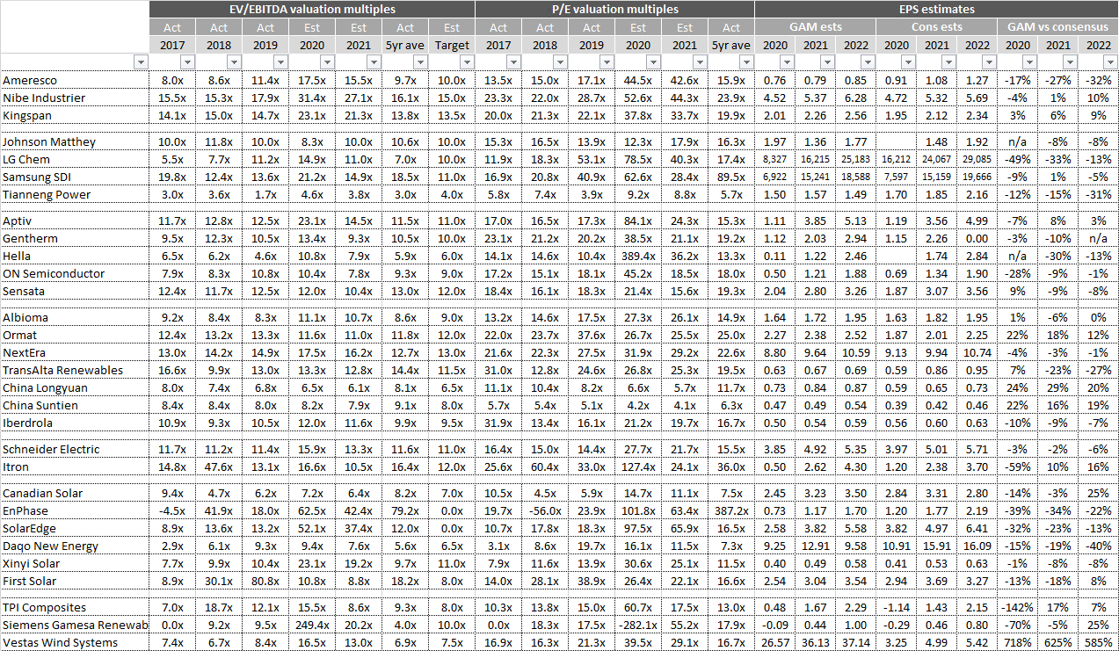
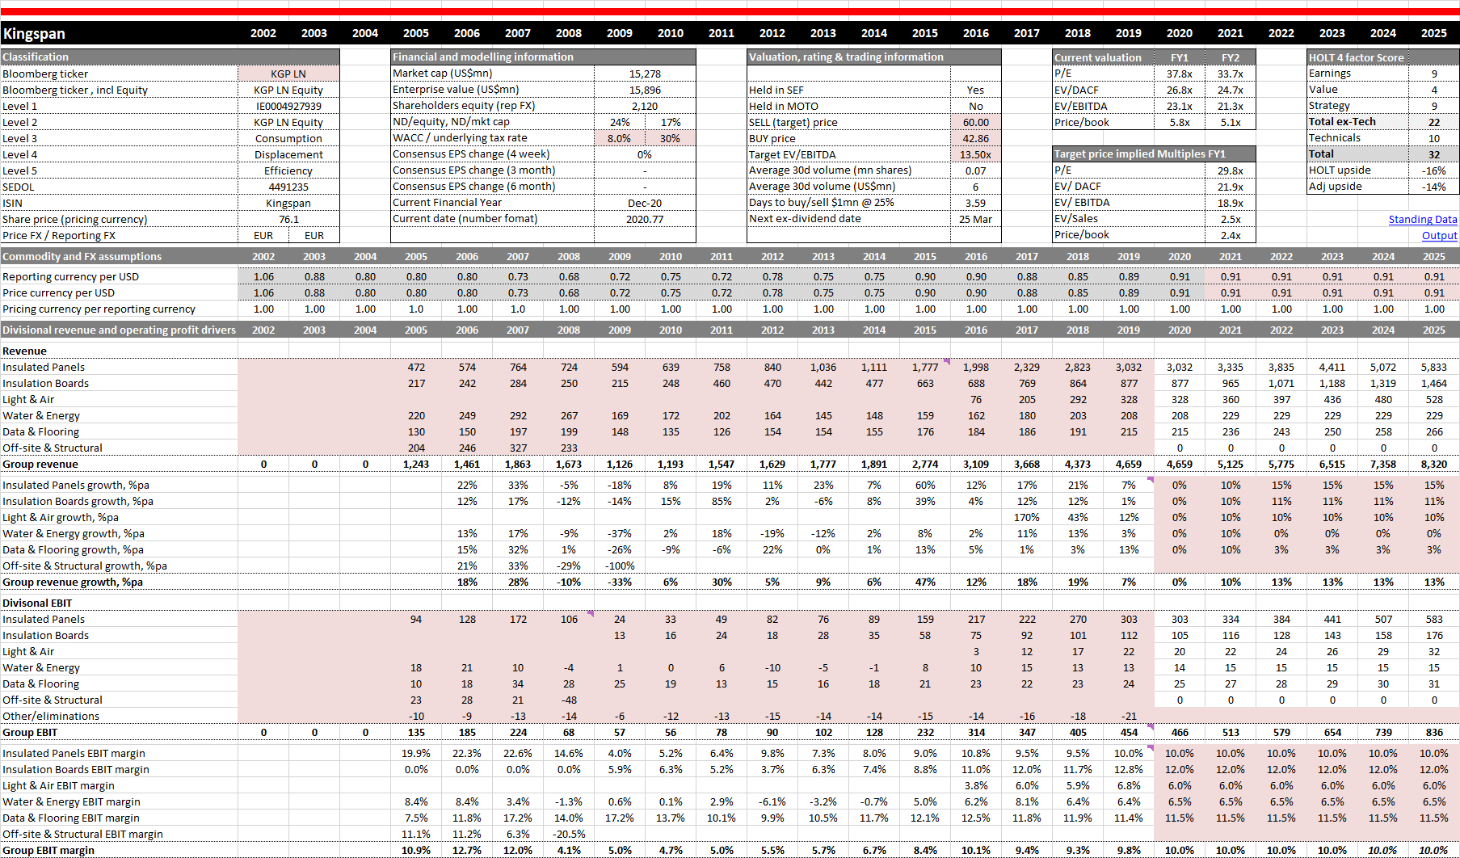
Process: fundamental screening of stocks
Guinness Sustainable Energy Fund
Targeted fundamental and rigorous analysis to deliver a final 30 position portfolio
Disciplined company valuation is integral to our due diligence procedure
We emphasise different valuation metrics for different energy subsectors
We look for patterns of value across various metrics rather than growth per se
Example valuation summary
Example company model
Source: Bloomberg; Guinness Global Investors

Slide 13

Responsible investing & ESG
Guinness Sustainable Energy Fund
We adopt the UN PRI framework for responsible investing & ESG:
ESG Incorporation Considering ESG issues when building a portfolio | Stewardship Improving Investees’ ESG Performance
“ESG issues can be incorporated into existing investment practices using a combination of three approaches: integration, screening and thematic.” | “Investors can encourage the companies that are already invested in to improve their ESG risk management.”
 | Engagement | Proxy voting
‘Top-down’ ESG integration via in-house global energy transition modelling ‘Bottom-up’ ESG integration via in-house qualitative ESG reviews Norges Bank exclusion list compliant Designated an impact-aligned fund in that it seeks to combine capital appreciation with a positive environmental outcome | ESG engagement with investee companies takes place: i) At corporate level ii) By investment team iii) Collaboratively via Climate Action 100+ | Proxy voting on ESG issues for companies in the fund carried out by the portfolio managers

Slide 14
Portfolio construction
Guinness Sustainable Energy Fund
Stock level
  Equally-weighted portfolio of 30 best ideas
  Reduces stock-specific risk (max 3.33% loss per position)
  Maintains a healthy level of fund concentration
  Imposes a structural sell discipline in that we have to sell an existing stock to buy a new one
  Generates a rebalancing premium as we “top up” positions when they underperform
  Keeps life simple as we focus our time on stock selection rather than position weighting
Sector level
  No benchmark adherence in sector weightings
  Sector weights driven entirely by top down subsector allocation and bottom up value characteristics
  No underweight restrictions
  Active share versus MSCI World NR Index is currently in excess of 99%
Market cap
  For liquidity and risk reasons, 90% of the Fund is generally invested in companies with a market capitalisation of more than USD$500m

Slide 15
Portfolio analysis
Guinness Sustainable Energy Fund
USA data excludes three US listed stocks; Trane Technologies and Aptiv (Irish domiciled) and SolarEdge (Israeli domiciled)
Source: Guinness Global Investors (data at October 31 2022)
Notes:
14
S:\GAM\Dublin Global Equity Income Fund\Factsheets\DEI Factsheet Data

Slide 16
Sustainable Energy Fund: portfolio by theme
Guinness Sustainable Energy Fund
Sustainable Energy Fund: portfolio by theme
Source: Guinness Global Investors (data at October 31 2022)

Slide 17
Portfolio valuation characteristics
Guinness Sustainable Energy Fund
The Guinness Sustainable Energy portfolio compares to the MSCI World as follows:
A premium P/E ratio in 2023/2024 of 10-26%
A higher EV/EBITDA multiple
Lower dividend yield
Stronger forecast EPS %pa growth
Improving cashflow return metrics
Source: Guinness Global Investors (data at October 31 2022)

Slide 18
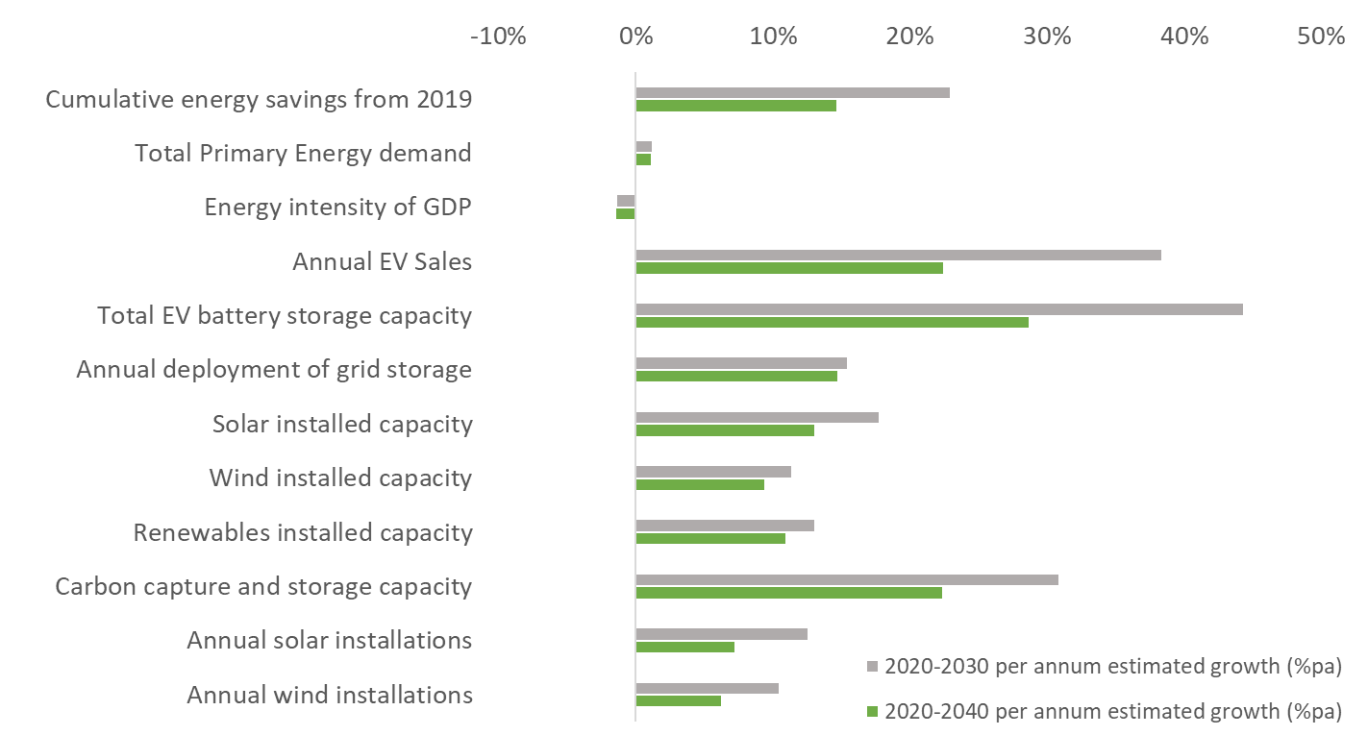
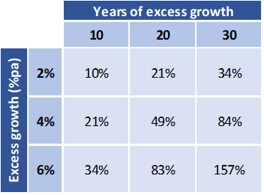
Growth potential well in excess of typical global equities
Guinness Sustainable Energy Fund
The various sustainable energy subsectors offer attractive per annum growth rates over the next ten or twenty years
Premium growth should justify premium valuation
A company that grew its cash flows at a 2%pa faster rate than its peer over a ten-year period would mathematically be worth about 10% more than its peer.
If it were maintained for 20 years, the valuation premium should be around 20%.
A 4% growth premium over 10 years would warrant a 20% valuation
A 4% growth premium for 20 years would justify a 50% premium
Ten- and twenty-year growth projections for sustainable energy sectors
Source: Guinness Global Investors estimates, Bloomberg, BP

Slide 19
Fund return since relaunch of strategy (USD)
Guinness Sustainable Energy Fund
Past performance does not predict future returns
The Guinness Sustainable Energy fund was repositioned at the end of 2018
*
*Simulated past performance. Performance prior to the launch date of the Y class of the fund (16.02.18) is a composite simulation for Y class performance being based on the actual performance of the Fund’s E class (1.24% OCF). The Guinness Sustainable Energy Fund was launched on 19/12/2007 (A class, 1.49% OCF). The E Class was launched on 02/09/2008 (1.24% OCF). The Y class was launched on 16/02/2018 (0.68% OCF).
Full 12 month performance is available on slide 60
Source: Financial Express, bid to bid, total return. Fund returns are for share classes with a current Ongoing Charges Figure (OCF) of 0.68%; returns for share classes with a different OCF will vary accordingly.

Slide 20
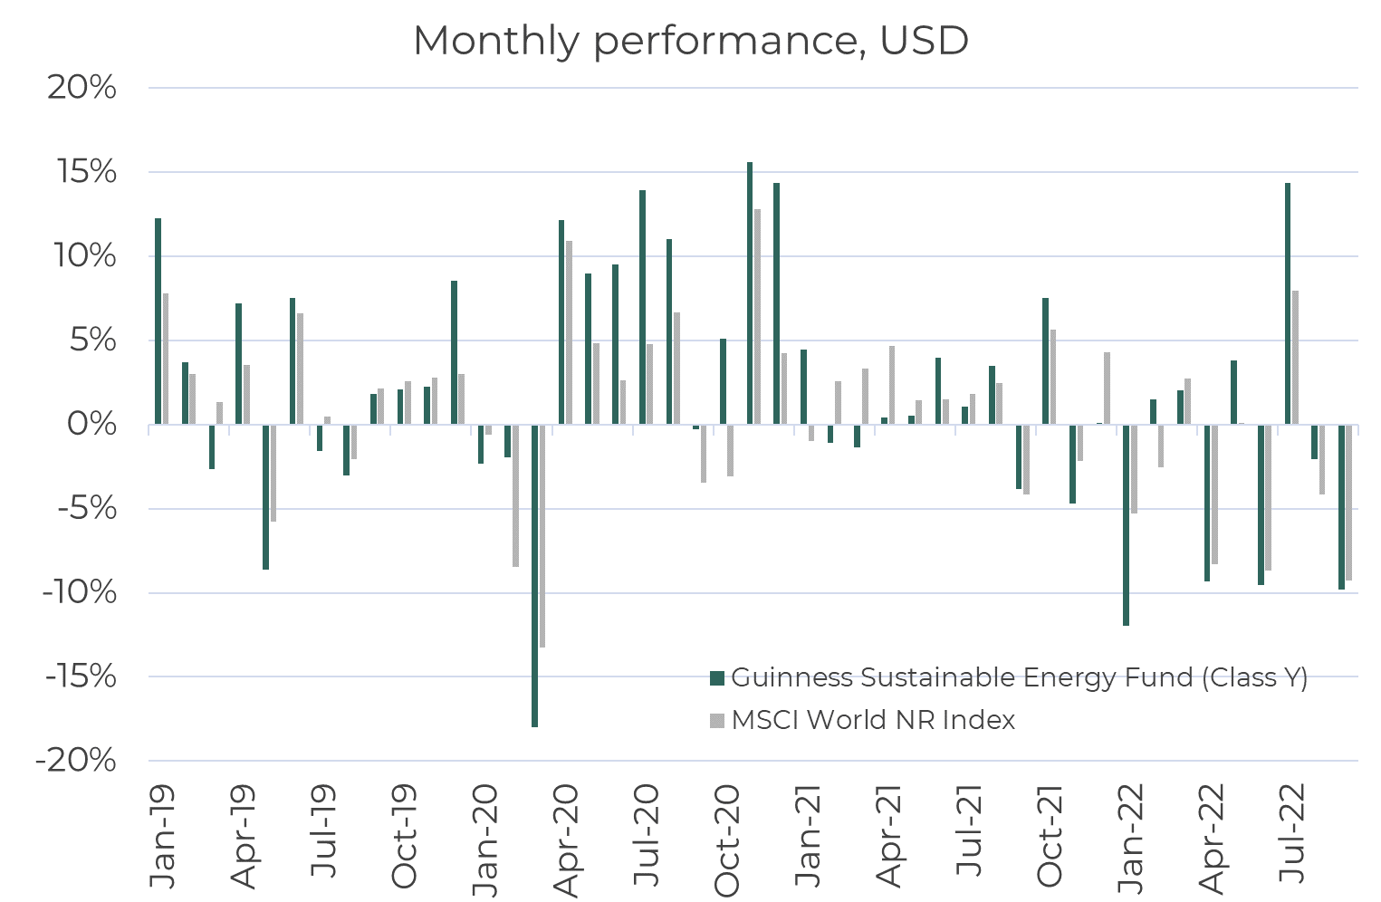
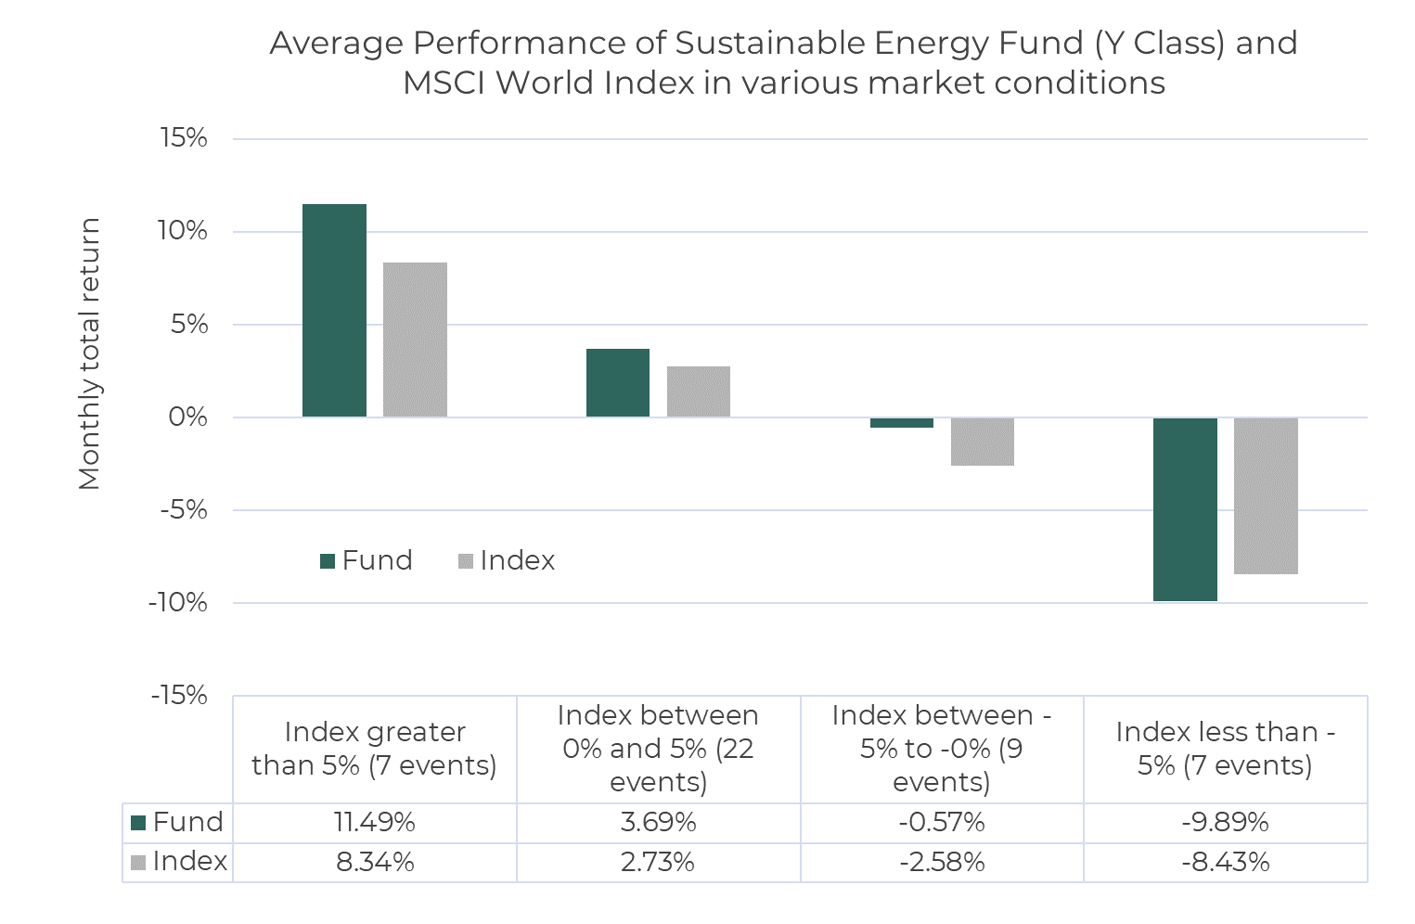
Performance characteristics
Guinness Sustainable Energy Fund
Past performance does not predict future returns
Source: Guinness Global Investors (data from 28 February 2019 at September 30 2022)..

Slide 21
Indicative fund attribution, 3yrs to December 2021
Guinness Sustainable Energy Fund
The Guinness Sustainable Energy fund delivered 166.7% (USD) TR over the 3yrs to Dec 2021
Sector allocation positive across most sub sectors
Stock selection positive on balance
Attribution of Guinness Sustainable Energy Fund versus the universe (2019-2021)
Source: Guinness Global Investors, Bloomberg, as of December 2021

Slide 22
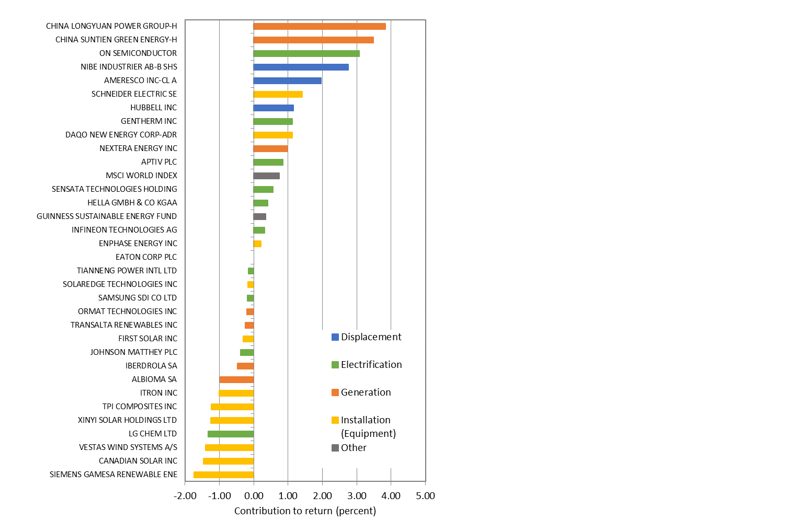
Indicative fund contribution, per position in 2021
Guinness Sustainable Energy Fund
Past performance does not predict future returns
2021 indicative contribution (USD)
Fund in 2021: +10.4% (USD)
Strongest themes/stocks:
China IPPs; Longyuan and Suntien
Electrification; Onsemi, Gentherm
Displacement; Nibe; Ameresco, Hubbell
Equipment; Schneider, and Daqo (China polysilicon)
Weakest themes/stocks:
Equipment; wind and solar
Generation; Iberdrola and Albioma
Source: Guinness Global Investors, Bloomberg, data as of end Dec 2021, Class Y USD ACC

Slide 23
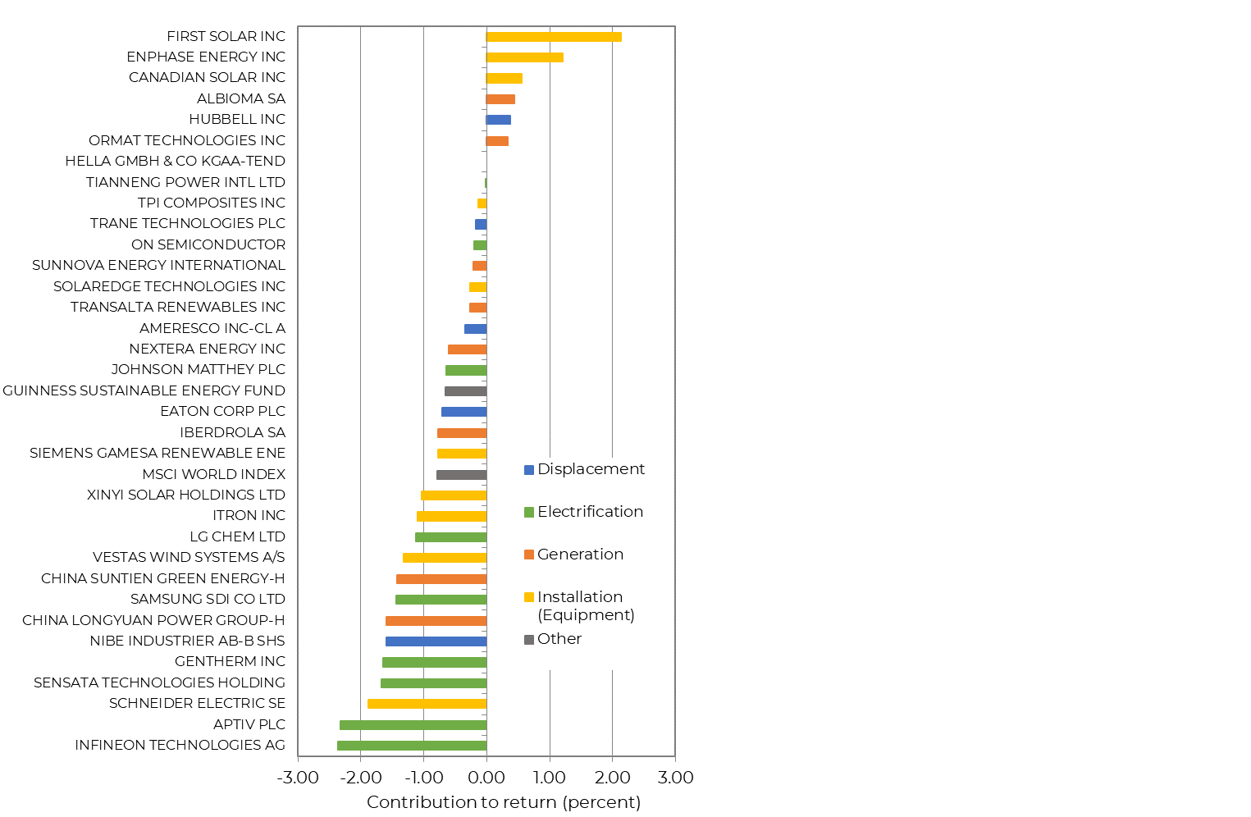
Indicative fund contribution, per position in 9mth 2022
Guinness Sustainable Energy Fund
Past performance does not predict future returns
9mth 2022 indicative contribution (USD)
Fund in 9mth 2022 (to end September): -21.6% (USD)
Strongest themes/stocks:
Solar equipment; First Solar, EnPhase and Canadian Solar in reaction to IRA announcement
Generation; Albioma (bid from KKR), Ormat and TransAlta (safe havens)
US domiciled stocks typically stronger
Weakest themes/stocks:
Electrification; slowing auto sales outlook and raw material inflation, Standard Investment take 5% of Johnson Matthey
Quality/growth de-rating; Schneider Electric and Nibe
Chinese generation; weaker with Chinese market weakness
Source: Guinness Global Investors, Bloomberg, data as of end September 2022, Class Y USD ACC

Slide 24
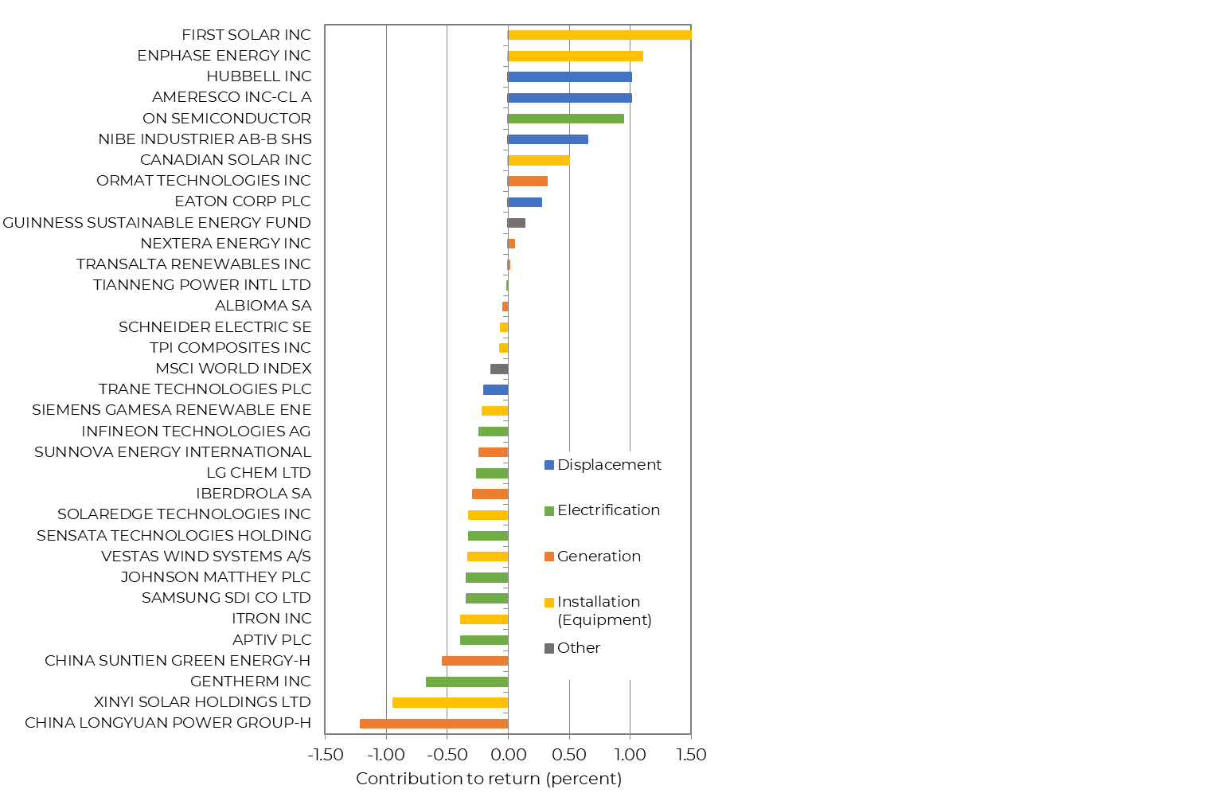
Indicative fund contribution, per position in 3Q 2022
Guinness Sustainable Energy Fund
Past performance does not predict future returns
3Q 2022 indicative contribution (USD)
Fund in 3Q 2022: +1.0% (USD)
Strongest themes/stocks:
Solar equipment; First Solar (+94% over 3Q, 320bp contribution), EnPhase and Canadian Solar in reaction to positive growth outlook from IRA announcement
Displacement; Hubbell, Ameresco and Nibe in reaction to efficiency products/services outlook post IRA announcement
US stocks particularly strong (11 of 12 strongest performers being US listed companies)
Weakest themes/stocks:
Electrification; slowing auto sales outlook and raw material inflation still persists but impact has lessened
China; 4 of 5 weakest stocks HK listed, whether generation or solar equipment) in line with Chinese market weakness
Source: Guinness Global Investors, Bloomberg, data as of end September 2022, Class Y USD ACC

Slide 25
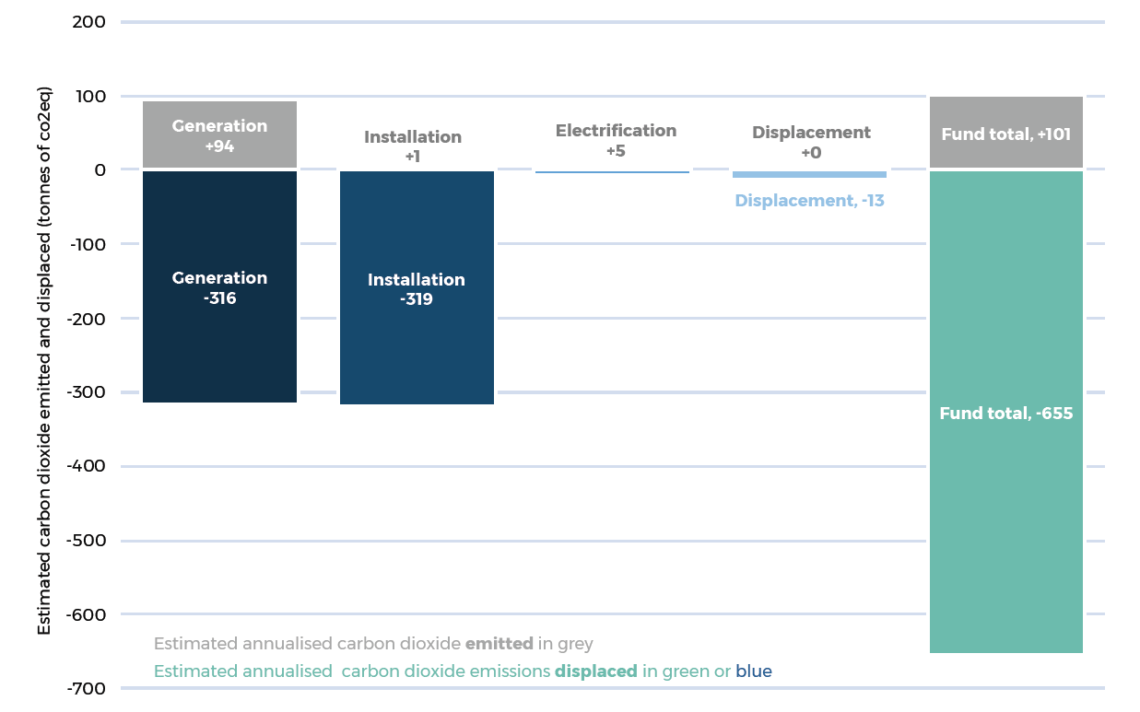
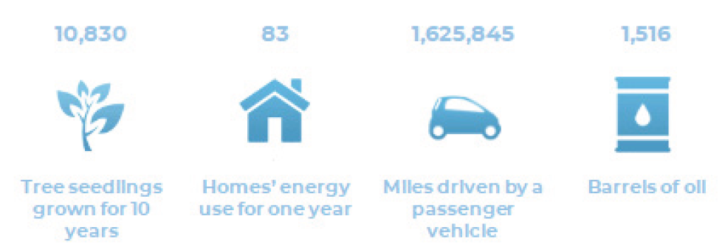
Portfolio holdings’ impact – carbon dioxide emissions avoided
Guinness Sustainable Energy Fund
Estimated annualised carbon cost vs carbon displaced
(tonnes) per $1m of AuM by sector
In 2021, per US$mn of portfolio assets, we estimate that the annualised carbon:
  cost was c.101 tCO2e/$m
  displaced was c.655 tCO2e/$m
655 tonnes of CO₂ is equivalent to one of the following:
Note: these are unaudited figures, which rely on internal estimates
Sources: Environmental Protection Agency; Guinness Global Investors estimates for carbon emissions displaced; net carbon emissions calculation incorporates scope 1, 2 and ‘4’ emissions. For further information please see the Guinness Sustainable Energy fund impact report

Slide 26
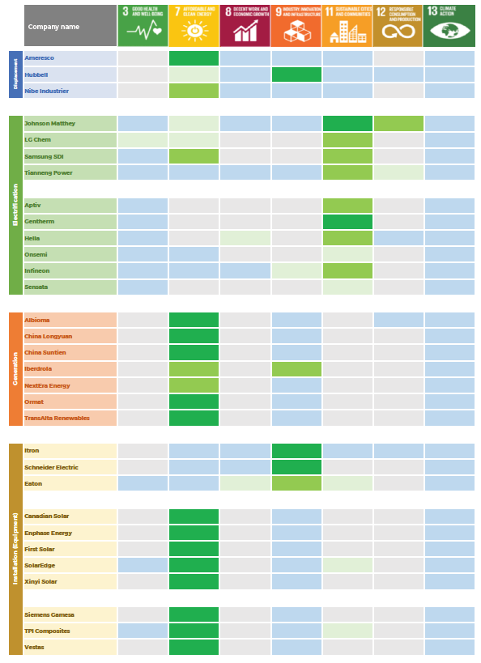

Portfolio holdings’ impact – mapping to the UN SDGs
Guinness Sustainable Energy Fund
We conduct an impact mapping exercise; matching divisional activity to relevant SDG targets
The fund maps to SDGs 7, 9 and 11 by design and contributes to SDG 13
Relevant ‘Direct’ SDGs
Source: United Nations, Guinness Global Investors estimates for portfolio at end December 2021

Slide 27
Why Guinness for sustainable energy?
Guinness Sustainable Energy Fund
Experience in energy 23+ year track record. The Guinness investment team therefore has a strong understanding of the energy transition, from both a conventional and sustainable energy perspective.
Intelligent universe design Guinness has built an intelligent universe of around 250 stocks, covering the breadth of the sustainable energy sector from electrification and efficiency to equipment and generation. This universe is specific to Guinness.
Attractive portfolio characteristics The Guinness sustainable energy portfolio has better expected growth prospects than the MSCI World and trades at a P/E premium.
Fund is impact aligned The Guinness Sustainable Energy Fund, designated as Article 9 under EU SFDR, invests in companies playing a key role in global decarbonisation and provides a vehicle for investors to align their capital with this positive impact.

Slide 28
Key takeaways
Guinness Sustainable Energy Fund
The transition to a sustainable energy system will driven as much by economics as climate concerns
The sustainable energy transition offers multiple investment themes that likely see secular growth for 20-30 years
The Guinness Sustainable Energy Fund is designed to capitalise on these opportunities

Slide 29
The Guinness Sustainable Energy portfolio
Guinness Sustainable Energy Fund
Source: Guinness Asset Management, Bloomberg (data as at 30.09.2022)
By receipt of this presentation document in either hard or soft copy, the recipient agrees not to copy, disclose, disseminate or use this information other than in their own fund selection process. Note: this portfolio data is Confidential Information that, until the 10th day of each month, is not in the public domain.
Source: Guinness Global Investors (data at October 31 2022)
Notes:
28
S:\GAM\Dublin Global Equity Income Fund\Factsheets\DEI Factsheet Data

Slide 30
Sustainable energy macro

Slide 31
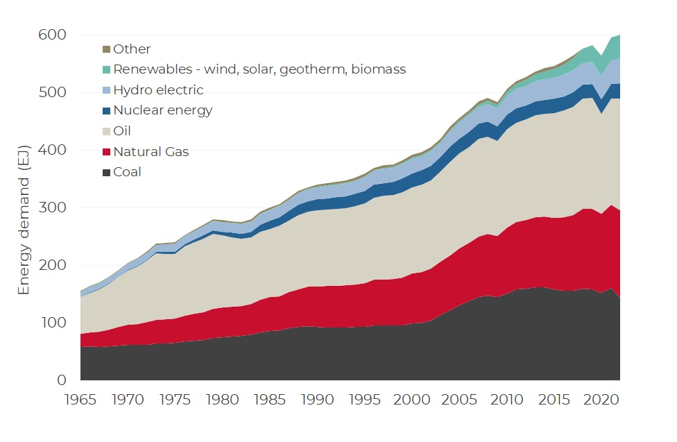
Energy demand has grown historically, more growth ahead
Sustainable energy macro
Global primary energy demand (1965-2021)
Global energy demand has expanded by 74% over the last 30 years, from 342EJ to 595EJ of demand
Hydrocarbons dominate, comprising 82% of the current energy mix
Source: BP Statistical Review; Guinness Global Investors, July 2022

Slide 32
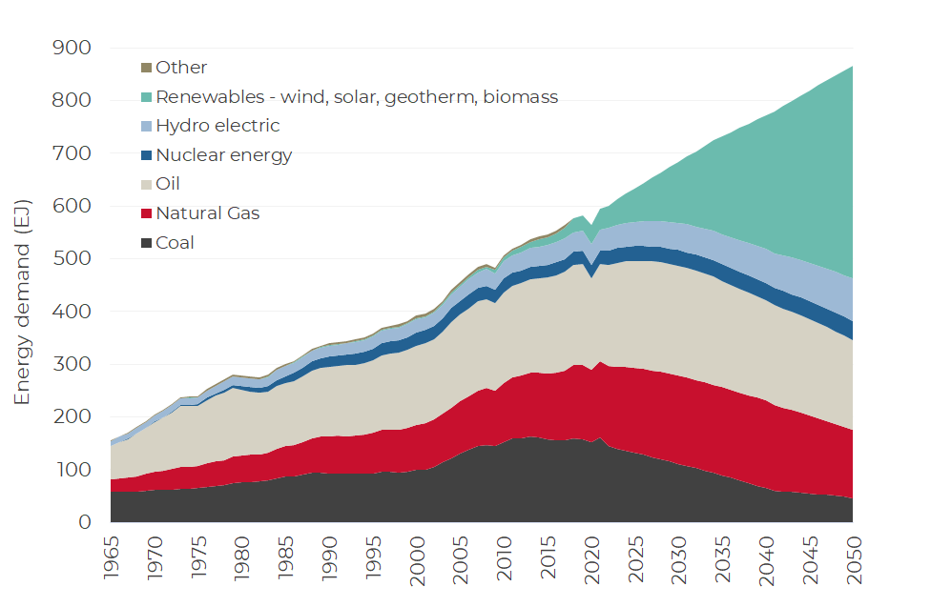
A future transition to renewables at the expense of coal
Sustainable energy macro
Global primary energy demand (1965-2050)
Coal demand is in terminal decline, falling by over 70% by 2050
Natural gas grows before declining to 2050 at around 90% of the 2021 levels
Coal and natural gas are 20% of the mix in 2050, down from 51% in 2018
Renewables (wind, solar, geothermal and biomass) expand rapidly from 4% in 2018 to 40% in 2050
Source: BP Statistical Review of World Energy, IEA, Guinness Global Investors, July 2022

Slide 33
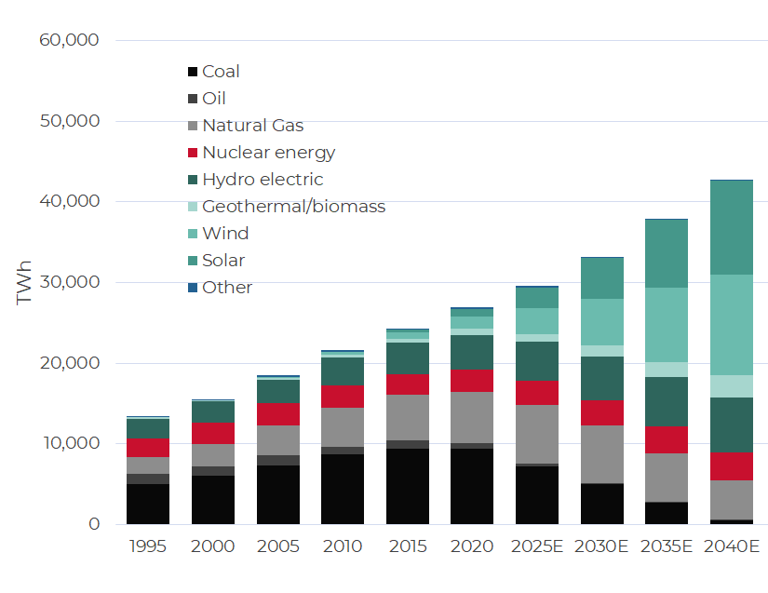
Renewable generation surges in the global power mix
Sustainable energy macro
Global electricity generation by type (TWh)
Wind and solar to go from 0.1% of the global power generation mix in 2005, to 9% in 2020 to around 40% in 2035
Current power grids should be able to tolerate 60% from wind and solar with investment in upgrading, digitalisation and the addition of storage
Source: BP Statistical Review; Guinness Global Investors, July 2022

Slide 34
YTD Summary
Guinness Sustainable Energy Fund
The energy transition has accelerated as a result of the Russian invasion of the Ukraine and the increasing importance of energy security
Europe and US have seen major policy advances via the REPower EU Plan and Inflation Reduction Act.
Despite raw material inflation, we see better relative economics of sustainable energy generation versus fossil fuels
Solar, wind, EV and energy efficiency activity is well ahead of growth expectations at the start of the year
Solar installation companies and some generation companies outperformed in 9mths 2022 while electrification underperformed. US stocks performing significantly better than Chinese stocks
M&A activity, indicating pockets of value. KKR acquisition of Albioma, Siemens deal for Siemens Gamesa and Standard Investments new 5%+ stake in Johnson Matthey
For the foreseeable future, we expect further acceleration of the energy transition driven by improved relative economics, supportive policy action and security of supply concerns

Slide 35
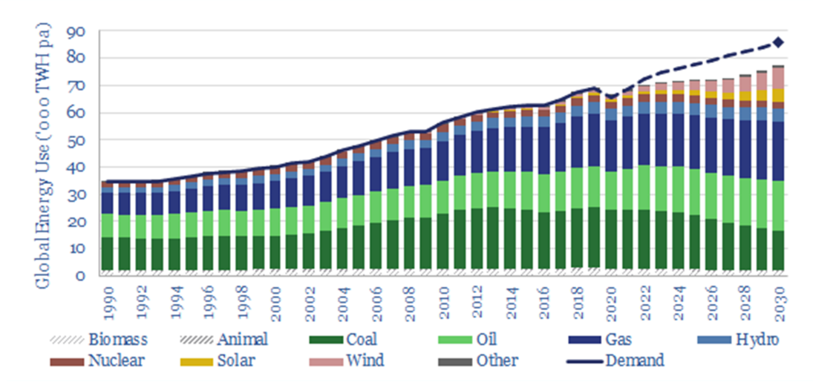
Global energy shortage likely opening up in the 2020s
Sustainable energy macro
Global energy demand and supply have been well matched over the last 30 years
An energy supply deficit is opening up in 2022 of around 2%, potentially widening to c.8% by 2030 (if current plans are pursued)
Likely to result in some demand destruction (via higher energy prices), acceleration of renewables, and some easing of conventional energy winddown
Global energy demand vs supply (‘000s TWH pa)
Source: Thunder Said Energy; Guinness Global Investors estimates

Slide 36
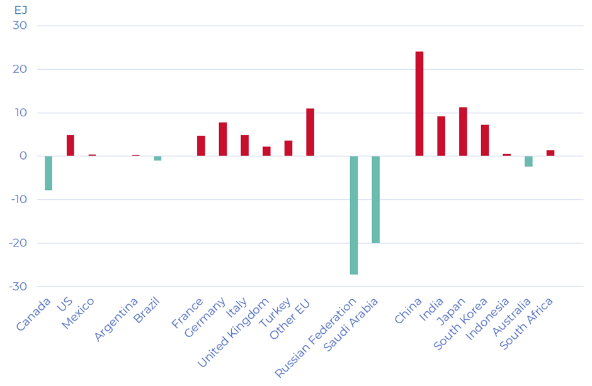
Energy Security
Guinness Sustainable Energy Fund
G20: net oil & natural gas imports/exports (Exajoules)
Energy security has risen up the energy transition agenda
Sustainable energy tends to be localised and distributed, and reduces energy importing nations’ reliance on imports
Source: Bloomberg and Guinness Global investors – Sept 2022
Importers in red and exporters in green

Slide 37
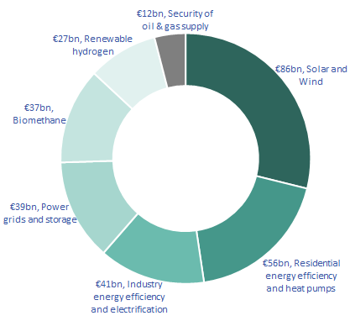
EU reaction to the Russian invasion of the Ukraine
Guinness Sustainable Energy Fund
Pre Ukraine invasion, the EU relied on Russia for 41% of its natural gas, 27% of its oil/oil product and 47% of its coal imports
The REPowerEU deal is designed to increase the resilience of the EU energy system
  Higher LNG and pipeline gas imports from non-Russian suppliers
  Larger volumes of biomethane and renewable hydrogen production/imports
  Greater emphasis on energy efficiency
  Increasing domestic renewable energy capacity
Builds on the EU’s ‘Fit for 55’ proposals which is designed to deliver a 55% reduction in GHG emissions by 2030 (vs 1990)
Split of funding for REPower EU
Source : Guinness Global Investors estimates; Sept 2022

Slide 38
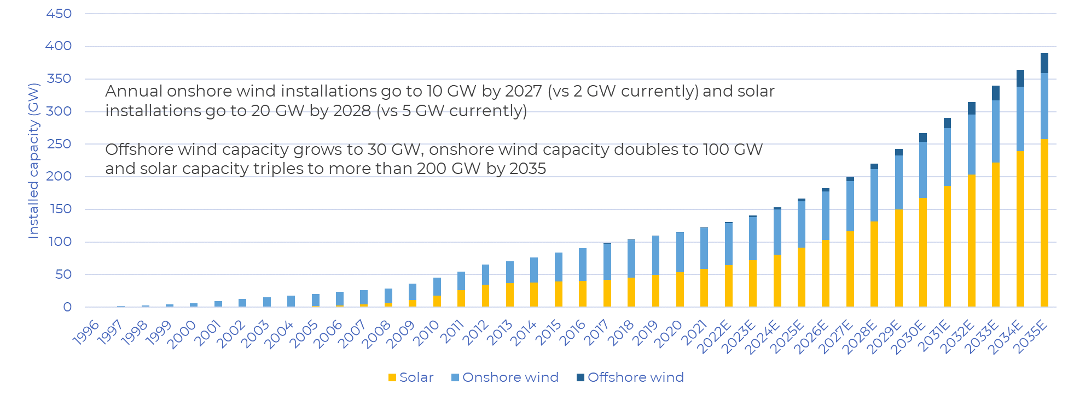
German reaction to the Russian invasion of the Ukraine
Guinness Sustainable Energy Fund
Germany imports nearly 64% of its energy consumption (up from 59% in 2000) with Russia representing one third of both crude oil/oil product and natural gas demand in 2021
  Two new LNG import terminals have been approved to help fulfil power needs this decade
  The Renewable Energy Sources Act brings 100% renewable power target forward to 2035 from 2040
Germany renewable power installed capacity (GW)
Source : BP; Guinness Global Investors estimates; Sept 2022

Slide 39
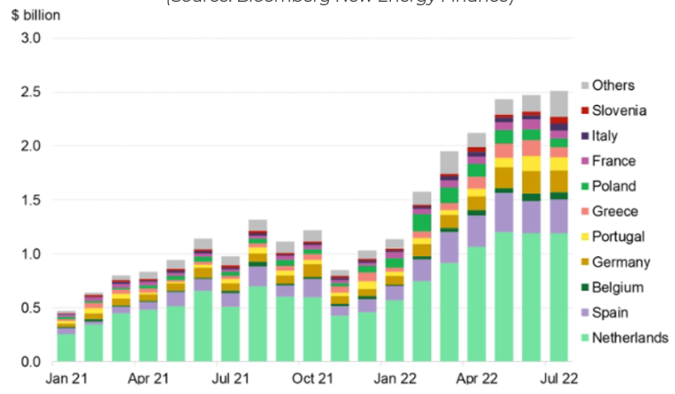
Broader acceleration of solar deployments across Europe
Guinness Sustainable Energy Fund
Chinese PV exports to Europe (EU and non-EU)
In July 2022, China sold $2.5bn of PV exports to European countries, up from around $1bn per month at the start of 2022, and $0.5bn per month at the start of 2021
The biggest importers include Netherlands, Spain, Portugal and Germany
Source : BNEF;; Sept 2022

Slide 40
The Inflation Reduction Act in the US
Guinness Sustainable Energy Fund
The Inflation Reduction Act brings potential $369bn in support for energy security and climate change in the US, specifically targeting:
  Financial support for clean sources of electricity and energy storage
  Tax credits and grants for clean fuels and clean commercial vehicles
  Grants and tax credits to reduce emissions from industrial manufacturing processes
  Funding for US-made clean products
  Funding to reduce emissions in disadvantaged communities and from leaks from natural gas production and distribution
The Act is a material positive for most subsectors owned within the fund including energy efficiency products, electric vehicle component suppliers, solar module manufacturers, wind blade manufacturers and renewable energy generators.
Source : Guinness Global Investors estimates

Slide 41
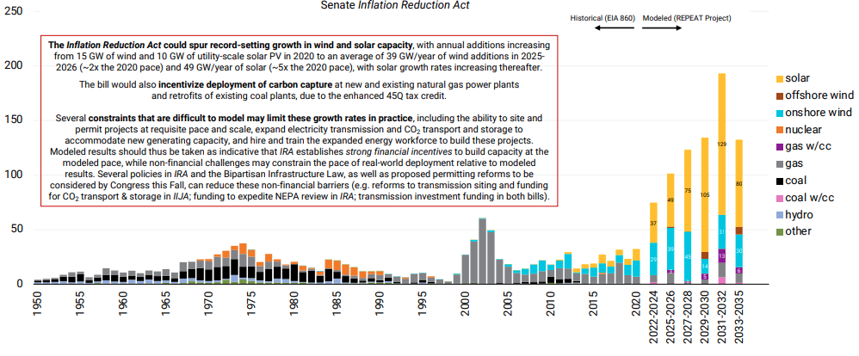
The IRA in the US likely spurs significant renewables growth
Guinness Sustainable Energy Fund
Historical annual capacity additions (1950–2020) vs estimated additions under IRA (2021-35)
GW/year
The Inflation Reduction Act looks likely to spur record growth in wind and solar capacity.
15GW of new wind capacity in 2020 is modelled to grow to around 39GW per year in 2025/26 (>2x growth)
10GW of utility-scale PV solar in 2020 is modelled to grow to around 49GW per year in 2025/26 (~5x growth)
Source : Princeton University; Guinness Global Investors (Sept 2022)

Slide 42
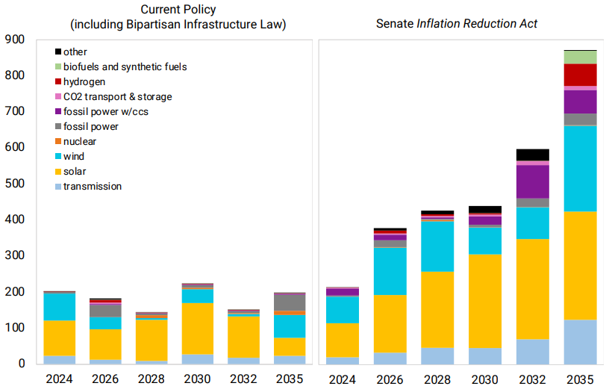
The IRA in the US will also bring major capital spending
Guinness Sustainable Energy Fund
Annual capital investment in energy supply related infrastructure (2024-35)
$bn/year
The Inflation Reduction Act could drive over $4.1trn in cumulative capital investment in new US energy supply infrastructure over the next decade
The Act will also spur significant investment on the demand side of the energy system (e.g. EVs; more efficient heating systems, appliances and industrial processes)
Source : Princeton University; Guinness Global Investors (Sept 2022)

Slide 43
Headwinds sustained this year
Sustainable energy macro
There have been three broad areas of headwind for the sustainable energy sector so far this year:
  Record natural gas and electricity prices
  Raw material inflationary conditions
  Supply chain pressures
Considering each the main subsectors in the fund:
  Displacement – higher raw material prices and finished product prices
  Electrification – battery metal and semiconductor cost inflation plus recessionary fears
  Generation – relatively immune but higher material costs on new installations
  Installation/Equipment – energy costs, supply chain and raw material inflation (eg aluminium and steel)
We believe that sustainable energy generation becomes relatively even more economic than fossil fuels despite manufacturing and raw material cost inflation

Slide 44
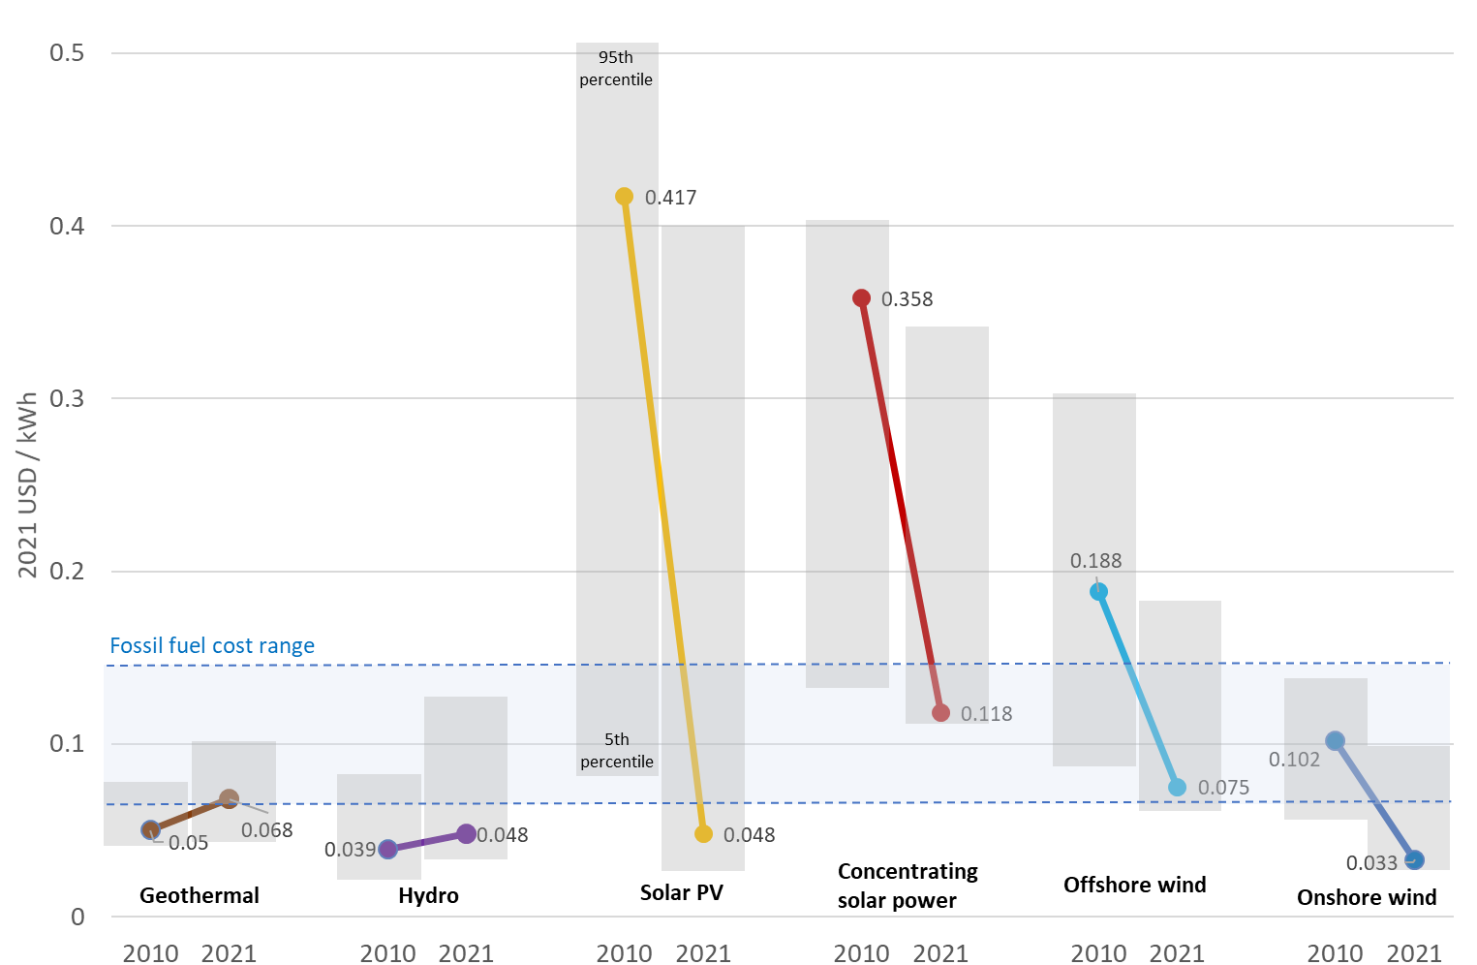
The cost of generating renewable electricity has collapsed
Sustainable energy macro
Global LCOE of utility-scale renewable power generation technologies (2010–2021)
Change in LCOE
(2021 vs 2020)
Onshore wind: -15%
Solar PV: -13%
Offshore wind: -13%
Geothermal: -4%
Hydropower: +9%
Concentrating solar: +7%
Source: IRENA; Guinness Global Investors, Sept 2022; LCOE = levelized cost of electricity

Slide 45
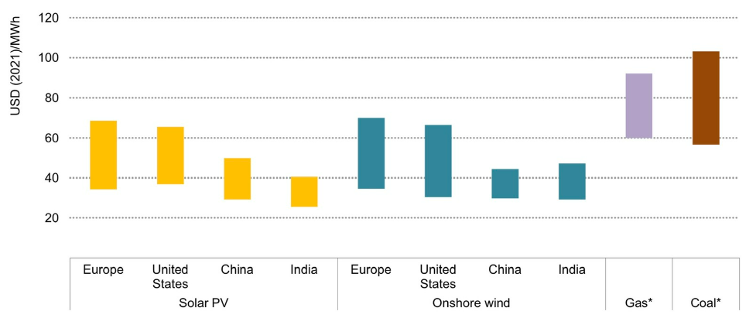
Relative economics of renewables have improved
Sustainable energy macro
LCOE (USD/MWh) of utility solar and wind vs competing fossil fuels (2022E)
Source: IEA estimates. Data sourced 30.06.2022, * Refers to same regions within the figure: Europe, United States, China and India

Slide 46
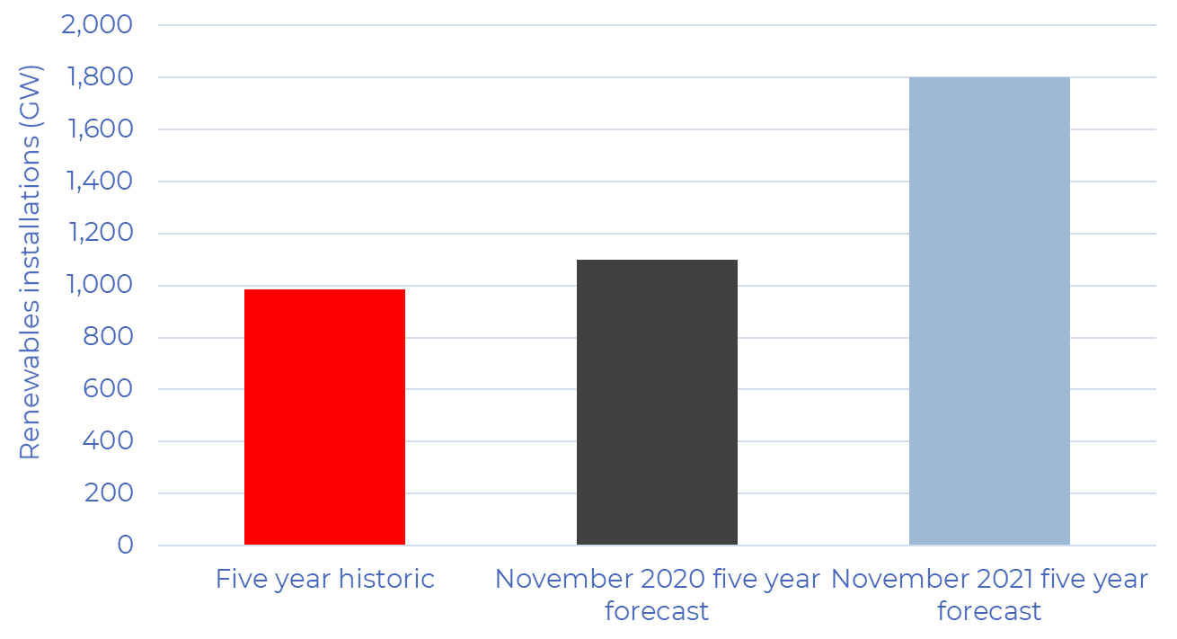
Outlook for renewable installation continues to improve
Sustainable energy macro
Renewable capacity installations (GW over five years)
The IEA is forecasting that renewable power additions over the next 5yrs will be just over 1,800 GW (a near 50% increase on its previous five-year forecast published twelve months earlier)
Source: IEA, Guinness Global Investors estimates. Data sourced 30.06.2022

Slide 47
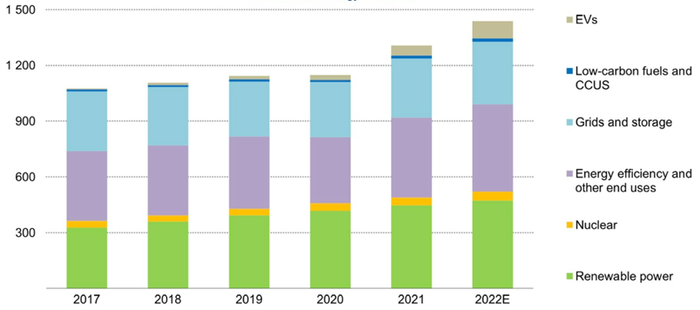
Clean energy investment growing and now a larger share
Sustainable energy macro
Annual clean energy investment (US billion dollars)
Global clean energy investment is $1.4trn and starting to grow
Represents around 55% of total annual energy investment and 75% of the growth in 2022
Clean energy needs to increase to $4.5trn pa in order to achieve a 1.5° scenario
Source: IEA; Guinness Global Investors estimates

Slide 48
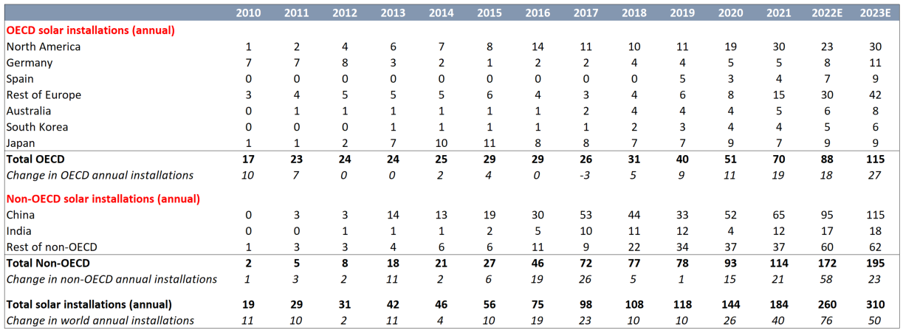
Record new solar installations in 2022, more to come in 2023
Solar
Annual solar installations have increased from 19 GW in 2010 to an estimated 260 GW in 2022
Non-OECD now dominates demand, being two thirds of expected installations in 2022
2022 installations higher than initial estimate of 215 GW and 2023 will see further increases
Global solar module installations, 2008-2022E (GW)
Source: BP; BNEF; Guinness Global Investors. Data sourced 31.10.2022

Slide 49
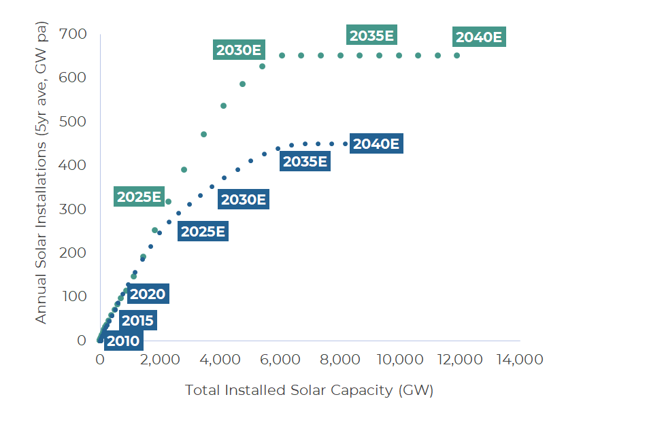
Solar annual installation to grow rapidly
Solar
Annual solar installations have increased from 1 GW in 2006 to 184 GW in 2021
Between 1998-2021, nearly 900 GW of solar cells were installed at a max 5yr average rate of 130 GW pa
Global solar annual installations and installed capacity (5 year average)
Guinness base case: Between 2020 and 2040, solar installations are 5,900GW (10x more than were installed between 1998 and 2019) with the 5yr average rate reaching a maximum rate of 400GWpa in the late 2030s
Achieving the IPCC 1.5° scenario would require installations to reach nearly 700GWpa with a total of 11,900GW being installed between 2020 and 2040
Source: IEA, IPCC, Guinness Global Investors estimates, data sourced 30 June 2022

Slide 50
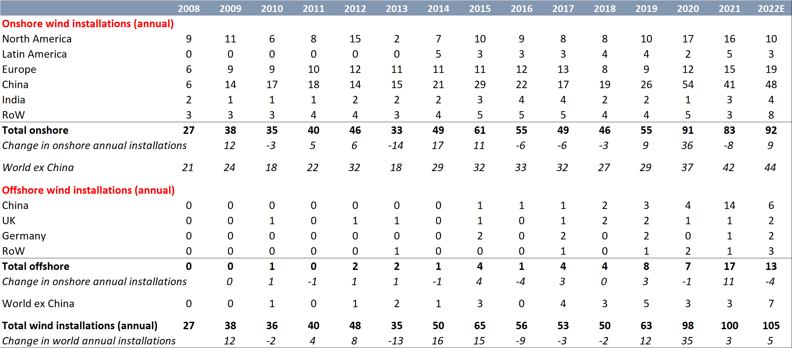
Wind: record installations in 2021, growth from China and offshore
Wind
Annual wind installations have increased from 36 GW in 2010 to a peak of 100 GW in 2021
China installations drive the growth – China was >50% of installations in 2021
Offshore installations picking up – expecting to take significantly bigger share by 2025
Global wind capacity installations, 2008-2022E (GW)
Source: BP; BNEF; Guinness Global Investors estimates, data sourced 30 June 2022

Slide 51
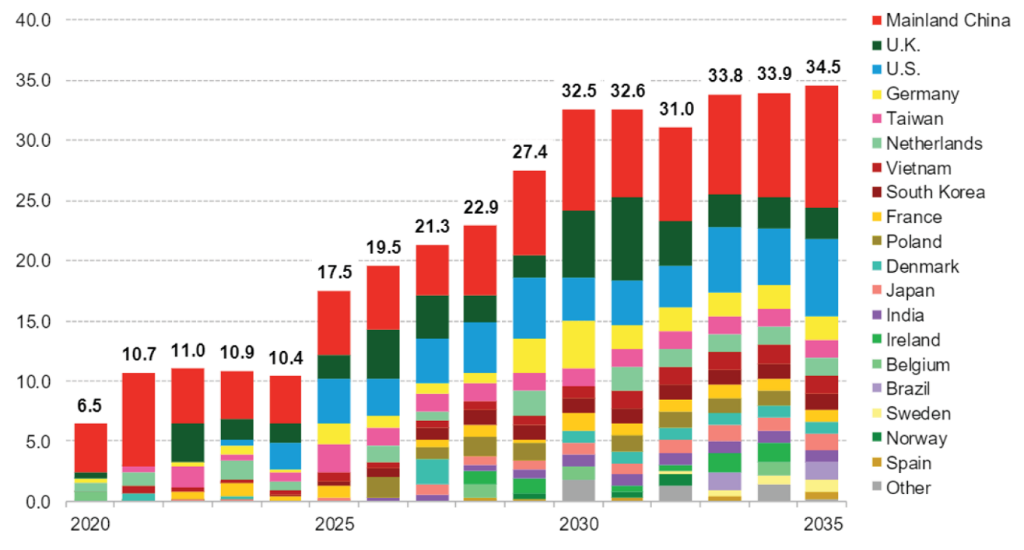
Wind: annual offshore installations to treble by 2030
Wind
Annual offshore wind installations increased from 1 GW in 2010 to an estimated 10.7 GW in 2021
Offshore installations expected to treble by 2030 to 28 GW. Pickup comes in 2025 onwards
Global offshore wind capacity installations, 2020-2035E (GW)
Source: BNEF; Guinness Global Investors estimates, data sourced 30 June 2022

Slide 52
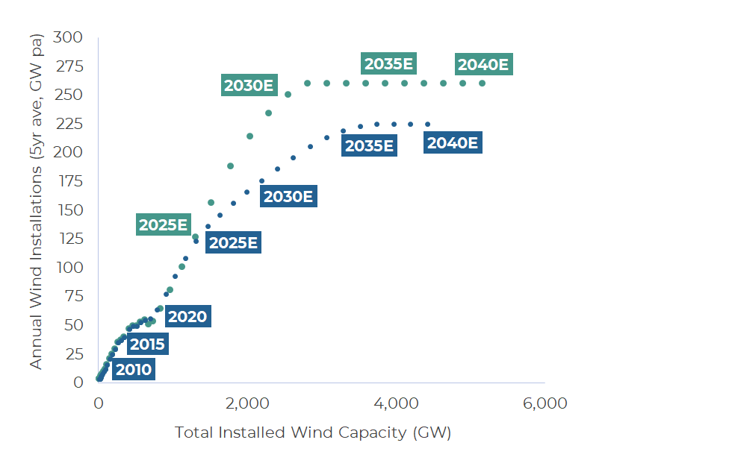
Wind annual installation to grow rapidly
Wind
Annual wind installations have increased from 15GW in 2006 to 100 GW in 2021
Between 1998-2021, 820 GW of wind power was installed at a max 5yr average rate of nearly 75 GW pa
Global wind annual installations and installed capacity (5 year average)
Guinness base case: Between 2020 and 2040, wind installations are 2,950GW (>5x more than were installed between 1998 and 2019) with the 5yr average rate reaching a maximum rate of 200GWpa in the late 2030s
Achieving the IPCC 1.5° scenario would require installations to reach around 260GWpa with a total of nearly 4,500GW being installed between 2020 and 2040
Source: IEA, IPCC, Guinness Global Investors estimates, data sourced 30 June 2022

Slide 53
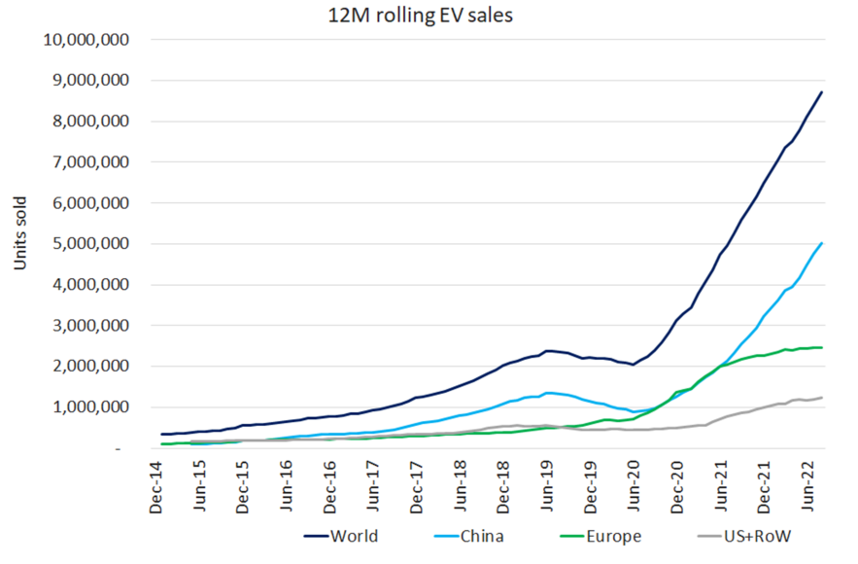
Over 10 million electric vehicles likely to be sold in 2022
Electric vehicles and batteries
EV sales by region (rolling 12-month basis)
New EV sales in 2021 around 6.5m vehicles, likely to be >10m in 2022
EV market share nearly 10% for 2022 (vs 4.0% and 2.4% in 2020 and 2019)
Key drivers are lower EV prices, greater brand choice and growing consumer appetite
Source: EV-Sales, Cleantechnica, Guinness Global Investors, September 2022

Slide 54
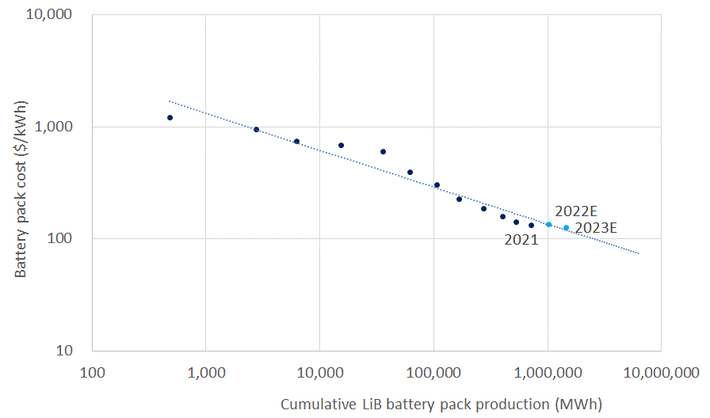
Electrification of demand as batteries become economic
Electric vehicles and batteries
Cumulative demand for LiB packs (MWh) vs Battery pack price ($/kWh)
18% learning rate* for lithium-iron battery storage since 2010
2021 volume weighted average battery pack price $132/kWh (BNEF)
$100/kWh is the economic tipping point where demand will increase
We expect pack costs to increase in 2022 due to raw material and freight inflation
* The ‘learning rate’ is the cost reduction achieved on average for every doubling of capacity
Source: Bloomberg; Guinness Global Investors estimates

Slide 55
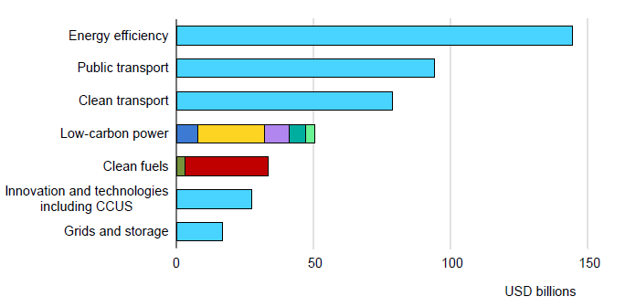
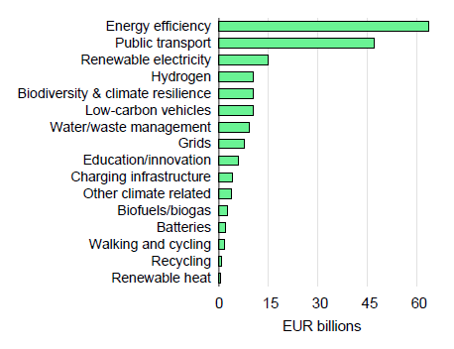
Efficiency investments starting to pick up, more needed
Efficiency
Investment into energy efficiency is accelerating, a focus of government recovery packages
Building renovation and building upgrades remain a critical focus
Based on current government policies, the IEA estimates that energy efficiency spending needs to increase this decade from around $250bn pa to around $375bn pa, rising to $550bn in the 2030s
Global government clean energy spending by sector and technology (October 2021)
EU Recovery and Resilience Facility (RFF) fund allocation
Source: IEA, IMF. Data from 31.12.2019 to 31.10.21

Slide 56
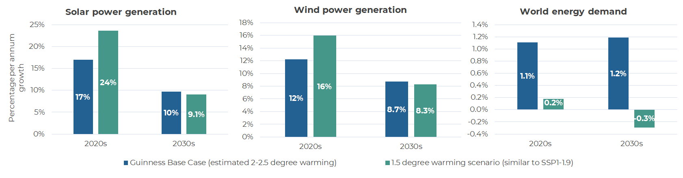
Implications for sustainable energy of a “net zero” scenario
Sustainable energy macro
A “net zero scenario” would require the following:
  Solar power generation to grow at c.24%pa in the 2020s (vs base est of 17%pa)
  Wind power generation to grow at c.16%pa in the 2020s (vs base est of 12%pa)
  Zero global energy demand growth in the 2020/30s (ve base est of 1%pa and history of 1.9%pa)
  Global energy investment would need to be over $4.5trn pa (vs $2trn pa currently)
Source: IPCC, IEA, Guinness Global Investors estimates. Data sourced 30.06.2022

Slide 57
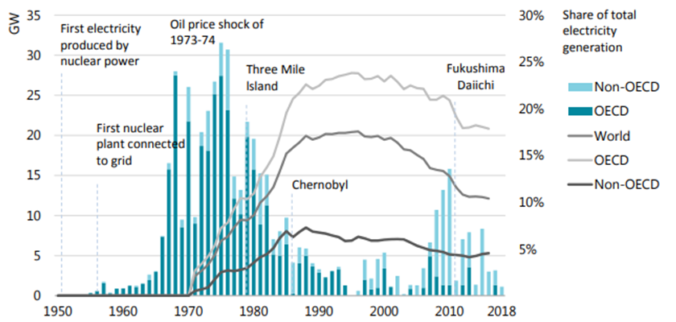
Nuclear power: will struggle to grow meaningfully
Sustainable energy macro
Nuclear power provides 11% of world electricity supply
Plants built in the 1970/80s now near the end of their assumed lives. Some will be extended, but many retired
New projects are proving too expensive and too capital intensive for the private sector to finance
Nuclear generation capacity additions since 1950
Source: IEA; Guinness Global Investors

Slide 58
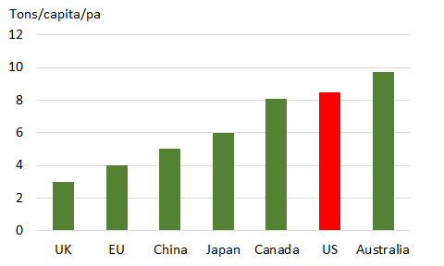
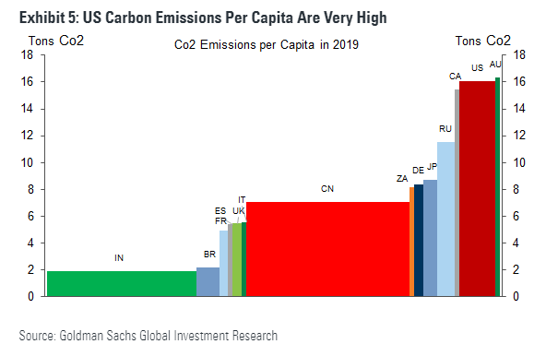
President Joe Biden announces new carbon emission targets
Energy transition policy
Joe Biden announced significantly increased 2030 GHG emissions targets
  New target is a 52% reduction in emissions by 2030 (vs 2005 levels)
  Old target was a 28% reduction in emissions by 2025 (vs 2005 levels)
Requires 2025 emissions to be cut by around 38% (up from old target of 28%)
The focus is on clean power generation, building efficiency upgrades and electrification of transportation
Per capita emissions
Target implied CO2 emissions per capita in 2030
Source: Guinness Global Investors, Goldman Sachs. Data sourced 30.06.2022

Slide 59
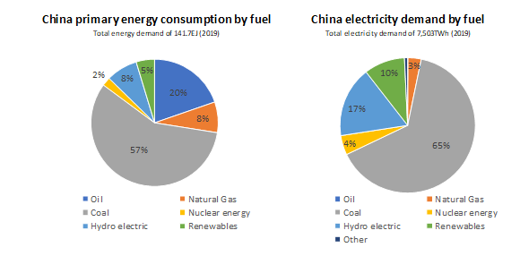
China targeting carbon neutrality in 2060
Energy transition policy
Key targets and benchmarks associated with China’s 2060 carbon neutrality plan:
  Energy demand to peak c.2035 at 6-6.5bn tons of coal equivalent (current 4.8bnTCE)
  Electricity to be 80% of total energy demand by 2060 (current 19%)
  Coal power phased out around 2050 (versus current 65% share)
  Non-fossil share of total energy demand from c15% in 2019 to 24% in 2030, 62% in 2050, and 84% in 2060
  Carbon emissions peak at 10.2bn tons in 2030; falling to c9bn in 2035, 3bn pa by 2050 and zero by 2060
Implications for power generation:
  Solar installed capacity to increase 12x
  Wind installed capacity to increase 8x
  Nuclear installed capacity to increase 4x
Sources: BP, Bloomberg, Guinness Global Investors estimates. Data sourced 30.06.2022

Slide 60
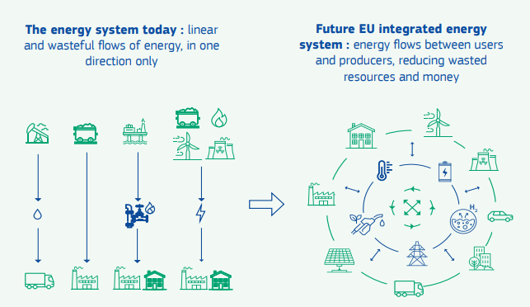
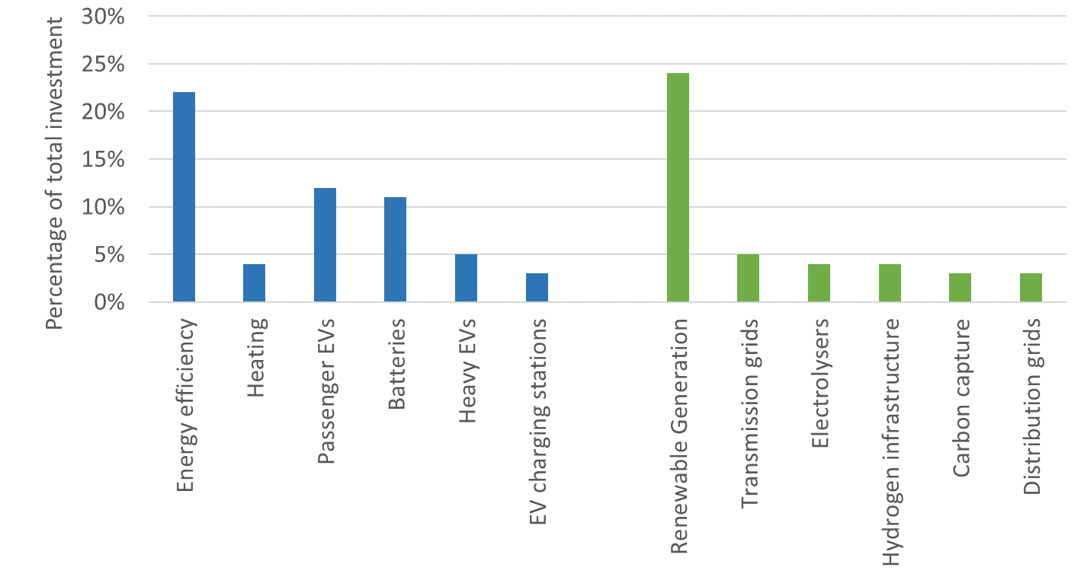
The European “Green Deal”
Energy transition policy
The European Green Deal makes Europe climate neutral in 2050, targeting a 50-55% reduction by 2030
  A more efficient and “circular” energy system ensuring efficiency and full utilisation of the energy system
  Greater generation of renewable power and consumption of electricity in buildings, transport and industry
  Promotion of renewable and low-carbon fuels to de-carbonise ‘hard to de-carbonise’ sectors and industries
  Adapt to an integrated energy system driven by infrastructure, smart grid and the adoption of hydrogen
Transition from a linear to an integrated energy system
EU Green Deal investment of Eur10trn (2020-2050)
Source: European Commission. Data sourced 30.06.2022

Slide 61
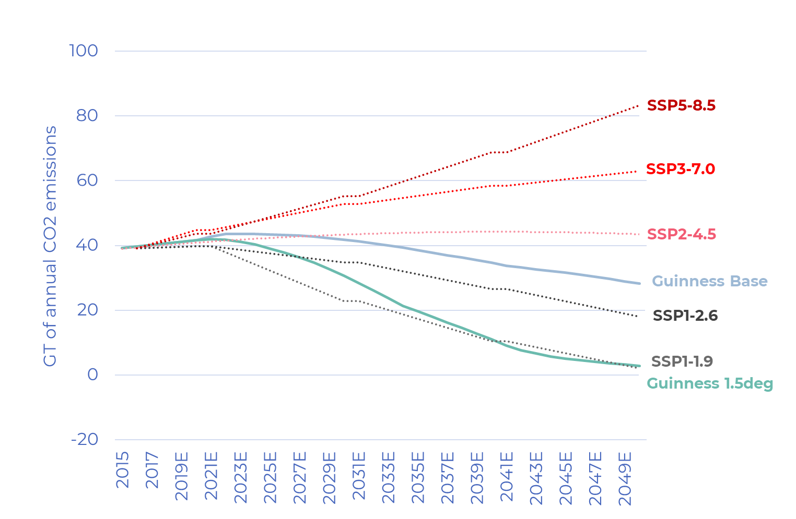
The influential 2021 IPCC climate report
Energy transition policy
Guinness 1.5 degree and base case versus IPCC carbon emission scenarios
Five 2020-2100 scenarios linking carbon dioxide emissions to global warming temperature ranges
The 2100 scenarios range from 1.4° (SSP1-1.9) to 4.4° (SSP5-8.5)
The Guinness base case energy model sits between SSP2-4.5 and SSP1-2.6 (around 2.3°)
The “Guinness 1.5 degree scenario” will be very difficult to deliver on current estimates
Source: IPCC, Guinness Global Investors. Data sourced 30.06.2022

Slide 62

The learning rate for solar has been 28%
Solar
Solar module prices (1976 – 2021)
The ‘learning rate’ is the cost reduction achieved on average for every doubling of capacity
Source: BNEF; Maycock; Guinness Global Investors, December 2021

Slide 63


Wind power costs will fall as turbines get bigger
Wind
Onshore wind power costs since 1980 vs turbine height
The power generated from a turbine is related to the square of the radius of the blade
As new turbines get bigger, efficiencies will go from around 30% in 2019 to nearly 45% by end 2030 and even higher thereafter
Planned turbine towers are over 150m high with each blade in excess of 100m long
Source: Openenergymonitor; Guinness Global Investors estimates, data sourced 30 June 2022

Slide 64

EVs: accelerating penetration
Electric vehicles and batteries
Global auto, ICE and EV population to 2050
We expect EV sales to be an increasing proportion of total global vehicle sales:
20% in 2025
50% in 2030
Nearly 100% in 2040
Source : US DoE (actual), Guinness Global Investors (estimates) as of December 2021

Slide 65

Batteries: demand growing at CAGR of around 20%
Electric vehicles and batteries
Global Lithium-ion battery demand 2016-25E (GWh)
Lithium-ion battery demand is expected to have risen by around 20% in 2021, to c.240 GWh of new capacity
Demand in 2025 is expected to increase to around 600 GWh, dominated by EV growth
Source: BNEF; Guinness Global Investors estimates

Slide 66

Consumption: Energy efficiency is the ‘first fuel’ to consider
Efficiency
‘Business as usual’: 74% world energy demand growth to 2050
Guinness ‘most likely outcome’: 43% world energy demand growth to 2050
Delivered despite population growing by 26% and GDP more than doubling
Energy efficiency measures by 2050 save around one quarter of current energy demand
World energy demand with and without efficiency gains
Source: BP Statistical Review; Guinness Global Investors estimates, July 2020

Slide 67
Understanding subsidies in sustainable energy
Sustainable energy macro
We consider subsidies to take two forms:
  Support of otherwise unprofitable activities to support political or social goals
  Acceleration of growth of otherwise unprofitable activities to ultimately gain profitability
According to IRENA, total global energy industry subsidies were at least $634bn in 2017, split
  77% to fossil fuels with around half of this going to oil
  23% to renewables with around half of this going to solar generation
Presence of subsidies in the Guinness Sustainable Energy Universe

Slide 68
Historic Performance (USD)
Guinness Sustainable Energy Fund
Past performance does not predict future returns
On 31 Dec 2018, the index for the Guinness Sustainable Energy fund became the MSCI World NR
Prior to this, the benchmark was the Wilderhill Clean Energy Index (ECO Index)
  From 31/12/2007 to 31/12/2018, the fund outperformed the ECO Index by 1.9%pa
Source: Financial Express, bid to bid, total return. Fund returns are for share classes with a current Ongoing Charges Figure (OCF) of 0.68%; returns for share classes with a different OCF will vary accordingly.
*Simulated past performance. Performance prior to the launch date of the Y class of the fund (16.02.18) is a composite simulation for Y class performance being based on the actual performance of the Fund’s E class (1.24% OCF) and in 2008, before the launch of the E class, the Fund’s A class (1.49% OCF). The Guinness Sustainable Energy Fund was launched on 19/12/2007 (A class, 1.49% OCF). The E Class was launched on 02/09/2008 (1.24% OCF). The Y class was launched on 16/02/2018 (0.68% OCF).
Notes:
67
S:\GAM\Dublin Global Equity Income Fund\Factsheets\DEI Factsheet Data

Slide 69
Appendix

Slide 70
Key facts: Guinness Sustainable Energy Fund
Appendix 2: fund & company information
The Fund | Fund launch date | 19 December 2007
 | Fund managers | Will Riley, Jonathan Waghorn
 | Fund size | $998m (Dec 31 2021)
 | AUM in sustainable energy strategy | $1030m (Dec 31 2021)
 | Reference index | MSCI World Energy NR Index
Structure & legal | Domicile | Ireland
 | Fund structure | Dublin OEIC (UCITS IV)
 | Administrator | Link Fund Manager Solutions (Ireland) Ltd
 | Custodian | Brown Brothers Harriman & Co
 | Reporting status | Reporting Fund for UK tax purposes
Pricing & dealing | Pricing | Daily
 | Performance fee | None
 | Exit fees | None
 | Valuation point | 23:00 (Dublin time)
 | Dealing cut off | 15:00 (Dublin time)

Slide 71

Key facts: Guinness Sustainable Energy Fund
Appendix 2: fund & company information
Name | OCF | Maximum initial charge | Minimum investment | ISIN | Bloomberg | SEDOL
C EUR Acc | 1.87% | 5% | € 0 | IE00BGHQF417 | GUINECE ID | BGHQF41
C GBP Acc | 1.87% | 5% | £ 0 | IE00B3CCJ633 | GUINAEC ID | B3CCJ63
C USD Acc | 1.87% | 5% | $ 0 | IE00B2PGVK34 | GUINAEB ID | B2PGVK3
D EUR Acc | 1.37% | 5% | € 0 | IE00B3CCJ740 | GUINAED ID | B3CCJ74
D USD Acc | 1.37% | 5% | $ 0 | IE00B2PGVJ29 | GUINAEA ID | B2PGVJ2
I USD Acc | 0.74% | 0% | $ 10,000,000 | IE00BMYPNB63 | GUSEIUA ID | BMYPNB6
Y EUR Acc | 0.67% | 5% | € 0 | IE00BFYV9M80 | GUIAEZE ID | BFYV9M8
Y GBP Acc | 0.67% | 5% | £ 0 | IE00BFYV9L73 | GUIAEZG ID | BFYV9L7
Y USD Acc | 0.67% | 5% | $ 0 | IE00BGHQF417 | GUINECE ID | BGHQF41
Fund available across a range of UK and European platforms, including:
* For country registrations, please contact our sales team

Slide 72
Contact details
Guinness Global Energy Fund
Sales, marketing and investor relations
Charlie Riddell | charlie.riddell@guinnessgi.com | +44 (0) 20 7222 3473
Flurry Wright | flurry.wright@guinnessgi.com | +44 (0) 20 7222 5703
Deborah Kay | deborah.kay@guinnessgi.com | +44 (0) 20 7222 2037
Alex Hall | alex.hall@guinnessgi.com | +44 (0) 20 7042 6525
Charlie Crole | charlie.crole@guinnessgi.com | +44 (0) 20 7042 6526
Rupert Bonsor | rupert.bonsor@guinnessgi.com | +44 (0) 20 7042 6529
Harry Fife | harry.fife@guinnessgi.com
Investment management team
Will Riley | will.riley@guinnessgi.com | +44 (0) 20 7222 3451
Jonathan Waghorn | jonathan.waghorn@guinnessgi.com | +44 (0) 20 7222 3457
Jamie Melrose | jamie.melrose@guinnessgi.com | +44 (0)20 7042 6510
Dan Hobster | dan.hobster@guinnessgi.com | +44 (0)20 7042 6536
Guinness Asset Management Ltd.
18 Smith Square, | info@guinnessgi.com | +44 (0) 20 7222 5703
London SW1P 3HZ | www.guinnessgi.com
+44 (0) 207 042 6585
For your protection, calls to these numbers will be recorded

Slide 73
Appendix: definitions
Alpha is a measure of a fund's over or underperformance by comparison to its benchmark. It represents the return of the fund when the benchmark is assumed to have a return of zero, and thus indicates the extra value that the manager's activities have contributed.
Beta is a statistical estimate of a fund's volatility by comparison to that of its benchmark, i.e. how sensitive the fund is to movements in the section of the market that comprises the benchmark. A fund with a Beta close to 1 will move generally in line with the benchmark. Higher than 1 and the fund is more volatile than the benchmark.
Information Ratio An assessment of the degree to which a manager uses skill and knowledge to enhance returns, this is a versatile and useful risk-adjusted measure of actively-managed fund performance. It is calculated by deducting the returns of the fund's benchmark from the fund's overall returns, then dividing the result by its Tracking Error. In this way, we arrive at the value, per unit of extra risk assumed, that the manager's decisions have added to what the market would have delivered anyway.
Maximum Drawdown Represents the worst possible return over a period, e.g. buying at the highest price over the period and selling at the lowest.
Maximum Loss Represents the worst running return over a period, e.g. the longest running consecutive loss without making a gain
The R-Squared measure is an indication of how closely correlated a fund is to an index or a benchmark. It can be treated as a percentage, showing what proportion of a fund's movements can be attributed to those of the benchmark. Values for R-Squared range between 0 and 1, with 0 indicating no correlation at all, and 1, rarely, showing a perfect match.
Sharpe ratio is a commonly-used measure which calculates the level of a fund's return over and above the return of a notional risk-free investment, such as cash or Government bonds. The difference in returns is then divided by the fund's standard deviation - its volatility, or risk measurement. The resulting ratio is an indication of the amount of excess return generated per unit of risk.
Tracking Error this statistic measures the standard deviation of a fund's excess returns over the returns of an index or benchmark portfolio. As such, it can be an indication of "riskiness" in the manager's investment style. A Tracking Error below 2 suggests a passive approach, with a close fit between the fund and its benchmark. At 3 and above the correlation is progressively looser: the manager will be deploying a more active investment style, and taking bigger positions away from the benchmark's composition.
Volatility Standard deviation is a statistical measurement which, when applied to an investment fund, expresses its volatility, or risk. It shows how widely a range of returns varied from the fund's average return over a particular period. Low volatility reduces the risk of buying into an investment in the upper range of its deviation cycle, then seeing its value head towards the lower extreme.

Slide 74
Important information and risk factors
Issued by Guinness Global investors which is a trading name of Guinness Asset Management Limited which is authorised and regulated by the Financial Conduct Authority.
This report is primarily designed to inform you about Guinness Sustainable Global Equity Fund. Any investment decision should take account of the subjectivity of the comments contained in the report.
This document is provided for information only and all the information contained in it is believed to be reliable but may be inaccurate or incomplete; any opinions stated are honestly held at the time of writing, but are not guaranteed. The contents of the document should not therefore be relied upon. It should not be taken as a recommendation to make an investment in the Fund or to buy or sell individual securities, nor does it constitute an offer for sale.
Risk
The Guinness Sustainable Global Equity Fund is an equity fund. Investors should be willing and able to assume the risks of equity investing. The value of an investment and the income from it can fall as well as rise as a result of market and currency movement, and you may not get back the amount originally invested. Details on the risk factors are included in the Fund’s documentation, available on our website. Shareholders should note that all or part of the fees and expenses will be charged to the capital of the Fund. This will have the effect of lowering the capital value of your investment .
Documentation
The documentation needed to make an investment, including the Prospectus, the Key Investor Information Document (KIID) and the Application Form, is available in English from www.guinnessgi.com or free of charge from:-
the Manager: Link Fund Manager Solutions (Ireland) Ltd (LFMSI), 2 Grand Canal Square, Grand Canal Harbour, Dublin 2, Ireland; or,
the Promoter and Investment Manager: Guinness Asset Management Ltd, 18 Smith Square, London SW1P 3HZ.
LFMSI, as UCITS Man Co, has the right to terminate the arrangements made for the marketing of funds in accordance with the UCITS Directive.
Investor Rights
A summary of investor rights in English is available here: https://www.linkgroup.eu/policy-statements/irish-management-company/
Residency
In countries where the Fund is not registered for sale or in any other circumstances where its distribution is not authorised or is unlawful, the Fund should not be distributed to resident Retail Clients. THIS INVESTMENT IS NOT FOR SALE TO U.S. PERSONS.
Structure & regulation
The Fund is a sub-fund of Guinness Asset Management Funds PLC (the “Company”), an open-ended umbrella-type investment company, incorporated in Ireland and authorised and supervised by the Central Bank of Ireland, which operates under EU legislation. The Fund has been approved by the Financial Conduct Authority for sale in the UK. If you are in any doubt about the suitability of investing in this Fund, please consult your investment or other professional adviser.
Switzerland
This is an advertising document. The prospectus and KIID for Switzerland, the articles of association, and the annual and semi-annual reports can be obtained free of charge from the representative in Switzerland, Carnegie Fund Services S.A., 11, rue du Général-Dufour, 1204 Geneva, Switzerland, Tel. +41 22 705 11 77, www.carnegie-fund-services.ch. The paying agent is Banque Cantonale de Genève, 17 Quai de l'Ile, 1204 Geneva, Switzerland.
Singapore
The Fund is not authorised or recognised by the Monetary Authority of Singapore (“MAS”) and shares are not allowed to be offered to the retail public. The Fund is registered with the MAS as a Restricted Foreign Scheme. Shares of the Fund may only be offered to institutional and accredited investors (as defined in the Securities and Futures Act (Cap.289)) (‘SFA’) and this material is limited to the investors in those categories
Telephone calls will be recorded and monitored.

